Slide 1
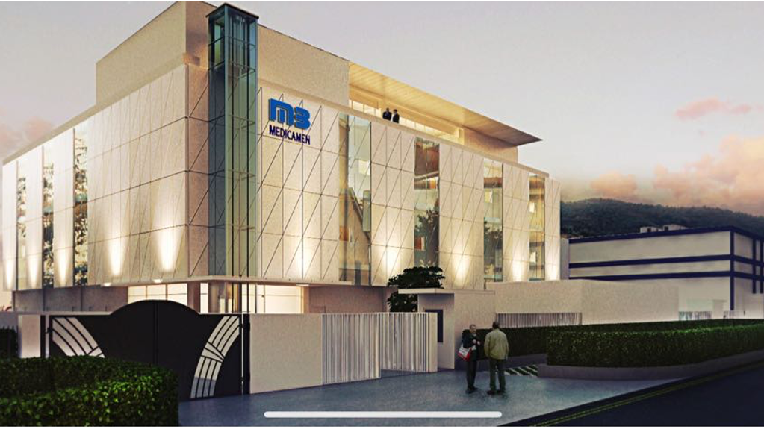


Medicamen Biotech Ltd
Oncology Portfolio
Corporate Presentation 2021

Slide 2

Vision
To be a global leader in oncology generics by providing access to cost effective and best-in-class quality products for patients worldwide
Confidential

Slide 3
Contents
Corporate Overview
Portfolio & Pipeline
R&D and Manufacturing
Commercial Presence & Plans

Slide 4
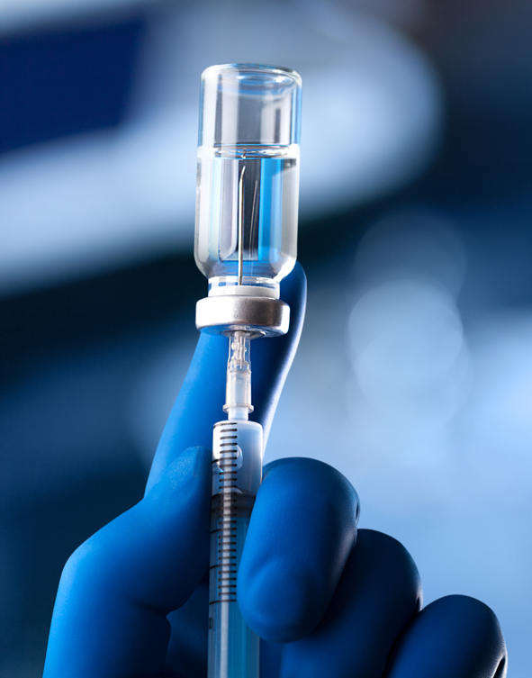
Who are we??
Shivalik Rasayan Ltd (SRL) group is a leading producer of APIs, complex chemicals used in pharmaceuticals, agrochemicals and specialty chemicals in India, with a market cap of > $ 150 million and > $ 35 million invested in manufacturing sites
Medicamen Biotech Ltd (MBL), a wholly owned subsidiary of SRL has successfully launched multiple pharma products in more than 30 countries
MBL has invested substantially in R&D and manufacturing of APIs & dosage forms for oncology products with a vision to be a global leader in oncology generics by offering cost effective products with best-in-class quality
MBL has firm plans & investments for global roll out of its oncology products, including in USA, Europe, Latin America, Asia Pacific, MENA, etc through a combination of own team and alliance partners

Slide 5

Business Overview
R&D Capabilities:
Chemical & Formulation Development, Analytical Research
Manufacturing Capabilities (oncology):
APIs, Dosage Forms
Dosage Types (oncology):
Injectables (RTU & Lyo Vials, PFS), Oral solids (Capsules, Tablets)
Additional Services (oncology):
CDO, CMO & CRAMS
R&D Center
Bhiwadi
API Plant
Dahej
Specialty Chemicals Plant
Dahej
Agrochemicals Plant
Dehradun
Non-Oncology FDF
Bhiwadi
Non-Oncology FDF, Unit-1
Haridwar
Oncology FDF, Unit-2
Haridwar
API = Active Pharmaceutical Ingredient, FDF = Finished Dosage Form, CDO = Contract Development Organization, CMO = Contract Manufacturing Organization, CRAMS = Contract Research And Manufacturing Services

Slide 6

Milestones
1
1996-99
1996: Operations started - Bhiwadi FDF Plant (non-onco) ✓
1998: WHO-GMP approval – Bhiwadi FDF Plant (non-onco) ✓
2007: Operations started – Haridwar FDF Unit-1 (non-onco) ✓
2
2000-10
3
2010-20
2016: Shivalik Rasayan Ltd acquires Medicamen Biotech Ltd ✓
2018: New R&D center setup at Bhiwadi ✓
2020: Operations started – Dahej API Plant ✓
4
2021: Operations started – Haridwar FDF Plant (onco) ✓
2021: Filing API USDMFs & CEPs started ✓
2021
5
2022: Targeted oncology FDF launch in India
2022: Targeted API facility approvals by USFDA, EMEA
2022: Targeted start of FDF dossier filing in USA & Europe
2022
2023: Targeted FDF (onco) facility approval by USFDA, EMEA
2023: Targeted first marketing authorizations in USA & Europe
2023-24: Targeted first launches in USA, Europe
6
2023 onwards

Slide 7
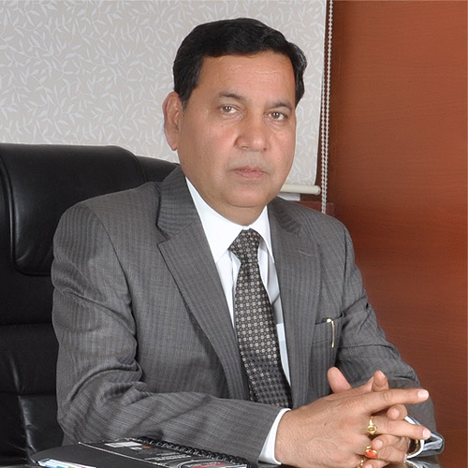
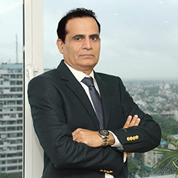
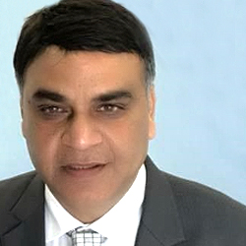

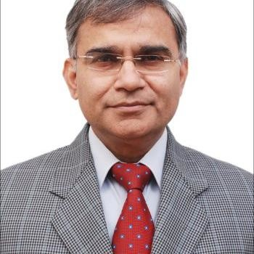
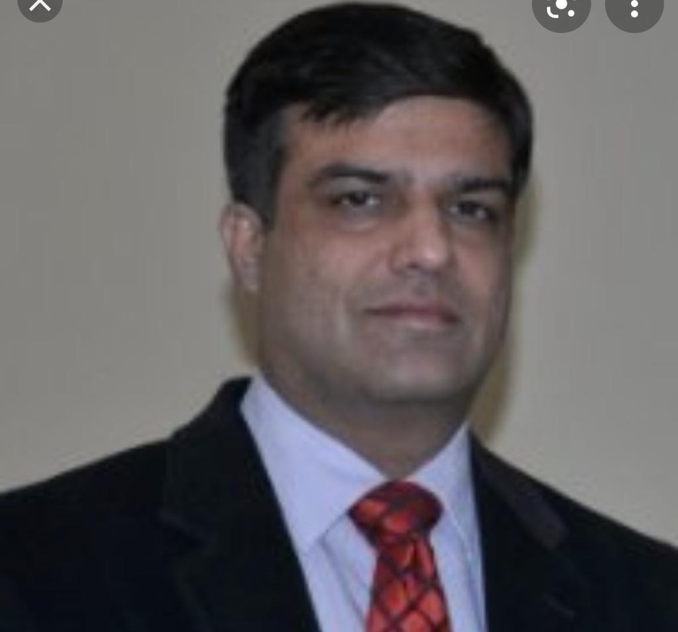
Our Leadership Team
The Executive Management team at MBL has an extensive global experience & subject matter expertise and is passionate about fulfilling the vision of being the global leader in oncology generics
Vimal Kumar Shrawat, PhD
Managing Director
Rahul Bishnoi
Chairman
Rajesh Madan
CEO
Akshay Kant Chaturvedi, PhD
Executive Director
R&D
Anand Kumar
Vice President
Sales & BD
Subir Chopra
Vice President
India & South Asia

Slide 8
Contents
Corporate Overview
Portfolio & Pipeline
R&D and Manufacturing
Commercial Presence & Plans

Slide 9

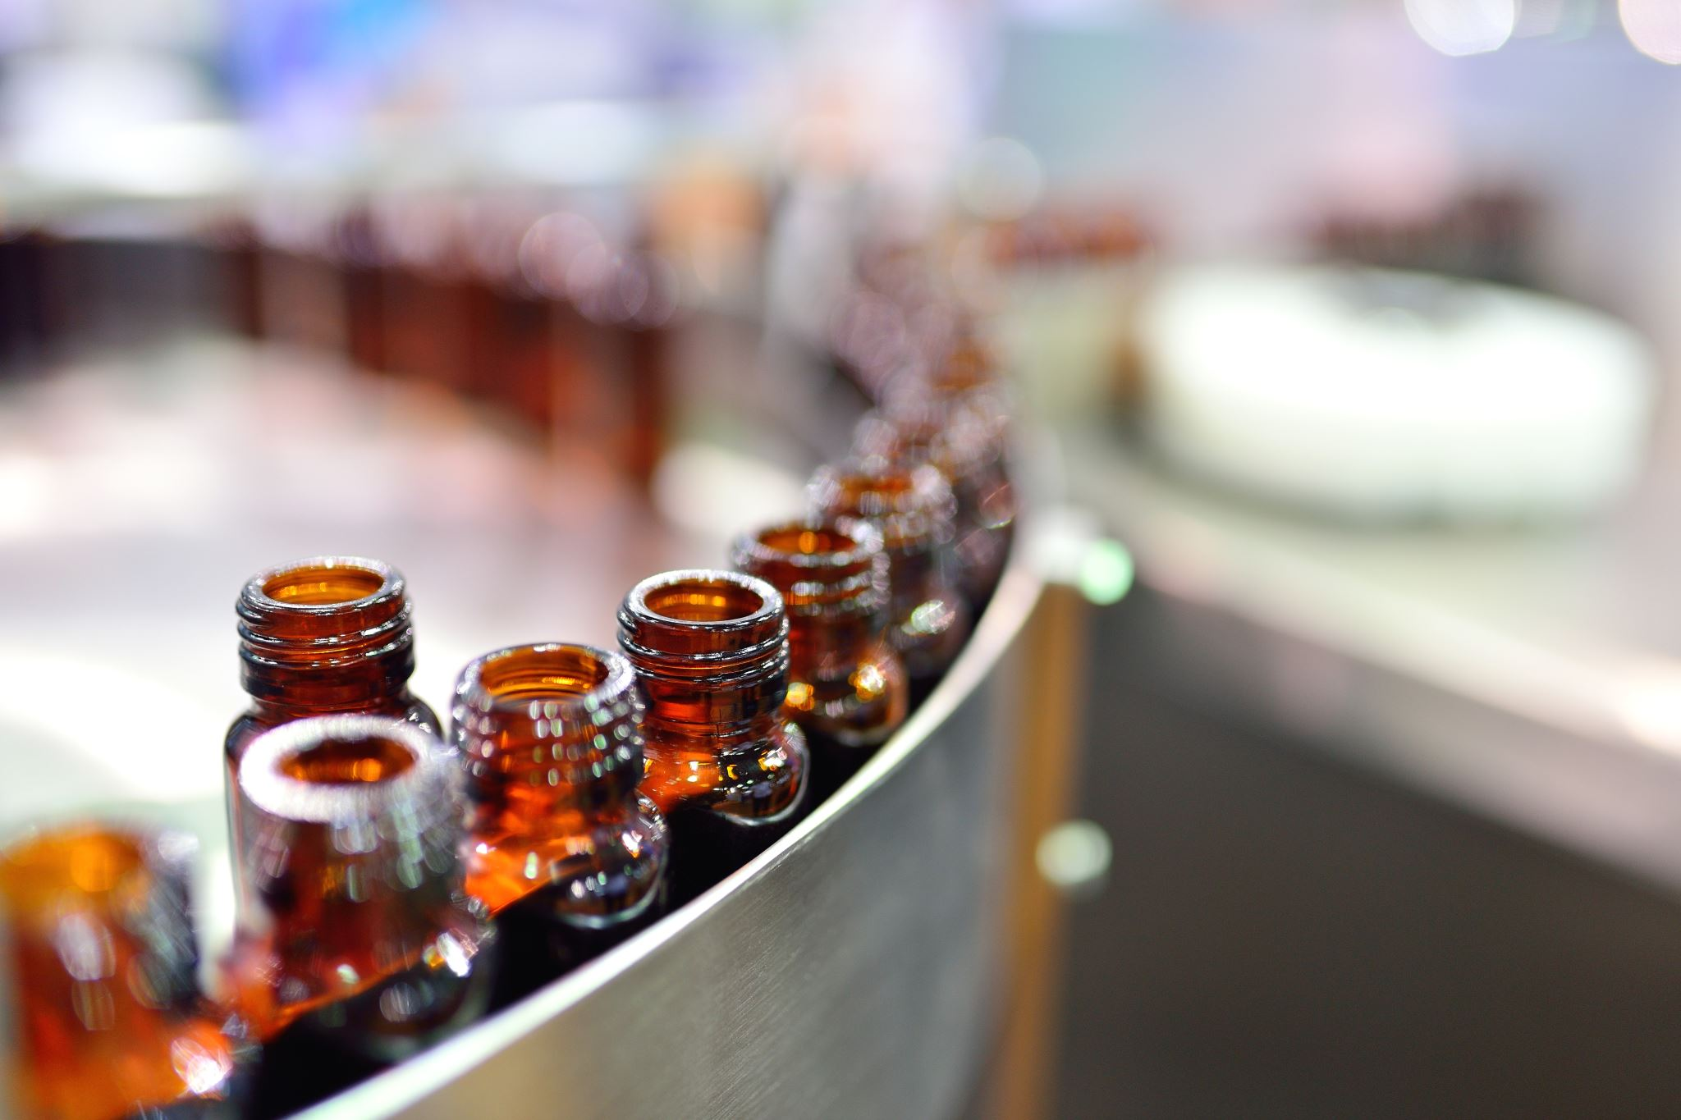

Oncology APIs & Dosage Forms
Product selection criteria:
* attractive market size * patent expiry launches * low competition
S No | Product | API by SRL | Dosage Forms Planned by MBL | Global Revenues*
1 | Abiraterone | Planned | Tabs | $ 3.2 b
2 | Acalabrutinib | Planned | Caps | $ 0.2 b
3 | Axitinib | Planned | Tabs | $ 0.6 b
4 | Azacitidine | Available | Inj | $ 0.7 b
5 | Bendamustine | Available | Inj | $ 0.7 b
6 | Bortezomib | Available | Inj | $ 1.5 b
7 | Bosutinib | Planned | Tabs | $ 0.4 b
8 | Busulfan | Available | Inj | $ 0.05 b
9 | Cabozanitinib | Planned | Tabs | $ 1.0 b
10 | Capecitabine | Available | Tabs | $ 0.7 b
11 | Carfilzomib | Planned | Inj | $ 1.1 b
12 | Dasatinib | Planned | Tabs | $ 2.3 b
13 | Enzalutamide | Planned | Caps, Tabs | $ 3.2 b
14 | Erlotinib | X | Tabs | $ 0.3 b
S No | Product | API by SRL | Dosage Forms Planned by MBL | Global Revenues*
15 | Fulvestrant | Planned | Inj (PFS) | $ 1.1 b
16 | Gefitinib | X | Tabs | $ 0.4 b
17 | Ibrutinib | Planned | Caps | $ 5.8 b
18 | Imatinib | Planned | Tabs | $ 1.7 b
19 | Ixazomib | Planned | Caps | $ 0.5 b
20 | Lenalidomide | Planned | Caps | $ 5.7 b
21 | Lenvatinib | Planned | Caps | $ 0.6 b
22 | Nilotinib | Planned | Tabs | $ 1.6 b
23 | Palbociclib | Planned | Caps | $ 5.7 b
24 | Pazopanib | Planned | Tabs | $ 0.6 b
25 | Pemetrexed | Planned | Inj (Lyo) | $ 2.5 b
26 | Pomalidomide | Planned | Caps | $ 1.6 b
27 | Regorafenib | Planned | Tabs | $ 0.4 b
28 | Temozolomide | Available | Caps | $ 0.5 b
* IQVIA, MAT Q1-2020
Note Products protected by valid patents (of innovators / third parties) are not offered for commercialization / sale in countries where the sale of such products constitutes a patent infringement

Slide 10

API Product List (Oncology)
Category 1: Development Completed
# | API | API Availability | Planned USDMF Filing | Planned CEP Filing | O-DMF Emerging Markets | WHO-GMP
1 | Azacitidine | Available | x | ** | *** | Available
2 | Busulfan | Available | x | Filed | *** | Available
3 | Bendamustine Hydrochloride | Available | x | x | ***
4 | Bortezomib | Available | Filed & reflecting in USFDA list | ** | *** | Available
5 | Capecitabine | Available | x | x | ***
6 | Temozolomide | Available | x | Filed | *** | Available
Category 2: Under R&D Development |  |  | Category 3: Pipeline Products
1 | Abiraterone Acetate |  | 1 | Carfilzomib
2 | Axitinib |  | 2 | Dasatinib
3 | Bosutinib |  | 3 | Fulvestrant
4 | Enzalutamide |  | 4 | Imatinib Mesylate
5 | Ibrutinib |  | 5 | Ixazomib
6 | Lenalidomide |  | 6 | Melphalan Hydrochloride
7 | Nilotinib |  | 7 | Pomalidomide
8 | Palbociclib |  | 8 | Regorafenib
9 | Pazopanib
10 | Pemetrexed Disodium
** This API is not official in EP. Hence, CEP cannot be filed. If an MA Holder in Europe requires, then ASMF support can be provided within a month's notice.
*** Open Part of DMF (for Domestic & Emerging Markets) can be provided within one month of receiving request.
Patent Disclaimers: 1. No information in this list - including any reference to any product or service - constitutes an offer for sale or commercialization. Products will be commercialized after expiry of all valid patents. 2. Products protected by valid patents (of innovators / third parties) are not offered for commercialization / sale in countries where the sale of such products constitutes a patent infringement. 3. Products currently covered by valid US Patents are offered only for R&D use in accordance with 35USC 271+A13(1). 4. Our valued partners / buyers are requested to ensure required patent evaluations at their end before purchasing any product from us. Any patent infringement liability is solely to the account of the buyer.
SHIVALIK RASAYAN LIMITED

Slide 11
API Product List (Non-Oncology)
Category 1: Development Completed
# | API | API Availability Date | DMF (Open Part) Emerging Markets | Planned USDMF Filing Date | Planned CEP Filing Date
1 | Dimethyl Fumarate | Available | *** | X
2 | Pirfenidone | Available | *** | X | Filed
Category 2: Under R&D Development
1 | Ambroxol HCl | Q1' 2022 | Q1' 2022
2 | Fingolimod | Q4' 2021 | Q4' 2021
Category 3: Pipeline Products
1 | Acebrophylline | 11 | Montelukast Sodium
2 | Atazanavir Sulphate | 12 | Prasugrel HCl
3 | Azilsartan Medoxomil | 3 | Praziquantel
4 | Azilsartan Kamedoxomil | 14 | Saxagliptin
5 | Canagliflozin Hemihydrate | 15 | Sitagliptin Phosphate
6 | Clopidogrel Bisulphate | 16 | Sofosbuvir
7 | Darunavir Ethanolate | 17 | Teneligliptin HBr Monohydrate
8 | Eletriptan HCl | 18 | Tenofovir Disoproxil Fumarate
9 | Emtricitabine | 19 | Teriflunomide
10 | Linezolid | 20 | Vildagliptin
***Can be provided at a month's notice for Emerging Markets
Patent Disclaimers: 1. No information in this list - including any reference to any product or service - constitutes an offer for sale or commercialization. Products will be commercialized after expiry of all valid patents. 2. Products protected by valid patents (of innovators / third parties) are not offered for commercialization / sale in countries where the sale of such products constitutes a patent infringement. 3. Products currently covered by valid US Patents are offered only for R&D use in accordance with 35USC 271+A13(1). 4. Our valued partners / buyers are requested to ensure required patent evaluations at their end before purchasing any product from us. Any patent infringement liability is solely to the account of the buyer.
SHIVALIK RASAYAN LIMITED

Slide 12

Non-Oncology APIs
Well thought after product strategy:
Products with attractive global revenues (> $ 1b)
Substantial expected revenues for SRL
Development Completed
# | API | Global Revenues*
1 | Dimethyl Fumarate | $ 4.9 b
2 | Fingolimod | $ 3.7 b
3 | Pirfenidone | $ 1.3 b
Under Development (>20 APIs)
# | API
1 | Saxagliptin
2 | Sitagliptin Phosphate
3 | Vildagliptin
# | API
4 | Darunavir Ethanolate
5 | Emtricitabine
6 | Sofosbuvir
* IQVIA, MAT Q1-2020
Note Products protected by valid patents (of innovators / third parties) are not offered for commercialization / sale in countries where the sale of such products constitutes a patent infringement

Slide 13
Contents
Corporate Overview
Portfolio & Pipeline
R&D and Manufacturing
Commercial Presence & Plans

Slide 14
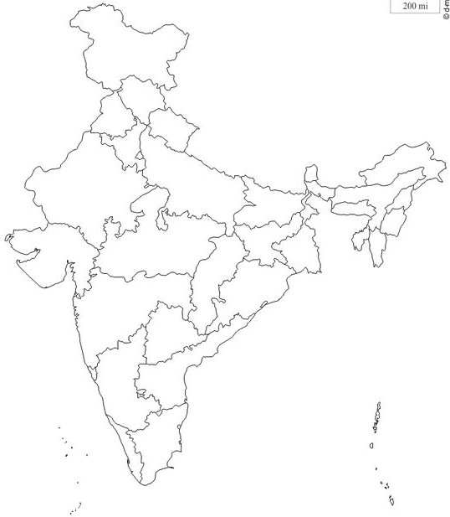


R&D and Manufacturing At A Glance
Dehradun
Agrochemicals Plant*
New Delhi
Head Office
Unit-1: Non-onco FDF Plant*
Haridwar
Unit-2: Onco FDF Plant
3
1
R&D Center
Bhiwadi
Non-Onco FDF*
2
API Plant
Dahej
Dahej
Specialty Chem
& Intermediate
Plant*
* Details available separately (not included in this document)

Slide 15
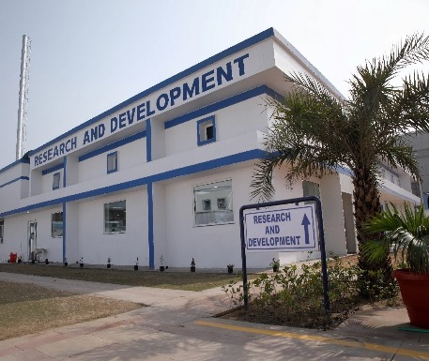
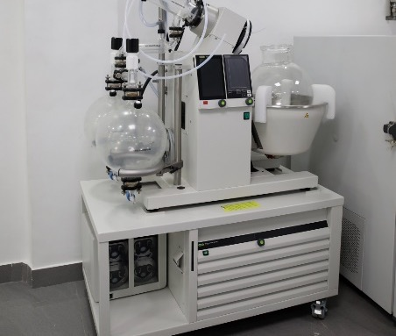
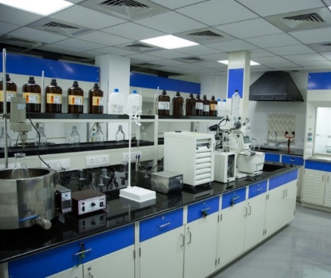
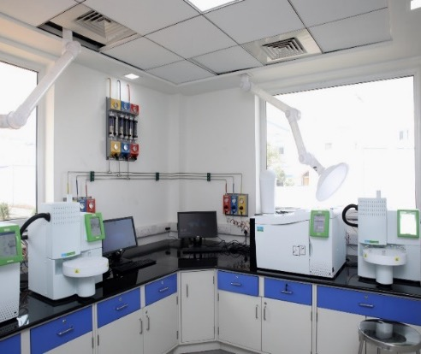
R&D Center Bhiwadi
1
Highly experienced technical team (scientists, pharmacists) with multiple developments and patents to its credit
Equipped with best-in-class equipment and systems for development of complex APIs & formulations
Full in-house capabilities for analytical research, stability studies, process validation and improvements
A robust quality assurance system for product development
Para IV filing capability with different API polymorphs
Strong in-house intellectual property management skills and expertise
Demonstrated technology transfer capabilities and operating systems
Approved by DSIR (Department of Scientific & Industrial Research), Govt of India

Slide 16
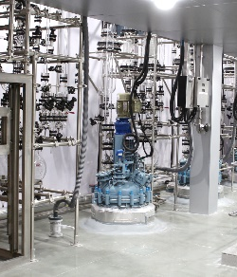
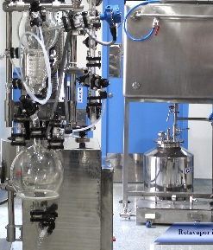
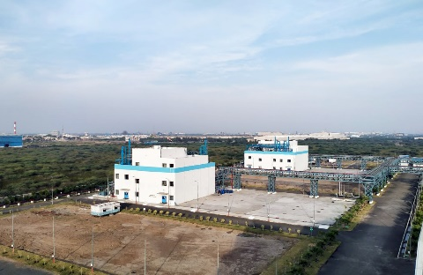
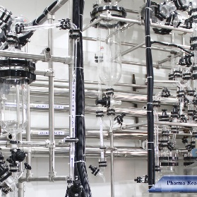
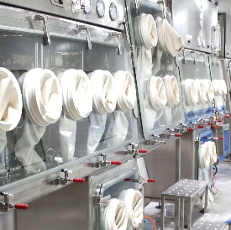
2
Steel Reactor
API Plant
Dahej
Site area of 50,000 m² including all production blocks, buildings, utilities
Design complaint with best-in-class regulatory requirements (US, Europe, Japan)*
4 oncology & 4 non-oncology blocks planned: thereof 1 onco & 1 non-onco block presently operational
Robust GMP compliant containment facility to rule out cross contamination between onco & non-onco APIs
  Extensive use of Active & Passive valves at various stages of process to achieve full containment
  Containment compliance starting from active raw material & API sampling to dispensing
Tested & validated technology transfer capabilities from R&D center to production floor
Fully equipped in-house quality control laboratory for chemical & microbiological testing
On-site regulatory affairs department experienced in approval requirements of all major geographies
Rotavapor
Pharma Reactor
Isolator

Slide 17
2
API Plant
Dahej
Installed capacity: 1500 tons
GL & SS Reactors with chilling facility upto -20°C : 32 Reactors
Reaction capabilities :
  Catalytic hydrogenation, Organoborane chemistry, Chiral synthesis & resolution, Grignard reaction, Acylation & Alkylation, Carbon homologation, Coupling reaction (Amide metal/catalysed), Amination (Reductive/Chiral), Nitration, Diazotisation, Reduction, Halogenation, Cyanation, etc
Zero affluent discharge facility
Apr 2020 | Jun 2020 | May 2021 | Aug 2021 | Dec 2022
Manufacturing License received | Plant Validation batches started | WHO-GMP received | Filing of DMFs/ CEP started | Targeted date for approval by USFDA, EDQM, TGA

Slide 18
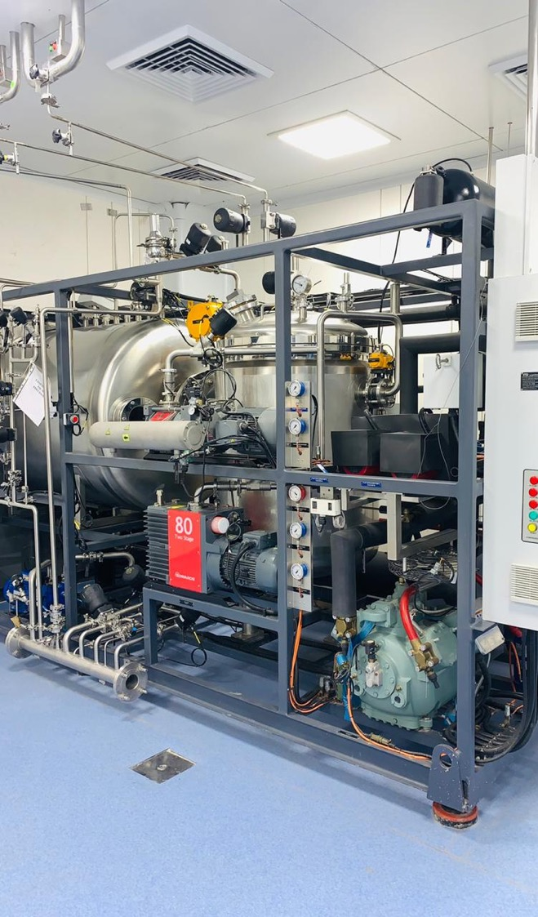
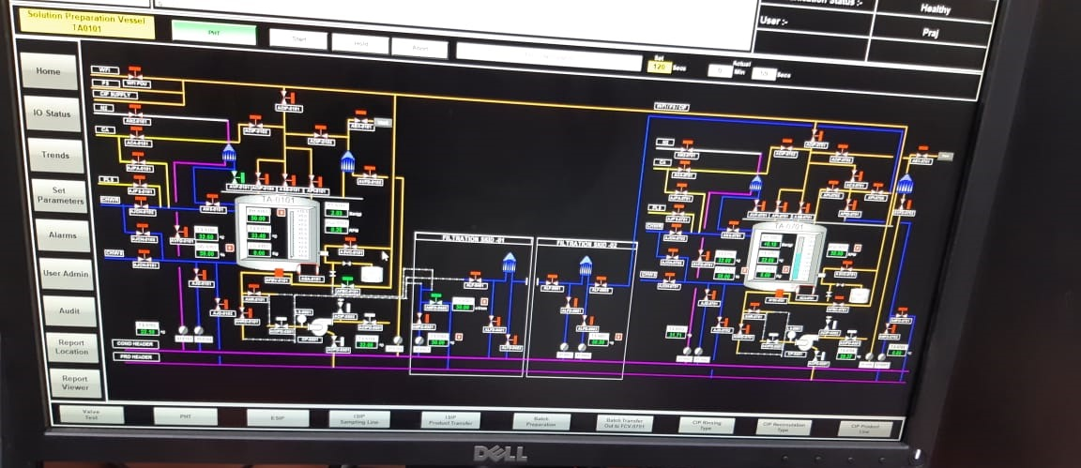
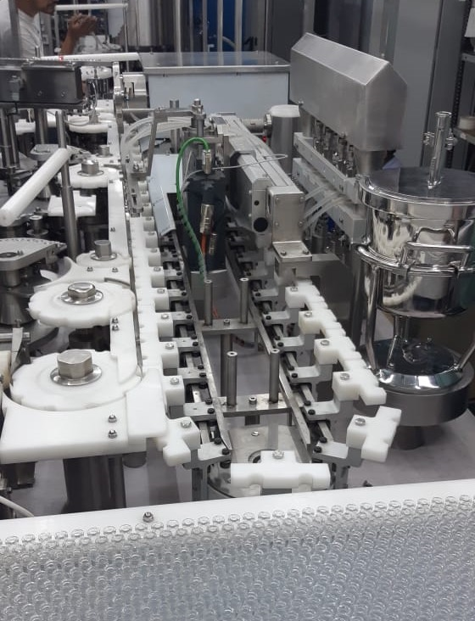
3
Lyophilizer Unit
Oncology
FDF Plant
Unit-2: Haridwar
Injectable Section:
Capacity of 120 vials/min with flexibility of handling different vial sizes, integrated with Particle Monitoring System for non-viable particle counting (NVPC)
5.6 m² with 6+1 radiant shelves Lyophilization Unit from LSI having self-stoppering facility
Unit Preparation & Sterilization: A double-door autoclave, SCADA (Supervisory Control and Data Acquisition) operated 10 litre & 50 litre capacity for manufacturing or holding vessel with filtration skid installed in between LAF/DPB units to maintain sterility of the products
A dedicated MLAF Unit for lyophilizer loading and unloading
SCADA: Sterile Manufacturing
Integrated Vial Filling Line
Confidential

Slide 19
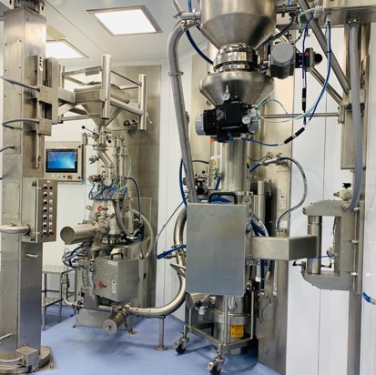
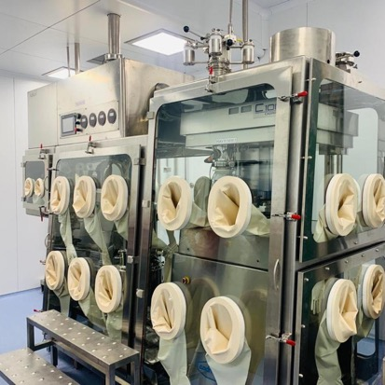
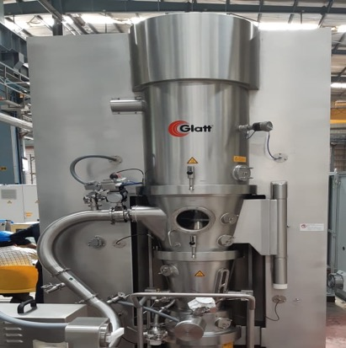
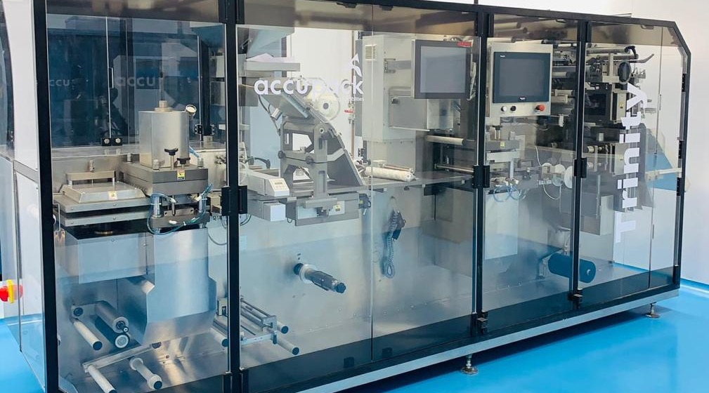
Tablet Compression in Isolator
3
Oncology
FDF Plant
Unit-2: Haridwar
Integrated Line
FBD
Oral Solid Dose (OSD) Section:
  Integrated Granulation line (Glatt , 30 Kg capacity) with WIP technology & interchangeable bowl size
  Tablet compression & encapsulation with Isolators
  Tablet coater with WIP technology (Glatt)
  Blister packing machine for Alu-Alu & Alu-PVC packing
  Bottle packing line in progress.
Blister Packaging
Confidential

Slide 20
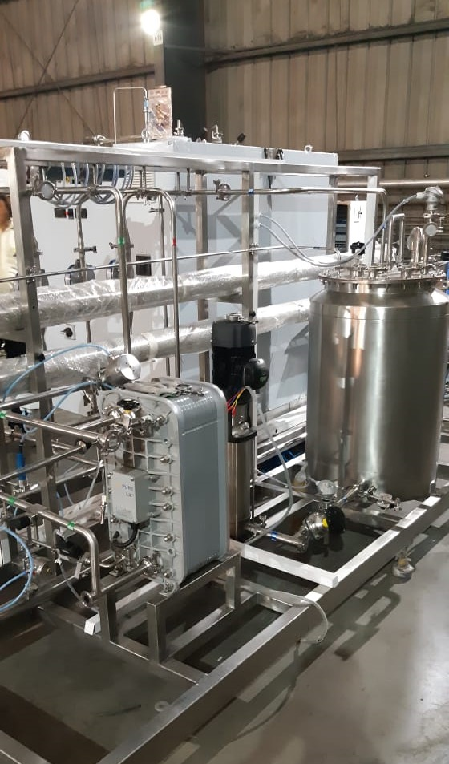
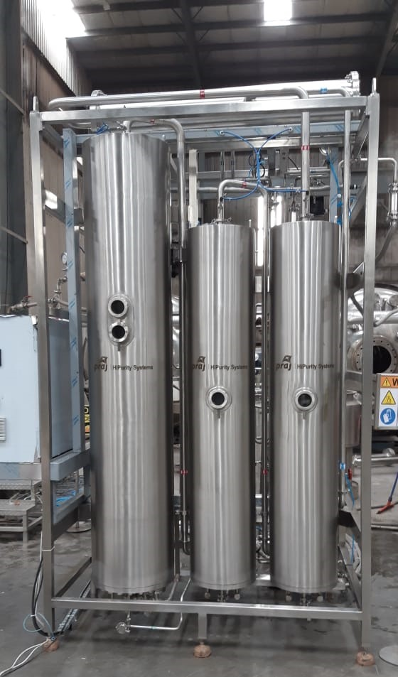
3
Oncology
FDF Plant
Unit-2: Haridwar
RO-EDI skid for PW generation, equipped with SCADA
Combi unit for WFI-PS, equipped with SCADA
Utilities Section:
  SCADA operated 21 CFR part 11 compliant 1000 LPH capacity Purified Water generation, storage & distribution system from PRAJ
  A single skid mounted / combi unit, SCADA operated 21 CFR part 11 compliant WFI-cum-Pure steam having 300 LPH & 300 Kg/hr capacities respectively.
  Generation, storage & distribution system from AQUANOVA / PRAJ
  Fire tube boiler with HSD-fired capacity: 1.5 TPH X 2 Nos (Thermax) with 100% redundancy plan
  Air-cooled screw compressor-chiller (JCI / York) equipped with VFD having capacity: 278 TR x 2 Nos with 100% redundancy plan
  DG set with capacity of 625 KVA x 2 Nos (Cummins / Jakson) with 100 % redundancy plan
  Plate type heat-exchanger based hot-water generation system for HVAC

Slide 21
Oncology FDF Plant, Unit-2: Haridwar
3
Section | Capacity
Injectables: Lyophilized Vials | 2 to 2.25 million / annum
 | Provision for installing another lyophilizer of same capacity
Injectables: RTU (liquid) Vials | 5 to 5.55 million / annum
Tablets | 140 million / annum
 | Provision for installing another tablet compression machine
Capsules | 4.5 million / annum
Jul 2020 | Dec 2020 | Aug 2021 | Mar 2022 | Dec 2023
Manufacturing License received | State GMP/GLP Certificate received | Commencement of exhibit batches | Targeted start of FDF dossiers filing in US & EU | Targeted date for plant approval by USFDA, EMEA

Slide 22








CDMO Services
CDMO = Contract Development & Manufacturing Organization
Product Development
Commercial Manufacturing
Tech Transfer
Integrated product development (IPD): continuous improvement in production efficiency & product quality
Transfer of manufacturing process to production site
Analytical method transfer to production site
Supply Chain
Warehousing capabilities
Secured storage at ambient as well as controlled temperatures
Shipping & forwarding facilities
Scale up
Quality by design (QbD) process optimization batches
Pilot, scale up, and engineering batches
Process validation
Stability studies
Packaging
Oral solids: bottles, alu-alu strips, alu-pvc blisters
Injectables: vials, PFS
Serialization, track & trace
Management of retention samples
Early-stage program
Process development for API-Intermediates and APIs
Formulation development
Analytical & microbiological method development & validation
Delivery of cGMP & non-cGMP batches
Manufacturing
Commercial batch sizes for APIs and dosage forms
Flexible batch sizes
Oral solids: tablets (dry & wet granulations), hard-gelatin capsules
Injectables: liquid, lyophilized

Slide 23
Contents
Corporate Overview
Portfolio & Pipeline
R&D and Manufacturing
Commercial Presence & Plans

Slide 24
MBL Global Presence
Dosage Forms: non-oncology
Our products are approved in more than 30 countries and are supplied through a network of alliance partners and distributors
Europe
Under Registration
CIS
Kazakhstan, Tajikistan
South Asia
Afghanistan, Bhutan, Sri Lanka`
Caribbean Islands
Cuba, Curacao, Domino Republic, Haiti, Jamaica
Dosage Forms: oncology
Presently in launch phase in India
Global roll out planned starting 2022
India
Africa
Cameroon, Congo, Ethiopia, Ghana, Ivory Coast, Kenya, Lesotho, Malawi, Namibia, Tanzania, Nigeria, South Sudan, Uganda, Zimbabwe
South-East Asia
Cambodia, Philippines
South America
Brazil
APIs: oncology & non-oncology
Presently in plant validation & regulatory phases
Will be available for commercial sales in early 2022
Australia
Under Registration

Slide 25

Oncology Roll Out Plan
Portfolio Strategy: focused on (1) patent expiry launches, (2) difficult to produce products with low competition
Development Plan: pegged on patent expiry launches wherever applicable
API Strategy: (1) backward integration of APIs for dosage forms, (2) APIs also offered in mature markets (US, Europe, Japan) for third party sales
Manufacturing Strategy: manufacturing capacity for APIs & dosage forms available for both captive consumption as well as CMO services
Geographical Roll Out: focused on US, Europe, Australia and all major markets in Asia, Africa, LAM
Commercialization Plan: (1) own team and setup in India and few select countries, (2) product launches through leading alliance partners in most countries
Our Alliance Philosophy: to be a business partner and not merely a supplier
Confidential

Slide 26

Contact Details
Global Head Quarters:
1506 Chiranjiv Tower, 43 Nehru Place, New Delhi – 110019, India
globaloncology@medicamen.com +91 11 47589500
European & International Business Office:
Kurmarkstrasse 19, 60437 Frankfurt am Main, Germany
+49 6101 9953825
Websites:
www.shivalikrasayan.com
www.medicamen.com
FDF & APIs: Business Development, API Sales
Anand Kumar, anand.kumar@medicamen.com +91 98110 43611
FDF: India & South Asia
Subir Chopra, subir.chopra@medicamen.com +91 88797 74529
FDF: International Markets
Sameer Agarwal, sameer@csa-healthcare.com +49 177 4983231

