Slide 2
About Us

Slide 3
Compay Overview
As a State-Level High-Tech company, Shandong Topscience Biotech Co., Ltd. is specialized in R&D, production, and sales of APIs, Biochemical Intermediates, and Cosmetics Ingredients. Featured Products are Sodium Hyaluronate, Chondroitin Sulfate, Hormones(HCG, HMG, FSH), Alpha-arbutin, L-Ascorbic Acid 2-Glucoside, Sulglycotide, etc.
Topscience is equipped with a professional technical team, focusing on R&D, Quality Control, and Innovation. Upon the principle of only providing high-quality and innovative products, we have entered into long-term relationships with many companies.
Topscience is aiming to be an innovative and sustainable player in the Pharmaceutical and Cosmetic Fields.

Slide 4
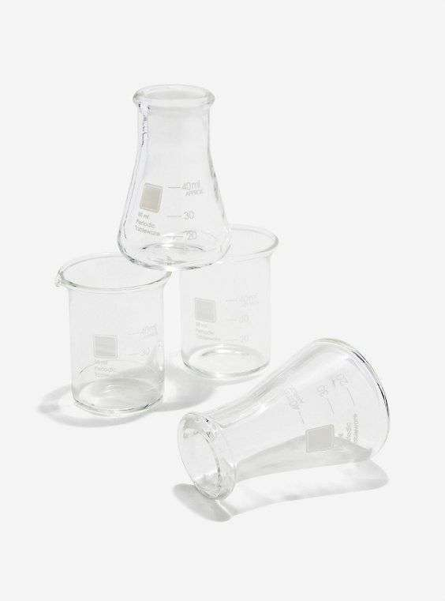
Company Overview
With Years Marketing and Operation, Topscience has developed its philosophy to meet the customers' need. Upon the existing portfolio and innovative technologies, Topscience is always in the pursuit of the market trend consistently.
01
Sterile
01
Pharmaceuticals
01
Medical
02
Cosmetics
03
Nutraceuticals

Slide 5
Our Location
Manufacturing Sites:
Site West: No 98 Lanshan West Road, Lanshan District, Rizhao City, Shandong Province, P.R. of China.
Site East: No. 789 Yuquan 2nd Road, Lanshan District, Rizhao City, Shandong Province, P.R. of China.
Sales Offices and Branches:
Beijing Office, for North China.
Shanghai Office, for East China.
Guangzhou Office, for South China.
Qingdao Branch, for Oversea Market.

Slide 6
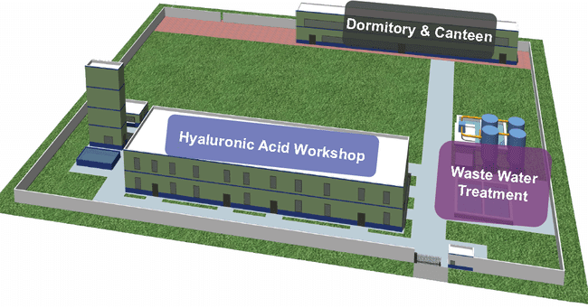
Manufacturing Sites
Site West
For Managements, QC&QA, R&D, Productions of Sodium Hyaluronate, Chondroitin Sulfate, Hormones, Alpha-arbutin.
Site East
Production of Sodium Hyaluronate.

Slide 7
Our History
· Korean KDMF certificate
· Indian Form41 certificate
· Food production license
Company
Established
Cosmetic grade HA expansion
Production site expansion
The CEP certification
2005
2008
2009
2014
2015
2017
2018
2019
2021
2023
Sodium hyaluronate goes into production
Product line expansion Production of a-arbutin
Pharma grade HA expansion
GMP certificate
Sterile HA launch

Slide 8
Organization Chart
Vice General Manager
Marketing Dept, Sales Dept
Vice General Manager
Safety & Environment Dept
Vice General Manager
Finance Dept
Production Director
Production Dept, Workshops.
Quality Director
QA Dept, Registration Dept
Board of Directors
General Manager
QC Director
QC Dept
Admin Director
Warehousing & Logistics Dep, General Office
R&D Director
R&D Dept, Product Support Dept.
Engineering Director
Engineering & Equipment Dept,
Purchasing Dept

Slide 9
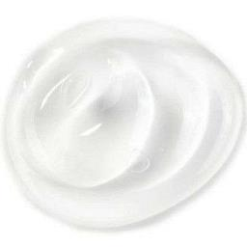
Part 1.
Sterile Grade
STERILEHYA

Slide 10
Sterile Grade
Product Advantages
Since Sodium Hyaluronate will degrade under high-temperature conditions, for customers who need sterile raw materials, using STERILEHYA will no longer need to consider the risk of viscosity degradation during material sterilization, avoiding the cost of experiments and time.
STERILEHYA is sterile raw material, which can be used directly without sterilizing products, such as sterile preparations, or sterile medical devices, that cannot be sterilized ultimately.
Completed closed production process
Advanced and complete production equipment.
Tightly controlled production environment.
Excellent production process standards.

Slide 11
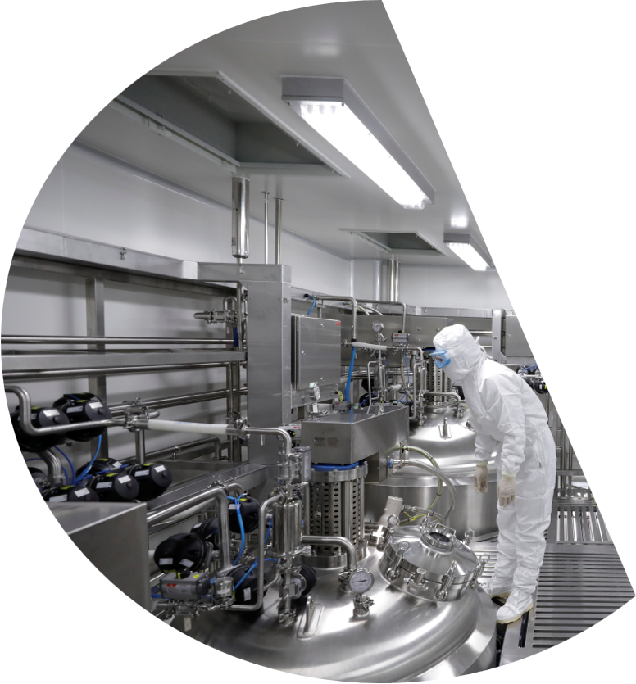
Sterile Grade
Product Specifications:
Items | Specifications | Methods
Appearance | White or almost white powder or fibrous aggregate. | Ph.Eur.
Identification A. Infrared absorption B. Reaction (a) of sodium | The IR spectrum of the sample exhibits maxima at the same wavelength as that of Ph.Eur. reference spectrum of Sodium Hyaluronate. Positive | Ph.Eur.(2.2.24) Ph.Eur.(2.3.1)
Appearance of solution | Clear and the absorbance is NMT 0.01 at 600 nm. | Ph.Eur.(2.2.1) Ph.Eur.(2.2.25)
pH | 5.0 ~ 8.5 (0.5% solution) | Ph.Eur.(2.2.3)
Intrinsic viscosity | Report the test value (on the dried substance) | Ph.Eur.
Protein | ≤0.1% (on the dried substance) | Ph.Eur.
Chlorides | ≤ 0.5% | Ph.Eur.(2.4.4)
Iron | ≤ 80 ppm (on the dried substance) | Ph.Eur.(2.2.23, Method II )
Sterility | No growth of microorganisms occurs. | Ph.Eur.(2.6.1)
Bacterial endotoxins | <0.05IU/mg | Ph.Eur.(2.6.14)
Residual solvents: Ethanol | ≤ 0.5% | In-house method

Slide 12
Part 2.
Pharmaceutical Grade
PHARMAHYA⁻INJ
PHARMAHYA⁻OPH
PHARMAHYA⁻EXC

Slide 13
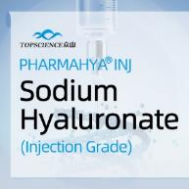
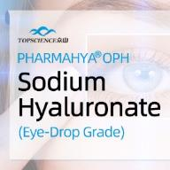
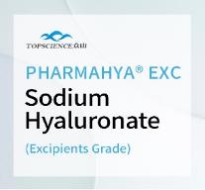
Pharmaceutical Grade
Product list
 | PHARMAHYA-INJ | PHARMAHYA-OPH | PHARMAHYA-EXC
Molecular Weight | 400-2200 kDa | 400-2200 kDa | 400-2200 kDa
Specification | ChP EP JP | ChP EP JP | ChP EP JP
Application | Can be used in Ophthalmologic operations, Intra-articular injection surgery, Intradermal injection, Cure for the sickness of cartilage(joint) and muscle tendon, etc. | Can be used in Cure of xeroma, Eye-drop, Eye ointment, Adjuvant medication for ophthalmic surgery, etc. | Can be used in Eye lotion, Adjunctive therapy for sprains and burns (small molecular weight), Adjuvant medication for ophthalmic surgery, Adjunctive therapy for sprains and burns (with cell factors, chemotactic factors and other relevant factors), etc.
Certification | CEP GMP KDMF Form 41 CDE Y20210001081 CDE Y20170000992 | CEP GMP KDMF Form 41 CDE Y20210001081 CDE Y20170000992 | CEP GMP CDE F20210000256

Slide 14
Pharmaceutical Grade
PHARMAHYA Advantages
SPECIALTY
Worldwide registrations including CEP, GMP, KDMF, Form 41, etc.
Patented Fermentation Technology of non-animal origin used in the manufacturing process.
QUALITY
According to the continuous batch test results of PHARMAHYA-INJ Sodium Hyaluronate of Topscience Biotech, the nucleic acid level is 0.01 (A260nm) and bacterial endotoxins is <0.001 IU/mg, which are 1/50 of the value specified in the standard of Ph. Eur. At the same time, the content of protein is lower than the detection limit (0.03%), which is in the leading position in the industry.
 | EP 10.0 | Other Product | PHARMAHYA-INJ
Bacterial Endotoxins | <0.05EU/mg | <0.0025EU/mg | <0.001EU/mg
Nucleic Acid | 0.5 | 0.03 | 0.01
Protein | <0.1% | <LOD | <LOD

Slide 15
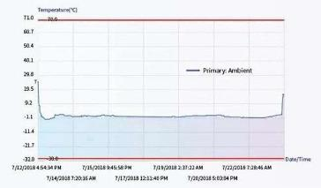
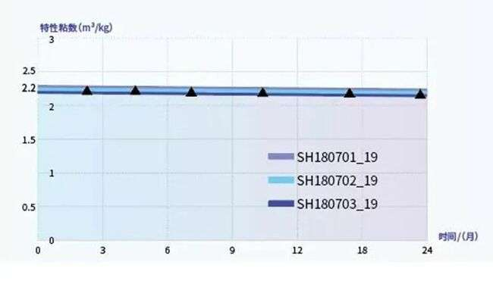
Pharmaceutical Grade
High purity, excellent stability.
According to the stability test of Injection Grade of Sodium Hyaluronate, PHARMAHYA-INJ have the characteristics of “excellent stability“.
Tailor-made service, temperature-controlled transportation.
According to the temperature-controlled transportation records of PHARMAHYA-INJ Sodium Hyaluronate, the temperature-controlled transportation protocol of PHARMAHYA-INJ is safe and effective.

Slide 16
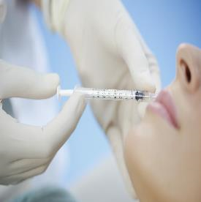
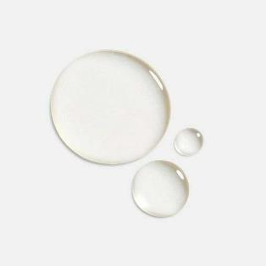
Part 3.
Medical Grade
MEDIHYA⁻I
MEDIHYA⁻M
MEDIHYA⁻S
MEDIHYA⁻T

Slide 17
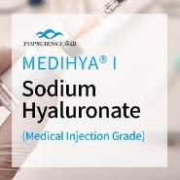
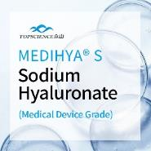
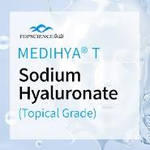
Medical Grade
Product list
Product | Description | Intrinsic Viscosity | Appilcation |  | Specification | GMP
Medihya-T | Sodium Hyaluronate Topical Grade | • 0.2 ~ 4.0 m³/kg • Tailor-made | • Suitable for medical device of external application. |  | • Tested according to Ph. Eur. Last Edition | Written Confirmation
Medihya-S | Sodium Hyaluronate Medical Device S Grade | • 0.2 ~ 4.0 m³/kg • Tailor-made | • Suitable for medical device of class II. |  | • Tested according to Ph. Eur. Last Edition • Bacterial endotoxins <0.05 IU/mg | Written Confirmation
Medihya-M | Sodium Hyaluronate Medical Device M Grade | • 0.2 ~ 4.0 m³/kg • Tailor-made | • Suitable for medical device of class II and Class III. |  | • Tested according to Ph. Eur. Last Edition • Bacterial endotoxins <0.015 IU/mg | Written Confirmation
Medihya-I | Sodium Hyaluronate Medical Device I Grade | • 0.2 ~ 4.0 m³/kg • Tailor-made | • Suitable for medical device of class II and Class III. |  | • Tested according to Ph. Eur. Last Edition • Bacterial endotoxins <0.005 IU/mg • Pass sterility test | Written Confirmation

Slide 18
Medical Grade
MEDIHYA Advantages
State-of-the-art Technology:
Microbial Fermentation.
Non-GMO, Non-animal origin.
Customization:
Customized specification.
Customized transportation solution.
Consistency:
Good consistency batch to batch.
High Purity:
Excellent control of impurity
Bacterial endotoxins
Elemental impurities
Proteins
Nucleic acids
Chlorides, etc.

Slide 19
Medical Grade
Certificates & Registrations
GMP Certificate issued by NMPA of China.
ISO9001 : 2015
CEP(CoS) Certificates
Written Confirmation for Active Substances
Kosher Certificate and Halal Certificate
Worldwide Registrations in China, Europe, India, South Korea, etc.
Application:
Intra-articular injection, viscosupplementation, dermal filler, eye drops, topical preparation, anti-adhesive agent, medical lubricant, mucosa healing, etc.
Origin:
Microbial fermentation of Streptococcus Zooepidemicus.
Specification:
Based on Ph. Eur last edition or higher.

Slide 20
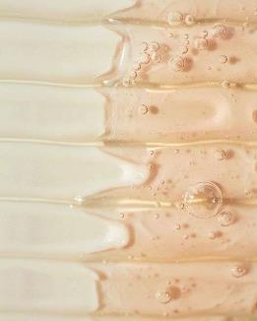
Part 3.
Cosmetic Grade
COSMEHYA
HYDHYA 致修
ACEHYA 致润
SMOHYA 致泽
Zinc Hydrolyzed Hyaluronate
Alpha-Arbutin
L-Ascorbic-Acid 2-Glucoside

Slide 21
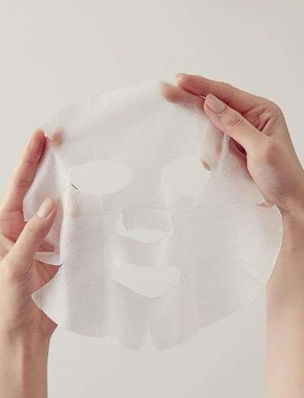
Cosmetic Grade
COSMEHYA:
COSMEHYA has excellent moisturizing and lubricating properties, and is internationally recognized as a “natural moisturizing factor“.
Sodium Hyaluronate is widely present in the interstitial cells of various tissues of the organism.
Type | Molecular weight
COSMEHYA H220 | >1800 kDa
COSMEHYA L180 | 1000-1800 kDa
COSMEHYA L100 | 400-1000 kDa
COSMEHYA SL40 | 10-400 kDa
COSMEHYA VL01 | <10 kDa

Slide 22
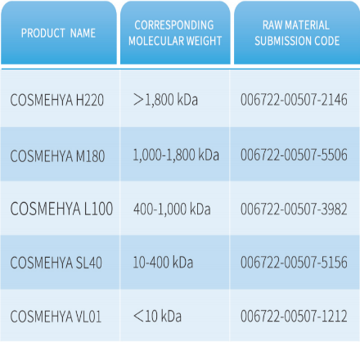
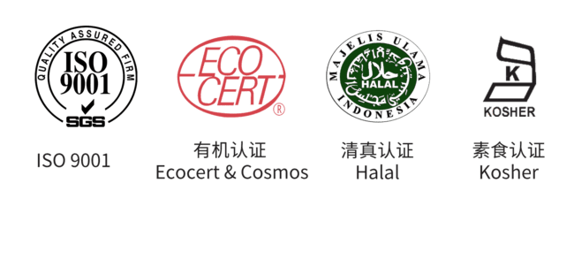
Cosmetic Grade
COSMEHYA Advantages
Molecular Weight
Raw Material Submission Code
Stability & Consistency
High purity & Tailor made
Workshops in compliance with GMP
Precise molecular weight control
High molecular weight HA
Form a breathable membrane. prevent harm, lock in moisture
Medium molecular weight HA
Nourish the skin, and enhance skin elasticity.
Low molecular weight HA
Deep skin penetration, replenish skin moisture.
Certification

Slide 23
Cosmetic Grade
HYDHYA 致修
Hydrolyzed Sodium Hyaluronate
Antiallergic
Anti-Inflammatory
Repair the damaged skin barrier
Features:
HYDHYA has an ultra-low MW of less than 10kDa, which makes it have high permeability. HYDHYA® can penetrate into the cuticle of skin, remove free radicals, nourish skin cuticle, and repair damaged cell barrier.
HYDHYA has the good absorbing ability and can be absorbed easily by skin to regulate cell metabolism, improve cell activity, retain skin elasticity and resist skin aging.
HYDHYA can promote blood circulation, effectively inhibit cell sensitivity and form strong moisturizing support and protection function for skin.
HYDHYA also has high biological activity such as promoting the proliferation and differentiation of epidermal cells, which is helpful for repairing UVA injury, promoting wound healing, relieving skin sensitivity, anti-inflammation and regulating immunity.

Slide 24
Cosmetic Grade
ACEHYA 致润
Sodium Acetylated Hyaluronate
Skin hydration
Repairing
Antioxidant
Firming
Features:
ACEHYA has high safety. mild skin feeling and long-lasting moisturing.
ACEHYA has a strong affinityto the skin. which can effectively reduce the evaporation of moisture fromthe bottom of the skin.
ACEHYA play double hydrating and moisturizing property functions due to its amphiphilic propertywhich enable the water binding ability of the Sodium Acetylated Hvaluronate in the stratum corneum than natural SodiumHvaluronate.
ACEHYA can promote the proliferation of epidermal cells, enhance the function of epidermal cuticlebarrier and improve natural resistance of skin.

Slide 25
Cosmetic Grade
SMOHYA 致泽
Cationic Hyaluronate
SMOHY Cationic Hyaluronate is obtained from synthesis with Sodium Hyalyronate and cationic reagents.
Features:
SMOHYA can be used as an exclusive moisturizing agent for personal care products. lt is natural and mild, suitable for hair and scalp care.
SMOHYA has kinds of ability: adsorbability and high affinity.
SMOHYA can protect skin against the irritation of surfactant and make the skin more smooth and soft.
SMOHYA has permeability, absorbability and film-forming properties, to eliminate free radicals, regulate metabolism.

Slide 26
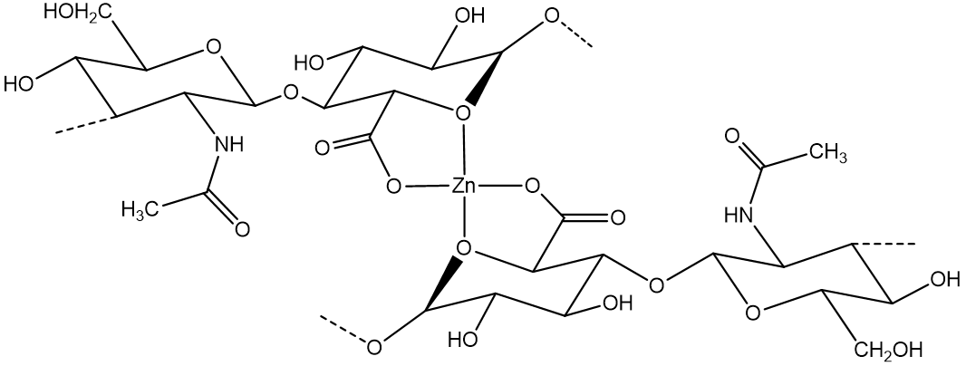
Cosmetic Grade
Zinc Hydrolyzed Hyaluronate
Zinc Hydrolyzed Hyaluronate of Topscience is the perfect combination of HA and zinc with both efficacies which is developed by patented technology. It not only has the characteristics moisturizing, repairing and nourishing HA but also has the functions of anti-oxidation and soothing of Zinc.
INCI name | 水解透明质酸锌
Name | ZINC HYDROLYZED HYALURONATE
Molecular formula | （Zn(C₁₄H₂₀NO₁₁) ₂）n
Recommended dosage | 0.1%~0.5%
Solubility | Easily soluble in water
Application | Lotion, Cream, Essence, Mask, etc.
Advantages:
Strengthen the skin barrier.
Decrease the expression of inflammatory factors.
Up-regulate the ratio of collagen lll/l to reduce scar formation.
Enhance Hydration capacity.

Slide 27
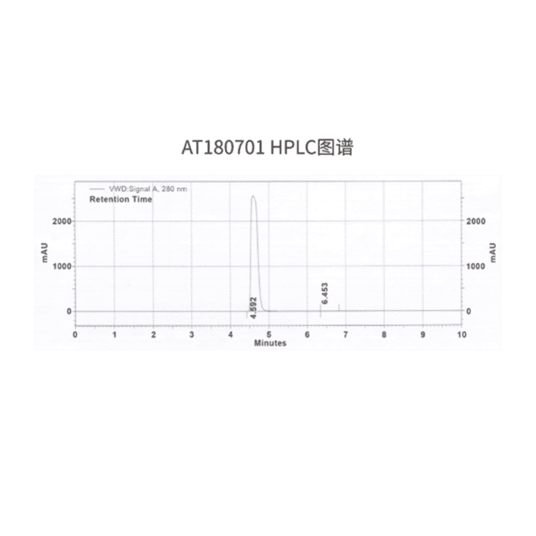
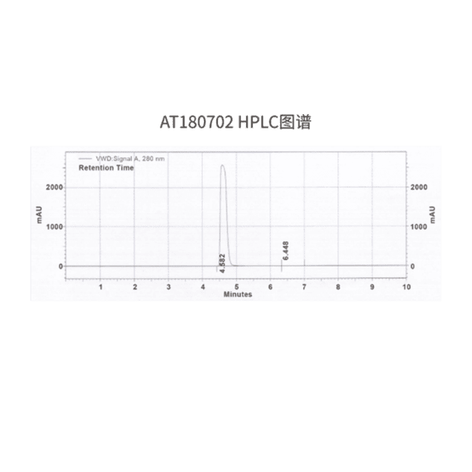
Cosmetic Grade
Alpha-Arbutin
Characteristics:
Alpha-Arbutin is considered one of the most effffective and safe lightening ingredients in foreign countries and the most competitive lightening spot removal active substance in 21st century.
The stability and durability of alpha-Arbutin is 15 times more than beta-Arbutin.
In the whole process of reaction, hydroquinone is never generated. It has no side effffects of cytotoxicity, irritation and anaphylaxis, but the effffects of moisture, healing wounds, sterilization and anti-inflflammation.
Batch Number: AT180701, AT180702 HPLC

Slide 28
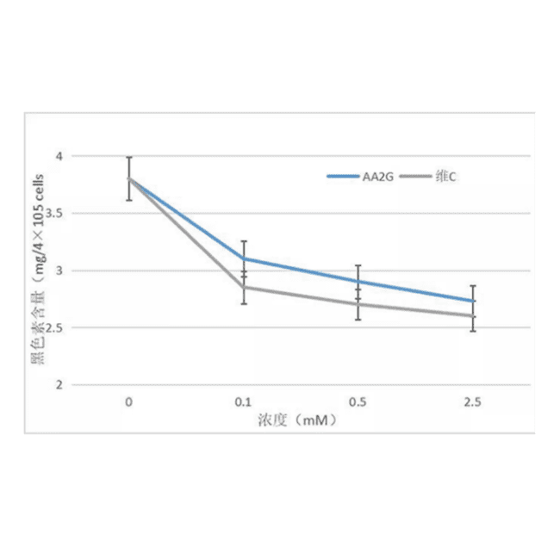
Cosmetic Grade
L-Ascorbic Acid 2-Glucoside
Product Characteristics:
L-Ascorbic Acid 2-Glucoside is a kind of natural vitamin C containing stable glucose stabilizers;
Compared with other vitamin C derivatives, L-Ascorbic Acid 2-Glucoside has good stability and solubility in solution everat high temperatures. lOW H and in the presence of metal irons,It can essentially inhibit discoloration and degradationof vitamin C in cosmetics while retaining all the biological activity of vitamin C;
L-Ascorbic Acid 2-Glucoside can desalinate pigment and reduce the pigmentation of senile spots and freckles;: Brightenskin tone, delay aging, protect the skin in sunscreen products.
L-Ascorbic Acid 2-Glucoside inhibits melanin synthesis
B16 melanoma cells were cultured in medium supplemented with L-Ascorbic Acid2-Glucoside and vitamin C for 12 h then treated with 1, 3-[theophyline(0.5 mM)] for48 hours. Using TCA to dissolve cells and measure the amount of melanin in thecells. The results showed that both L-Ascorbic Acid 2-Glucoside and vitamin C couldinhibit melanin synthesis.

Slide 29
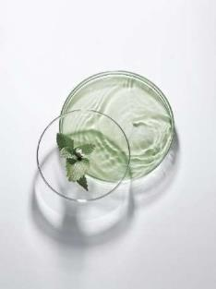
Part 4.
Food Grade
NUTRIHYA

Slide 30
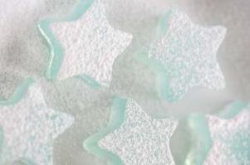
Food Grade
NUTRIHYA:
Oral intake could replenish the inadequate status in the human body. By digestion and absorption, sodium hyaluronate could make your skin moisturizing, soft, and elastic, delay aging and prevent arthritis, arteriosclerosis, pulse disorder, encephalanalosis, and so on.
In many developed countries such as the USA, EU, and Japan, it's widely applied in functional food.
Advantage:
Can increase skin moisture and improve dry skin.
Can modulate inflammation
Can make people energetic and youthful.

Slide 31
Quality Management
Quality Management-Element
Quality Management-System
Quality Management-Lab
Quality Management-Certificates

Slide 32
Quality Management
Quality Management-Element
Quality Management-System
Set up an integrated quality system covering Regulations, according to the regulation and guidelines of GMP and ICH Q7.
Quality Control and Quality Assurance.
Advanced analytical instruments and professional technicians.
Quality Certificates.
Change Control & Deviation Handling
Quality Risk Management
Materials & Products
Quality Management-Lab
Personnel
Validation & Qualification
Equipment & Facility
Central Lab
G.C
HPLC
I.R.
Incubator

Slide 33
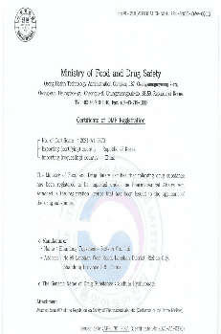
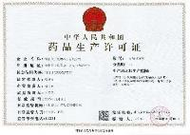
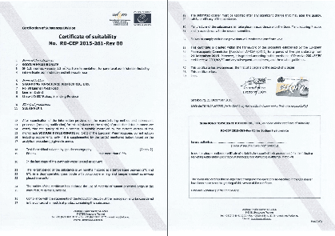
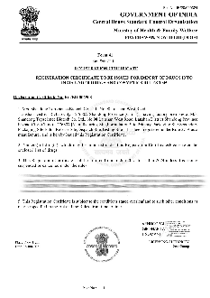
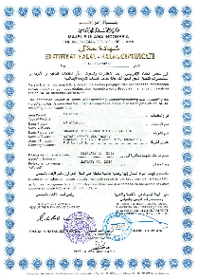
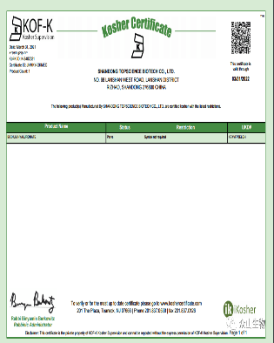
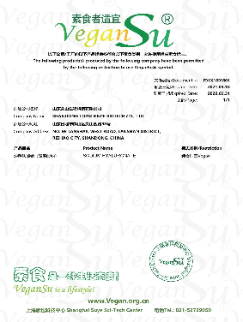
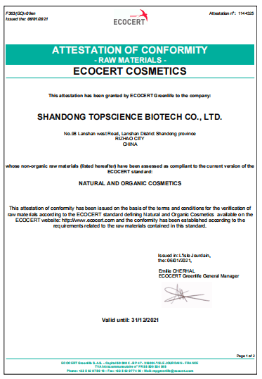
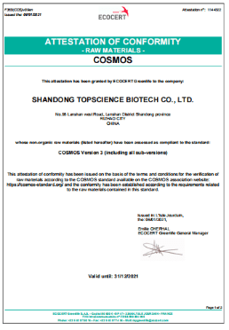
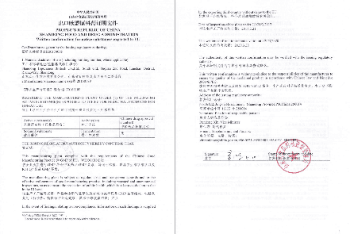
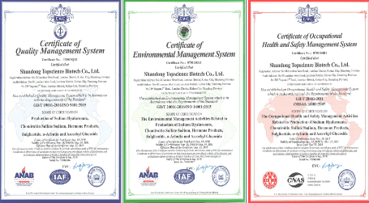
Quality Management-Certificates
Pharma MFG License
GMP
CEP(CoS)
Form 41
KDMF
Halal
Pharmaceutical Manufacturing License
Issued by Shandong FDA
GMP Certificate
Issued by Shandong FDA
CEP SH1.3 & SH2.2 & SH3.0
Issued by EDQM
Form 41
Issued by CDSCO
Certificate of KDMF
Issued by MFDS
Issued by
The Indonesian Council of Ulama
EU Written Confirmation
Kosher
ISO
Vegan
ECOCERT & COSMOS
Written Confirmation for
Active Substances Exported to EU.
Issued by Shandong FDA
Kosher
ISO 9001
ISO 14001
OHSAS 18001
Vegan
ECOCERT COSMETICS
COSMOS

Slide 34
Marketing
Our Sales and Marketing

Slide 35
Our Sales And Marketing
North America
Europe
Japan&Korea
Southeast Asia
Latin America

Slide 36
Thank You!
Better Medicines From Better Sources - Topscience

