Slide 1
COMPANY OVERVIEW

Slide 2
EXECUTIVE SUMMARY
Biotherapeutics company based on proven proprietary collagen technology platform
US operations in Princeton, NJ with manufacturing in Saal, Germany and domiciled in Athlone, Ireland
Management team with a strong history of success and backing of Gurnet Point Capital and Hillhouse Capital, and debt facility from Oaktree Capital Management
PRODUCTS AND PIPELINE
PLATFORM TECHNOLOGY
MANUFACTURING CAPABILITIES
XARACOLL® (bupivacaine HCl) implant – post-operative analgesia in open inguinal hernia repair
Broad soft tissue label expansion anticipated as early as 2024
POSIMIR® (bupivacaine) solution for post-operative analgesia in subacromial decompression (shoulder) procedures
Novel pipeline in oncology and immunology based on collagen platform technology
Collagen Leadership – 15+ years of R&D in Collagen Technology
Capability to deliver APIs with broad applications across multiple therapy areas
Biocompatible, absorbable technology enabling customized properties
Patent protection and proprietary know-how
Fully-owned manufacturing facility in Saal, Germany to supply global demand
“End-to-end” differentiated manufacturing capabilities
Capacity at existing site to enable business expansion

Slide 3
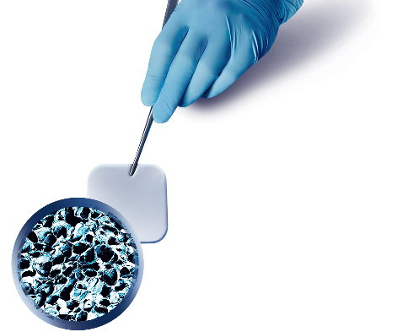
Collagen Platform Offers Multiple Therapeutic Opportunities
Unique Approach to Drug Delivery to Optimize Efficacy & Tolerability
Biocompatible, absorbable technology
Compatible with wide range of APIs
Provides customized properties:
Physical properties e.g., size, shape, structure, etc.
Drug release characteristics, formulation, API solubility, etc.
Approved products in the US and EU are based on COLLARx™ technology
Combined with API to deliver the “right effect to the right location over the right time”
COLLARx™ implant
magnification 200X
Patent-Protected, Proprietary Technology Platform

Slide 4
COLLAGEN PLATFORM TECHNOLOGY: RIGHT DRUGS, RIGHT PLACE, RIGHT TIME
Customized API Delivery
Controlled Localization
Custom Kinetics
Enable localization of API
Customize API Release
Broadly Applicable
Therapeutically Relevant
Compatible
Localization to all major organ systems
Works with NMEs, Biologics, & Cells
Regulatory Pathway Risk Mitigation
Expedited US Regulatory Pathway
Novel Development
Leverage approved therapies with 505(b)(2) regulatory pathway
Advance drug delivery through local administration rather than systemic
Post-Operative Pain
Oncology
Local Delivery of Chemotherapeutics
Immunology
Topical Treatments

Slide 5
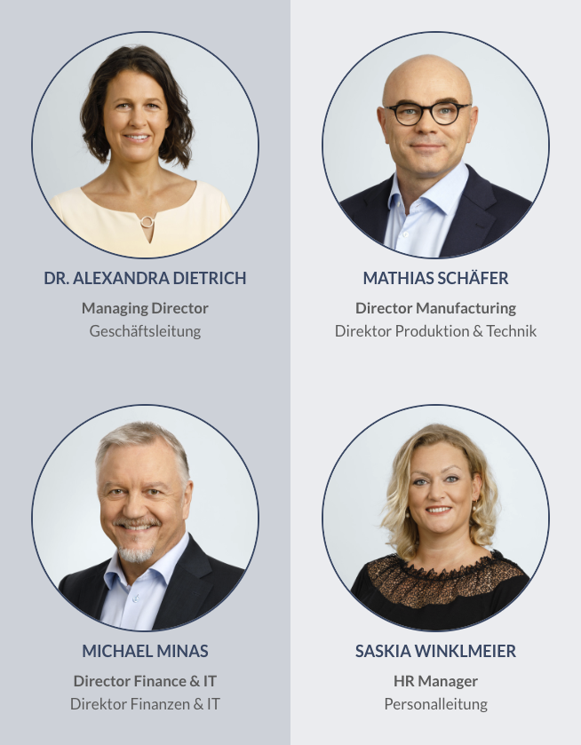
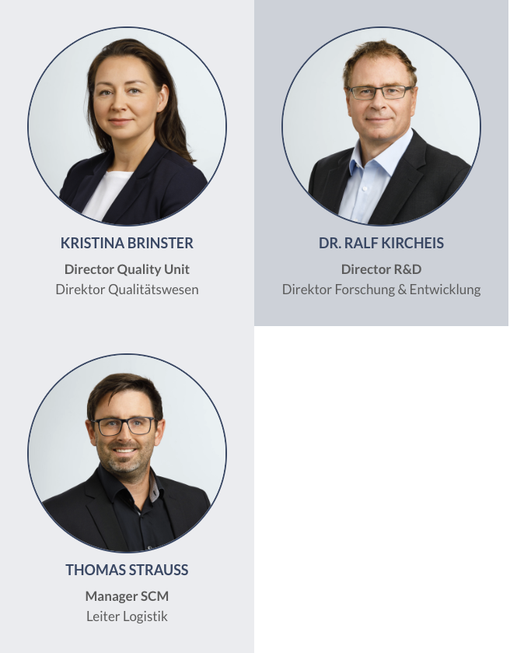
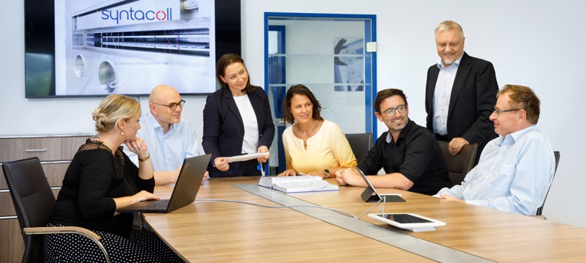
LEADERSHIP TEAM

Slide 6
HISTORY OF SYNTACOLL GMBH
1927
1950
1980s
1985
1992
1996
2005
2016-2017
2020
Foundation of suture business under the name of Dr Ruhland GMBH in Nürnberg
Development of collagen products as haemostyptica
Cooperation with Schering Plough with the goal to develop a collagen implant containing gentamicin
Approval of collagen implant containing gentamicin
Renaming into innocoll gmbh and closing of the suture business
First equine collagen product
Renaming into syntacoll gmbh
Approval of current facility
Approval of XARACOLL;
start of commercial manufacturing

Slide 7
RELATIONSHIP PRINCIPLES
Mutual ownership
Aligned goals and incentives
Mutual trust, respect, and accountability
Collaboration and innovation in your process
Sharing best practices to improve productivity
Open and honest communication with quick resolution
Excellence in execution
Mutual Ownership, Goals
Share Information
High Levels of Trust and Communication
Value Creation

Slide 8
Leading, full-service, multi-platform CDMO specializing in collagen-based drug delivery technologies and the development of additional biomaterial products
End-to-end solutions for clients, from initial product design and development, through commercial-scale manufacturing, including packaging and labelling of fully-finished product
Several expansion opportunities, including organic pipeline augmentation via expansion into new therapeutic areas and development of novel products, as well as inorganic M&A of additional biomaterials CDMOs
State-of-the-art cGMP facilities (Saal, Germany) with an extensive suite of product and service offerings as well as available Day 1 capacity
Highly-skilled management team experienced in all facets of manufacturing operations, including CMC, QA/QC, supply chain, project management and business alliance
1
SUMMARY HIGHLIGHTS
2
3
4
5

Slide 9
Numerous Uses Exist For Pharmaceutical – grade Collagen
1
Collagen supplements
2
Pharmaceutical additives
3
Wound dressings & surgical sealants
4
Bone void fillers
5
Drug delivery system
6
Tissue engineering
7
Nucleic acid therapy, virotherapy, cell therapy
8
Cellular scaffolds
9
Tissue/cell transportation
10
Collagen gel cell culture
Research from Insight Partners.

Slide 10
ISO 13485 CERTIFIED
GMP CERTIFIED AND HOLDER OF A MANUFACTURING LICENSE
SITE FOR RESEARCH
AND DEVELOPMENT
AND FORMULATION
MANUFACTURING
SITE FOR INNOCOLL
AND OTHERS
Notified Body: TÜV SÜD MDSAP: for Canada, Australia, US
Competent Authority: Government of Upper Bavaria
Direct transfer and scale-up into GMP production
Located in Saal, Germany
3 buildings with a total size 56,510 sq ft

Slide 11
ABOUT
Multi-Product Production Site
Collagen-only products
Collagen / Gentamicin Sponge
Collagen / Bupivacaine Matrix
Clean Room Environment, including
41 rooms / areas
ISO class 5 – 8
In total ~16,145 sf classified clean room area

Slide 12
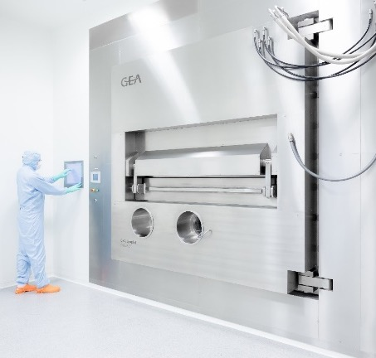
PRODUCTION CAPABILITIES
1500m² classified clean room area
Clean room environment with GMP classes A – D (class 100 to 100,000), ISO 5-8
2 freeze dryers with 36 m² each on 11 shelves
150m² Controlled-Non-Classified Area for Final Packaging
Production Capability including:
Collagen rendering
Matrix production
Packaging and labeling
Serialization with aggregation
Testing
GMP certification or QP release

Slide 13
QUALITY PHILOSOPY
Patient safety is most important for everything we do
We want our customers to be satisfied with our services
Quality is an ongoing task and obligation of all employees

Slide 14
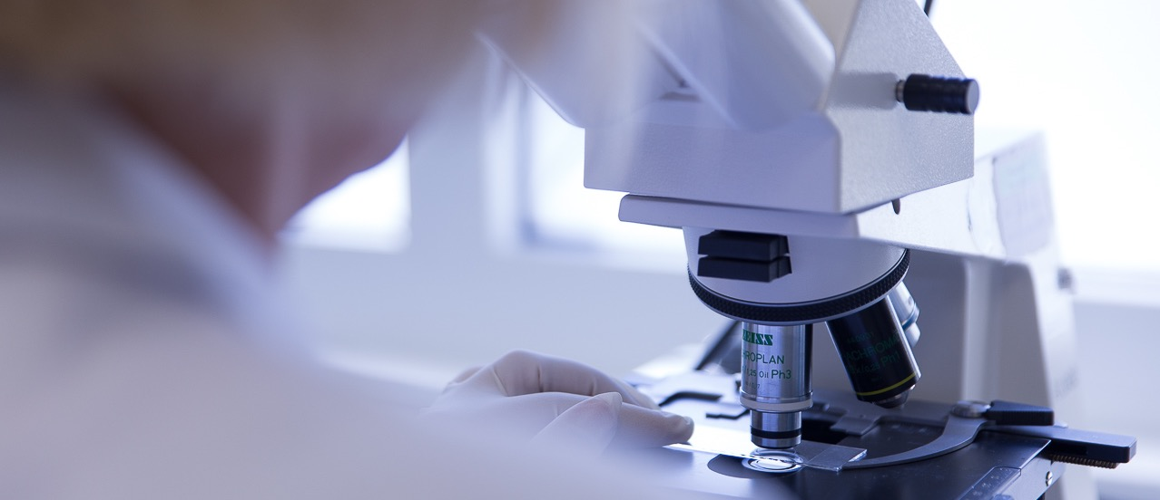
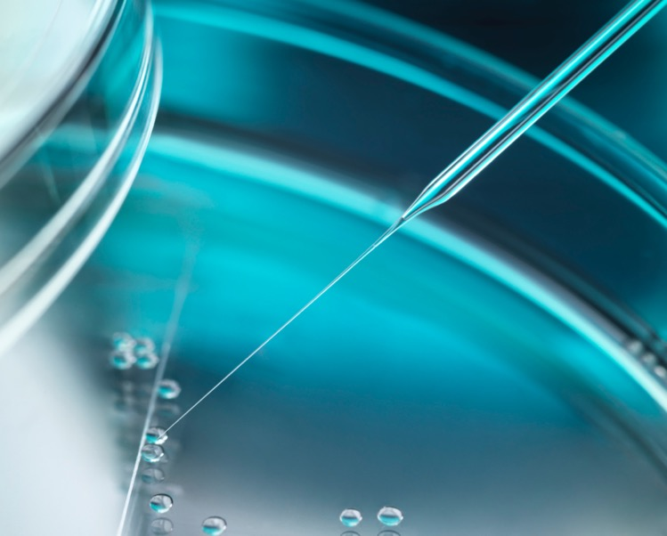
QUALITY SYSTEM

Slide 15
QUALITY SYSTEMS
Syntacoll’s quality system covers medical devices, medicinal products, and combination products
Inspected routinely by various authorities throughout the world
Qualified person on site with ability to certify product to the market

Slide 16
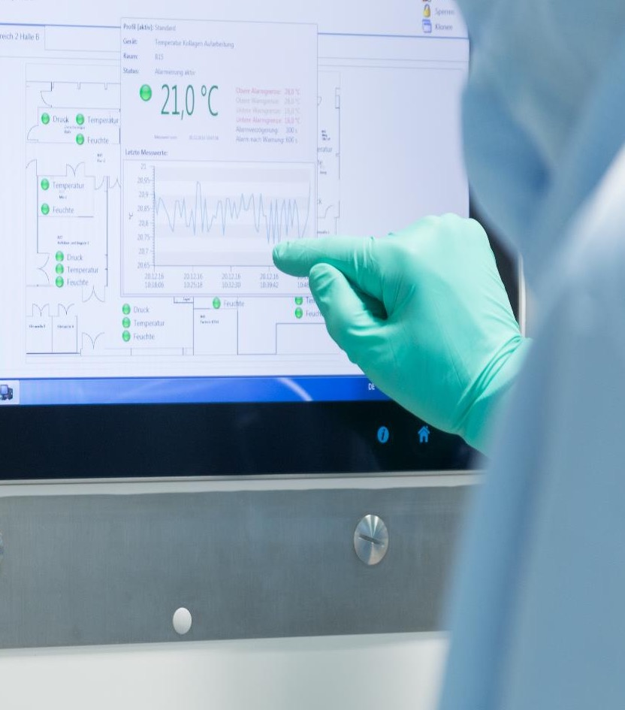
QUALITY ASSURANCE
Quality management system
Quality events
Change controls
CAPAs including effectiveness checks
Documentation
Line clearance
Batch record review
Regulatory
Safety

Slide 17
HISTORY OF INSPECTIONS
Date | Authority | Audit Subject | Product
Jan 2015 Mar 2015 Dec 2015 | Ministry of Belarus Government of Upper Bavaria TÜV SÜD Product Service | Product specific Regular surveillance inspection Regular surveillance inspection | MD GMP MD
May 2016 May 2016 Dec 2016 Dec 2016 | Government of Upper Bavaria TÜV SÜD Product Service Government of Upper Bavaria TÜV SÜD Product Service | Approval of current QC laboratories Approval of current QC laboratories Approval of current warehouse and water system MDSAP certification audit (incl. US) | GMP MD GMP MD
Jan 2017 Feb 2017 Mar 2017 Aug 2017 Nov 2017 Dec 2017 | Government of Upper Bavaria Government of Upper Bavaria TÜV SÜD Product Service Government of Upper Bavaria KCL (KFDA) TÜV SÜD Product Service | Part I - Approval of current clean room Part II - Approval of current clean room Acceptance inspection of current clean room Approval of process flows for commercial product — MDSAP surveillance audit | GMP GMP MD GMP MD MD
Jun 2018 Dec 2018 | FDA TÜV SÜD Product Service | Pre-Approval Inspection (PAI) MDSAP recertification audit (incl. US) | CP MD
Jul 2019 Nov 2019 Dec 2019 | Government of Upper Bavaria Government of Upper Bavaria TÜV SÜD Product Service | GPM routine inspection Approval of process flows for commercial product MDSAP surveillance audit (incl. US) | GMP GMP MD
Sep 2020 Nov 2020 | KCL (KFDA) TÜV SÜD Product Service | (paper based Sep - Dec 2020) MDSAP surveillance audit (incl. US) | MD MD
Mar 2021 Oct 2021 | TÜV SÜD Product Service TÜV SÜD Product Service | Unannounced audit MDSAP recertification audit (incl. US) | MD MD
Mar 2022 Oct 2022 | Government of Upper Bavaria TÜV SÜD Product Service | GPM routine inspection MDSAP surveillance audit (incl. US) | GMP MD

Slide 18
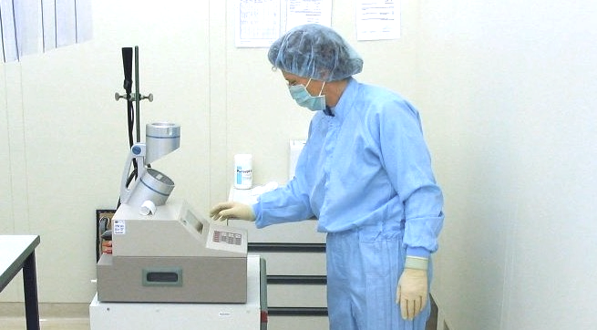
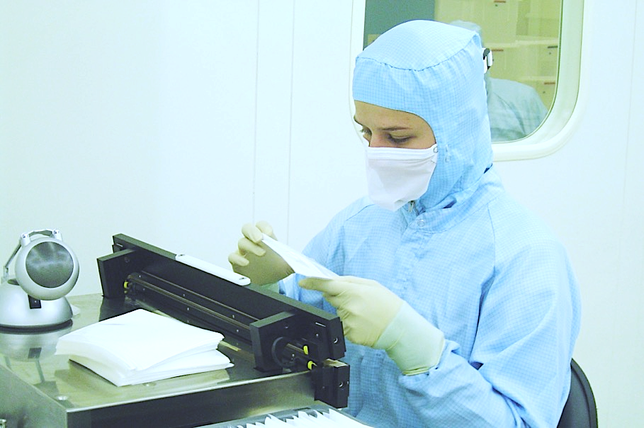
QUALITY CONTROL CAPABILITIES

Slide 19
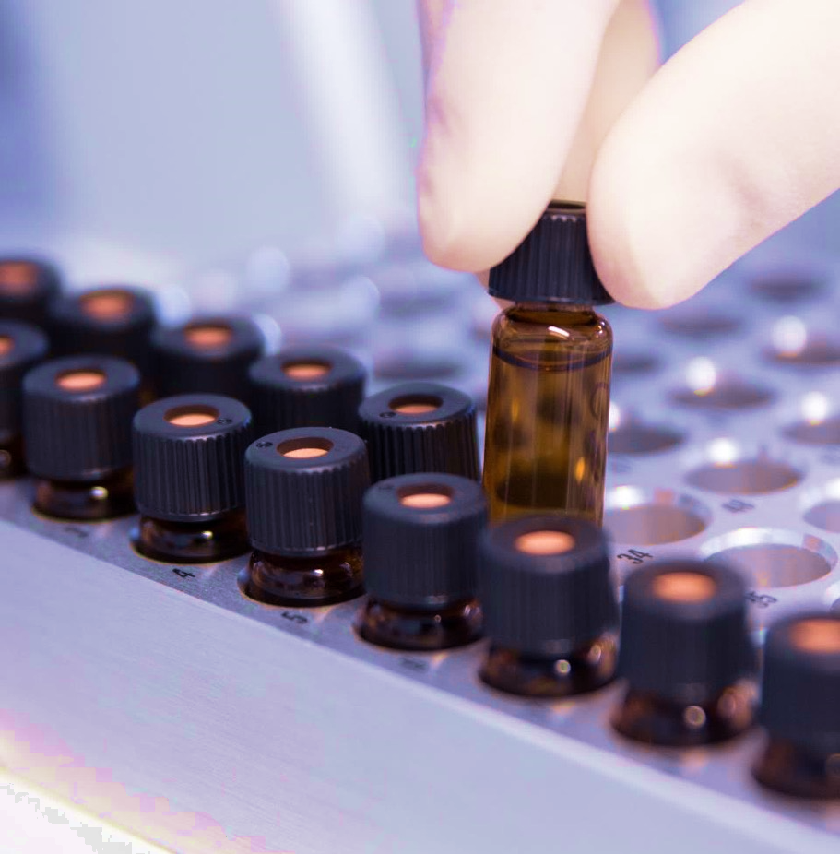
QUALITY CONTROL OVERVIEW
Raw material testing
In-process and release testing
Stability testing
Environmental monitoring
Cleaning validation
Trending

Slide 20
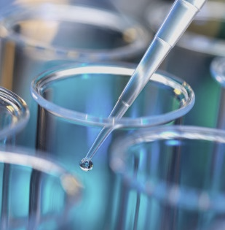
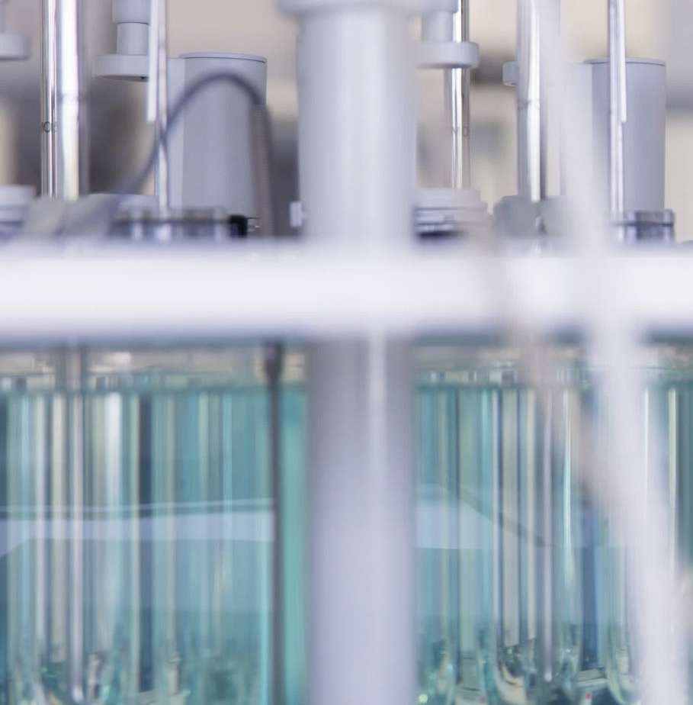
CHEMICAL / PHYSICAL
SDS-PAGE
Differential Scanning Calorimetry (DSC)
Dissolution
Dry weight
Collagen content
Viscosity
Packaging tests (burst test, pressure decay, seal strength, dye penetration)
Identity testing
Titration, limit testing, residual analysis

Slide 21
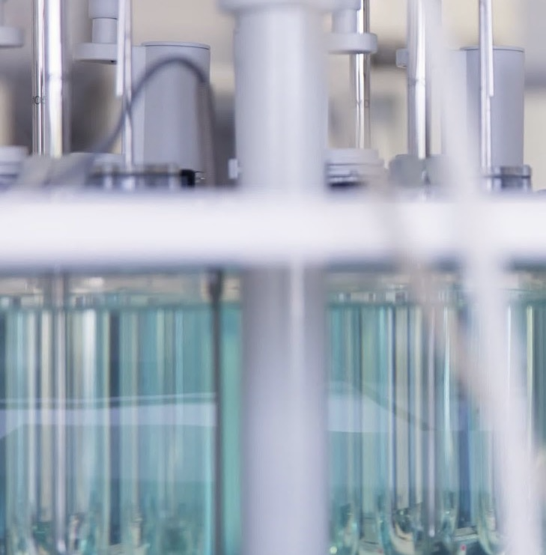
CHROMATOGRAPHY
GAS CHROMATOTOGRAPHY (GC)
Residual testing: EO, ECH, EGly
Impurities
Related substances
HIGH PERFORMANCE LIQUID CHROMATOTOGRAPHY (HPLC)
Impurities
Gentamicin sulfate content
Bupivacaine HCl content
Release testing

Slide 22
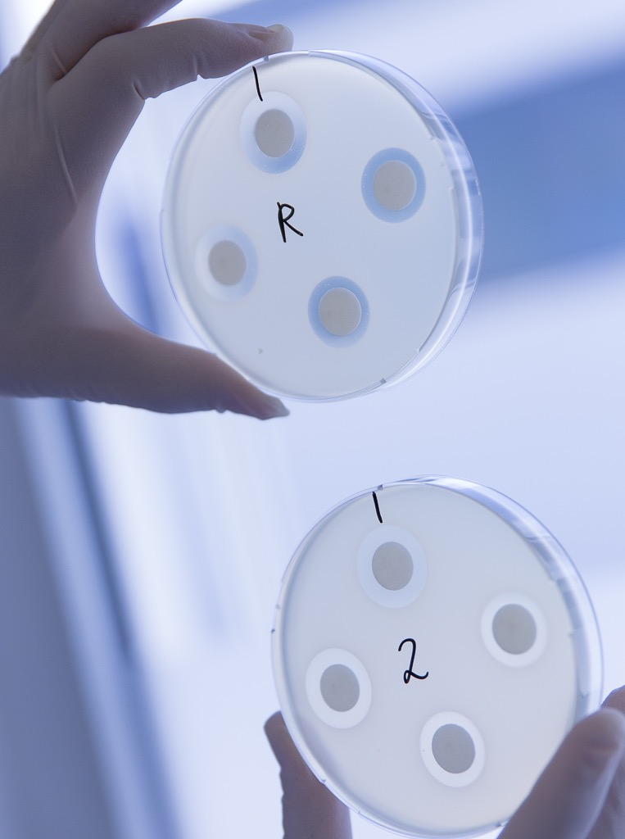
MICROBIOLOGICAL
Bioburden
Bacterial endotoxins
Bioassay
Plate count environmental monitoring

Slide 23
TEXTURE / MECHANICAL
Resistance to pressure
Bending
Tensile strength
Dimensions

Slide 24
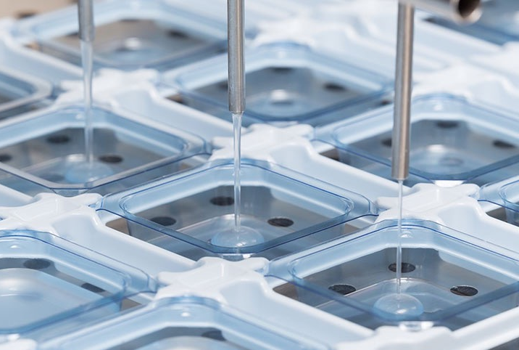
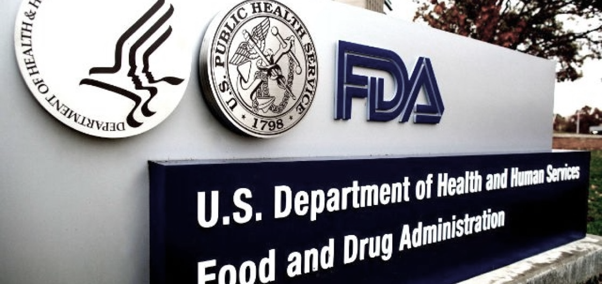
SERVICE ADDITIONS
Tech transfers of methods and processes
Development of validation plans and execution, summary of validation activities in validation reports
Support of regulatory filings

Slide 25
R&D CAPABILITIES
Experienced R&D team for collagen development including incorporation of new APIs into different formulations
Development of different forms of collagen
Formulation and method development with direct tech transfer into GMP production and laboratory

Slide 26
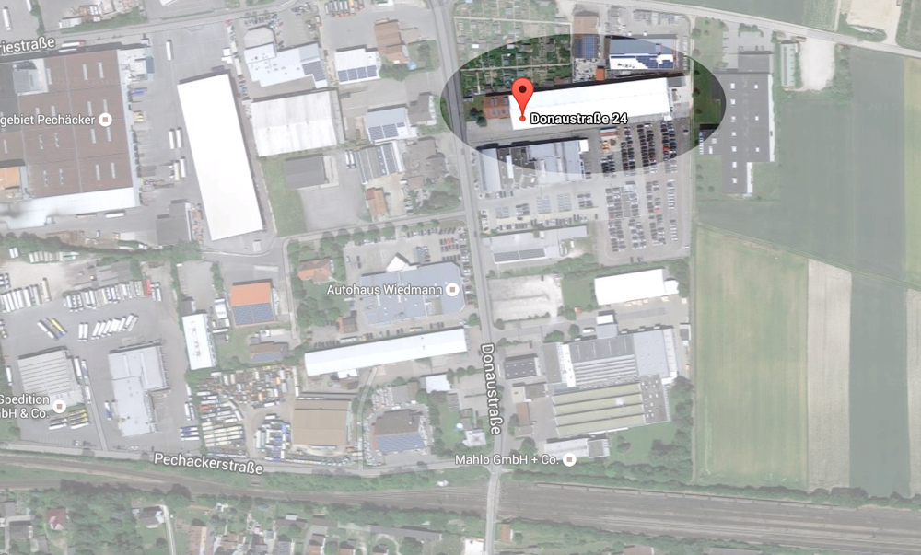
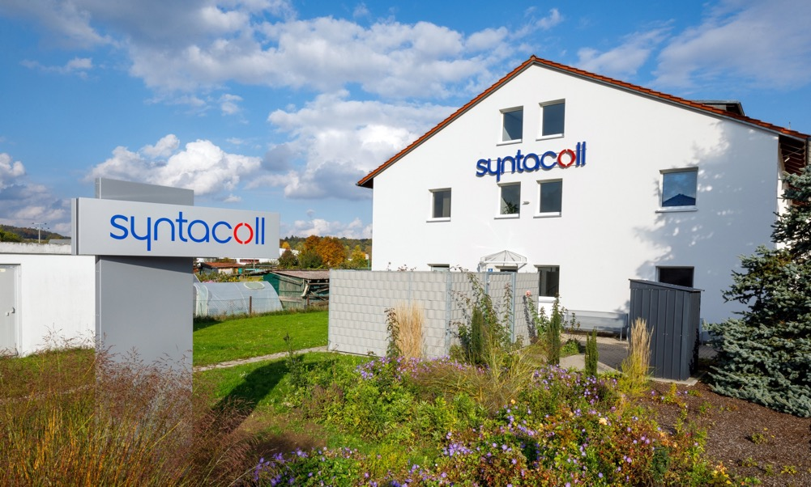
THANK YOU

