Slide 1
TECHNOLOGY
FOR HEALTH
PHARMACEUTICAL
DEVELOPMENT

Slide 2
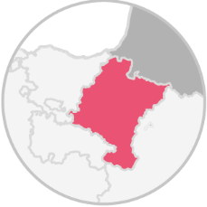
WHO WE ARE
Geiserpharma is a pharmaceutical company founded in 2008 in Navarra, Spain.
We are specialized in the development of value-added products within the main pharmaceutical areas, implementing advanced technologies and innovative pharmaceutical forms.
· NICHE GENERIC RX PRODUCTS
· HEALTHCARE OTC PRODUCTS
· CE MARKED MEDICAL DEVICES

Slide 3
OUR BUSINESSES
Geiser Pharma is part of the Qube Group
Specialised in contract development, licensing-out, registration and supply of value added products globally.
Specialized in development, manufacturing and packaging of pharmaceutical lozenges.
Specialized in research and development of high-tech pharmaceutical products for the treatment of breakthrough pain.
Specialized in research and development of niche generics.

Slide 4
OUR STRENGTHS
1
3
EXPERTISE RA/R&D
(UNIQUE KNOWLEDGE)
FASTNESS/
EFECTIVENESS
A company focused in the development and regulatory affairs activity with expertise of developing and registering value added products in 61 countries.
Geiser Pharma flat structure is more effective in completing tasks and projects faster.
2
4
HIGH ADAPTABILITY
CUSTOMER EXPERIENCE
A broad network and solid relationships with CMOs able to manufacture multiple pharmaceutical forms.
A team focused on the needs of the customer that provide support and assistance to customers before, during, and after a purchase or transaction.
Notes:
Revisar y redactar

Slide 5
Oral sprays
CMOs Network
Lozenges
Oral powder in sachet
Chewing gums & gummies
Gel
Syrups & Mouthwash
Coated Tablets
Oral solution in sachet
Effervescent tablets

Slide 6
WHAT DO WE OFFER?
LICENSING-OUT
OUR PORTFOLIO
WIDE RANGE OF DOSSIERS READY TO BE
SUBMITTED WORLDWIDE
CONTRACT RESEARCH
CO-DEVELOPMENT PROJECT
COMPLETE MANAGEMENT OF PHARMACEUTICAL DEVELOPMENT PROJECTS

Slide 7
WHAT DO WE OFFER?
LICENSING-OUT
OUR PORTFOLIO
WIDE RANGE OF DOSSIERS READY TO BE
SUBMITTED WORLDWIDE
Value added products selected by our Business Intelligence Team ready to be commercialised under your own private brand.
Solid Business Development Team with flexible partnership models.
Highest quality of EU-CTD dossiers registered in several countries.
Expertise of Regulatory Affairs team who adapt the Dossier to your specific requirements.
Timely and complete product delivery worldwide.

Slide 8
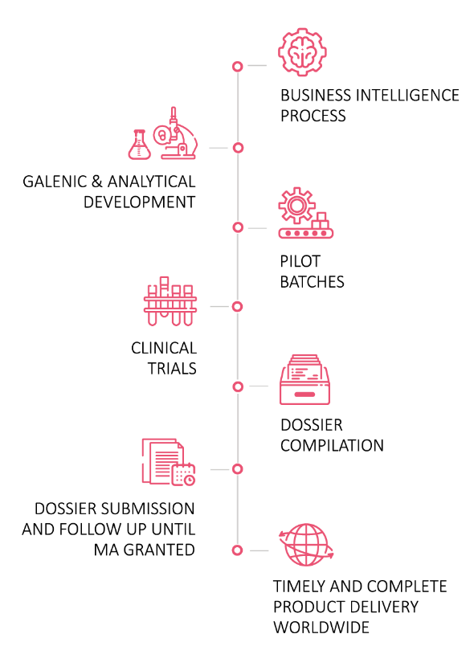
WHAT DO WE OFFER?
CONTRACT RESEARCH
CO-DEVELOPMENT PROJECT
COMPLETE MANAGEMENT OF PHARMACEUTICAL DEVELOPMENT PROJECTS

Slide 9
KEY THERAPEUTIC AREAS
OTC
MEDICAL DEVICES
RX
COUGH & COLD
MOTION SICKNESS
PAIN RELIEF
SLEEP DISORDERS
WOMAN HEALTHCARE
TOBACO CESSATION
DENTAL CARE
COUGH & COLD
MOSQUITO REPELLENT
·
INFECTIOUS DISEASES
ONCOLOGY
CENTRAL NERVIOUS SYSTEM (CNS)
ANTI-INFLAMMATORY

Slide 10
CORE CAPABILITES
BUSINESS
INTELIGENCE
SUPPLY
CHAIN
PHARMACEUTICAL
DEVELOPMENT
QUALITY
BUSINESS
DEVELOPMENT
CLINICAL
STUDIES
REGULATORY
AFFAIRS

Slide 11
KEY FIGURES
MARKETING AUTHORIZATIONS GRANTED
PRODUCTS CURRENTLY UNDER REGISTRATION
*Cumulative value
332
75
61
5
MARKETING AUTHORIZATIONS GRANTED
PRODUCTS CURRENTLY UNDER REGISTRATION
PRESENCE WORLDWIDE
AVERAGE NEW PRODUCTS DEVELOPMENTS INITIATED
Notes:
Mas en 2022: 332
Productos en registros: Pdte confirmer

Slide 12
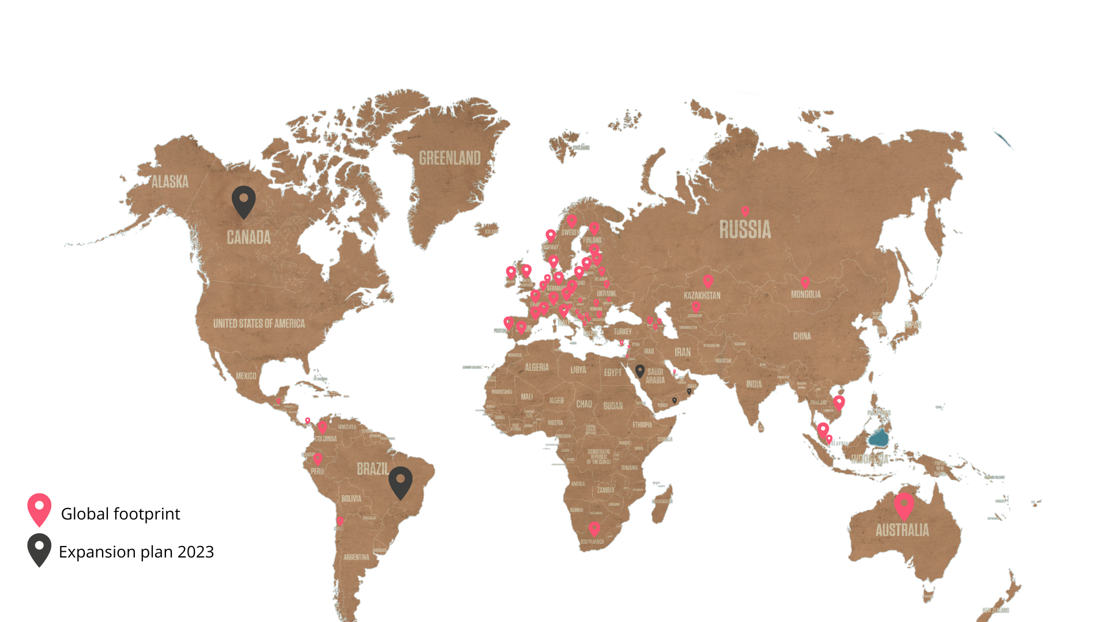
INTERNATIONAL PRESENCE
Notes:
PLAN EXPANSIÓN: MENA, BRASIL, CANADÁ
- IRENE CONSEGUIR MAPA DONDE ESTAMOS PRESENTES

Slide 13
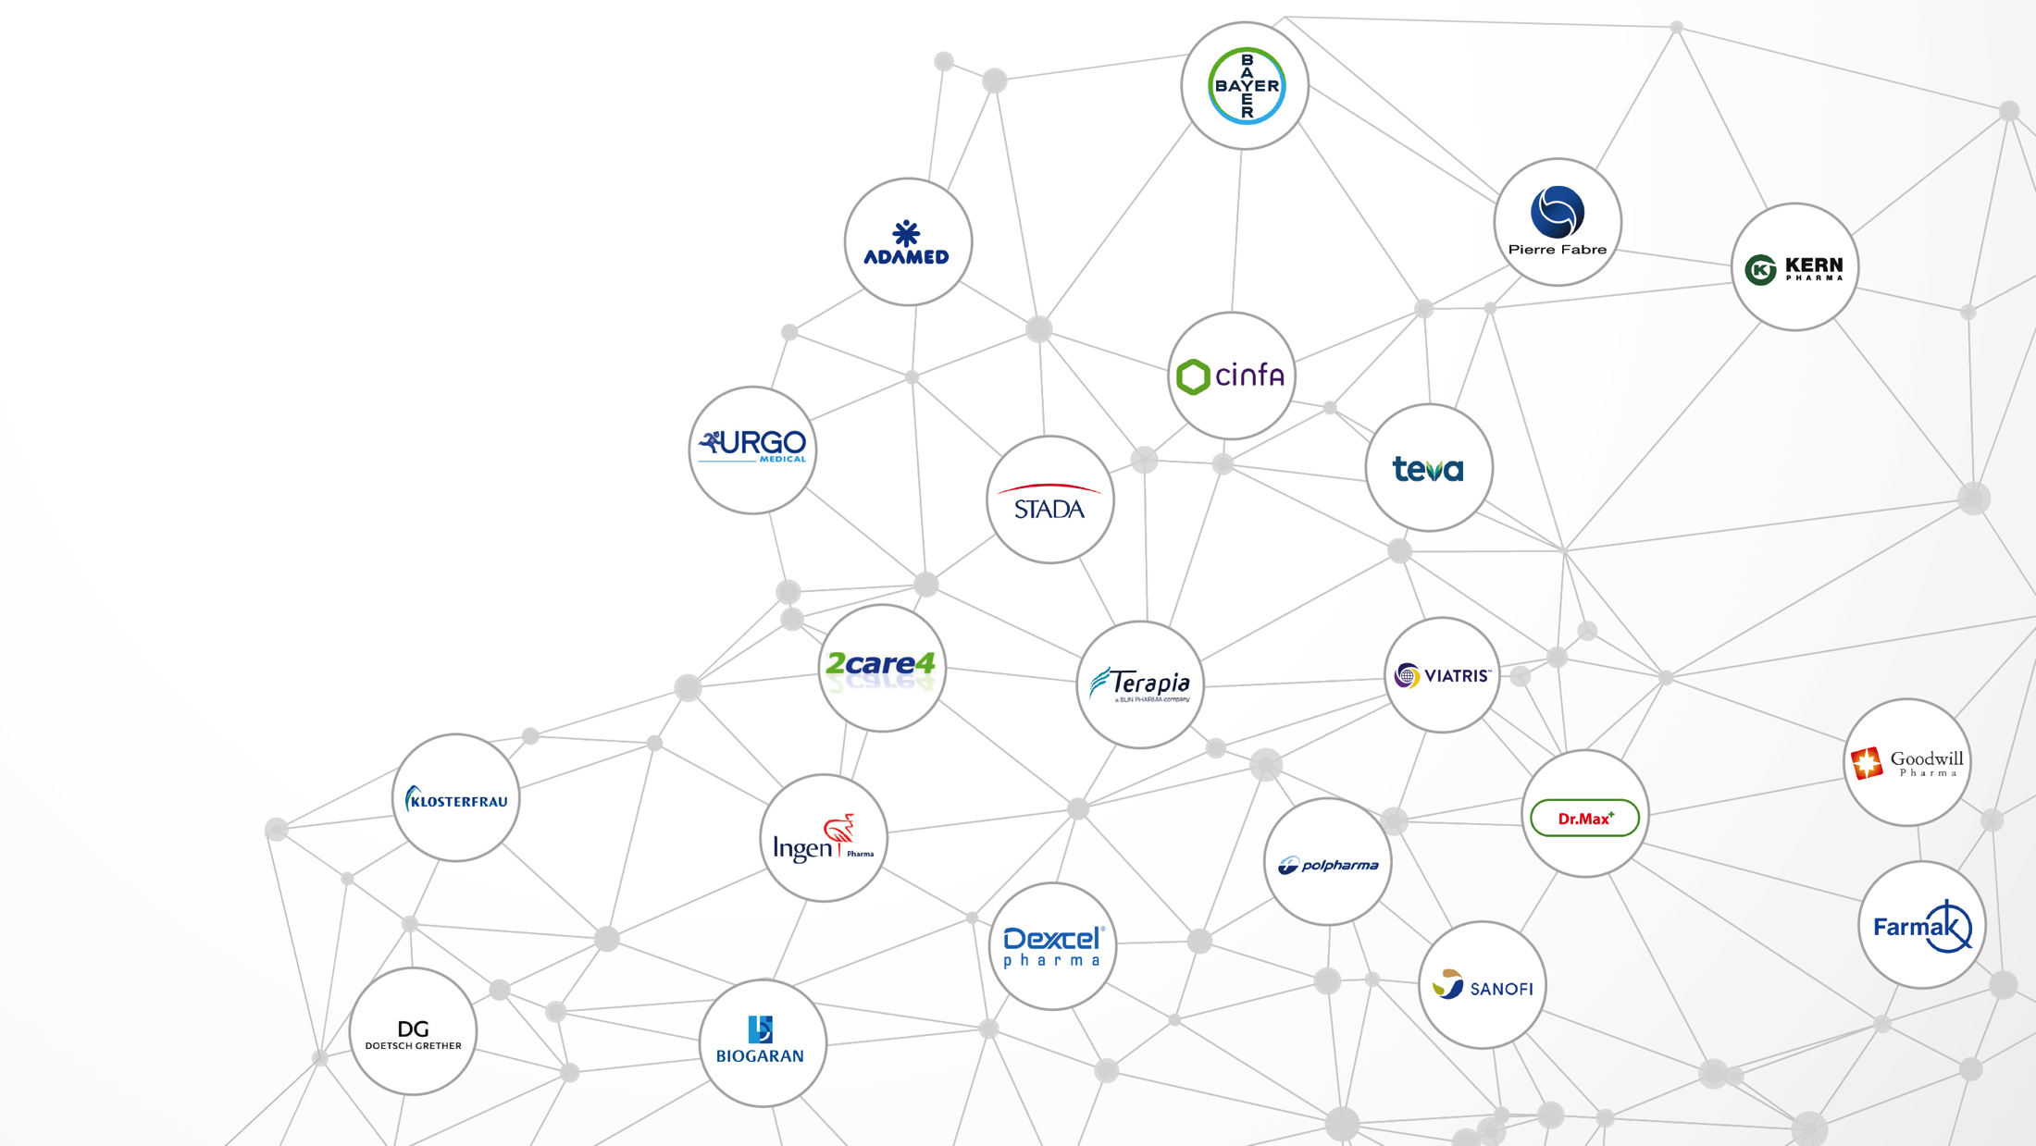
MAIN CLIENTS
MAIN PARTNERS
STRATEGIC AGREEMENTS
WITH RELIABLE PARTNERS

Slide 14
CUSTOMER SERVICE
We ensure that our customers are always treated in the best way.
YOUR SATISFACTION IS OUR PRIORITY!
A customer service manager assigned to you will support during all the process of business, regulatory and supply.
WHAT OUR CLIENTS SAY ABOUT US:
“
Geiser has unique position in the market for this kind of products, no competition in terms of pricing/quality/service.

Slide 15
CUSTOMER SERVICE
We ensure that our customers are always treated in the best way.
YOUR SATISFACTION IS OUR PRIORITY!
A customer service manager assigned to you will support during all the process of business, regulatory and supply.
WHAT OUR CLIENTS SAY ABOUT US:
“
We appreciate Geisers’ willingness to clarify all doubts and their service during all the process.
Geiser should not change their good communication and flexibility with us.

Slide 16
THANK YOU!
geiserpharma@geiserpharma.com | T. +34 948101943
www.geiserpharma.com |

