Slide 1
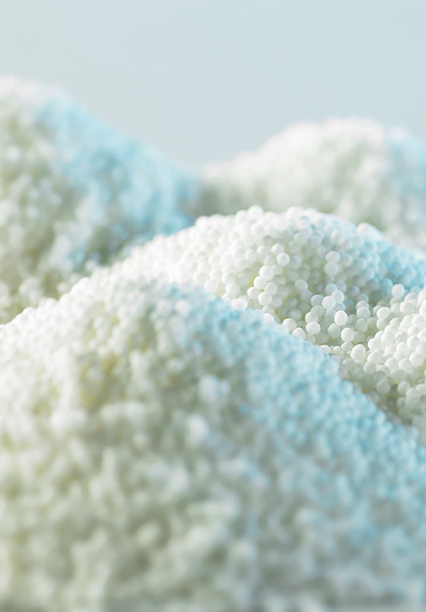

Manufacturer of Pharmaceutical Pellets
Al Wajer Pharmaceuticals

Slide 2
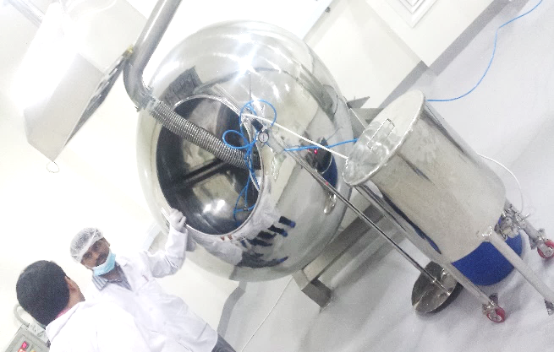

Al Wajer Pharma
Al Wajer Pharmaceuticals LLC is a professionally managed company, part of Pharmaceutical Group Company in Oman, involved in manufacturing and marketing of quality pharmaceuticals range of products (Pharmaceutical Pellets). The company has a state-of-the-art factory in Sohar Industrial Area in Oman.
Al Wajer Pharmaceuticals LLC have achieved GMP Ministry of Health 0f Oman certification. It is one of the fastest growing companies in Oman.
Vision
Every new venture is set up with a vision in mind, with a goal to continuously work towards. We at Al Wajer aim to achieve excellence in the manufacturing of quality drugs. We believe in working tirelessly to accomplish maximum customer satisfaction and making concerted efforts for the well being of each individual associated with us.
We look forward to fostering mutually beneficial relationships with all our customers and ensure profitable growth.
Mission
To develop and manufacture pharmaceutical pellets that comply with the highest regulatory standards.
To meet current and future customer needs through smart investments in R&D.
To deliver best-in-class service and superior value.
To enhance the communities in which we live and work.
To build shareholder value in all we do.
Certifications
Our commitment towards the manufacturing of exceptionally high quality products and the maintenance of sound R&D, QC & QA facilities.
GMP certified company.
ISO 9001 – 2008 certified company (under persuasion)

Slide 3
Products
Immediate release pellets
Sustained release pellets
Delayed release pellets
Sustained release tablets
Regular Pellet Products:
Omeprazole Pellets 7.5%, 8.5%, 9%, 10%, 12%, 15%, 20%, 22.5%
Esomeprazole 7.5%, 8.5%, 15%, 22.5%
Lansoprazole 8.5%, 11%, 12%, 15%, 20%
Dexilansoprazole 23%,
Itraconazole 22%, 22.5%
Tamsulosin 0.16%, 0.20%
Orlistat 50%
Pellets Products under development:
Ketoprofen; Duloxetine; Venlafaxine;; Tolteridone; Pentaprazole; Itopride;
Pellets Manufacturing Block
Liquid layering of pellets
Powder layering of pellets
Melt granulation pelletization
Wet granulation pelletization
Extrusion and spheronization
Quality Control Laboratory
Fully Equipped Quality Control Laboratory
Raw Materials
Drug Product
Re-assay
Retains

Slide 4
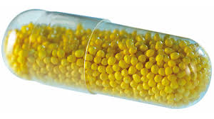

Processes and Services
Pelletization
Our pelletizing solutions include extrusion and spheronization, production by powder layering and liquid layering, and pelletization by melt and wet granulation.
Process and Product Development
Based on our strong commitment to process development, our experienced staff can assist with process development, optimization and transfer, and our state-of-the-art test and application centers can produce pharmaceutical dosage forms for clinical studies. Customers can also rent or hire equipment to perform in-house product development and process feasibility work.
Contract Manufacturing
Al Wajer undertakes contract manufacturing of pellets offering a competitive advantage to its clients. Al Wajer offers Contract manufacturing facilities for other pharma players for low cost manufacturing.
Turnkey Project Services
Al Wajer provides clients with solutions tailored to meet the unique requirements of their product and business and providing turnkey project services by collaborating with client on the design, construction, management and operation of a fully equipped GMP compliant manufacturing suite.
Al Wajer Pharmaceuticals
Sohar Industrial Area, Phase V
P.O. Box: 98, Postal Code: 327, Sultanate of Oman (سلطنة عمان).
Tel.: Mr. Maqbool (+968) 9715 0407
Ms. Maryam (+968) 9821 1404
Landline: (+968) 2237 2677
Email: marketing@alwajirpharma.com
md@alwajirpharma.com
URL: http://alwajirpharma.com
International Offices:
Egypt: Dr. Ahmed Khuzam (+201 012955637)
India: Mr. Reddy (+ 91 73309 26097)
الوجر الدوائية

