Slide 1


CORPORATE PROFILE
Presented By,
Dr. Bapu Gawade, M.Sc. Ph.D
(Founder & Managing Director)
Cleanchem Laboratories LLP
Corporate office and R&D
​Plot No. A-737/2, TTC Industrial Area, MIDC Khairane, Navi Mumbai, INDIA- 400710 Mob: +91 98921 69560
Email: bapugawade@cleanchemlab.com Website: www.cleanchemlab.com

Slide 2

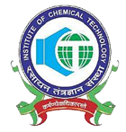

About Cleanchem
Cleanchem is registered on 11th May 2015 under Ministry of Commerce, Govt. Of India
Approved by DIPP, Govt. of India, (Recognition No: DIPP31605)
Deals in various Products & Services to Pharmaceutical, Agro, Biotech & allied industries
Independent Reliable Synthesis & Analytical R&D based CRO / CDMO
Pioneer in Developing Nitrosamine standards in India
Largest Inventory of Nitrosamines & NDSRI across the globe
**Accreditations & Recognition**
ICT Mumbai

Slide 3


Vision
Our motto is “To develop all the chemical products and processes environmental benign, high quality and cost effective”.
Our manufacturing processes are majorly based on catalysis, which are ‘CLEAN’ and ‘GREEN’ taking an account on environment concern and global warming.
To deliver the best output that remains unquestionable. We are focus on rapid response in both the quotes and the delivery of the product to the customers.
Mission
We strive to provide a cost-effective and time-bound research solutions in the area of custom synthesis.
Cleanchem is committed for quality research products & services delivery to comply projects needs in timely.

Slide 4
Quality Policy
As a part of Cleanchem’s commitment to Quality:
Cleanchem’s business is conducted in compliance with applicable quality regulations, codes and standards.
All Colleagues and Contingent Workers have the appropriate education, training, skills and experience to carry out their work competently, in accordance with applicable regulations and Cleanchem policies and procedures;
Records, documentation and data are managed in accordance with applicable regulations. Processes for escalating issues to ensure product integrity and patient and consumer safety are in place and consistently used.
Cleanchem’s Quality Policy is implemented through a comprehensive Quality Management System. Our performance is monitored and regularly reviewed to ensure our standards of conduct meet our high expectations of quality for our patients, customers, and stakeholders.

Slide 5

Cleanchem at Glance
10 Yrs dedicated service to Pharma, Chemical & Allied Industries
Global Presence 35+ Countries
State of Art World Class R&D Infrastructure of 15,000 Sq. Ft area
Custom Synthesis of Reference Standards, Impurities, Metabolites, Drug Discovery
Services Isotope Labelled compound, API Intermediates, KSM
Team of 100+ Scientists including Ph.D’s & Post Graduates

Slide 6
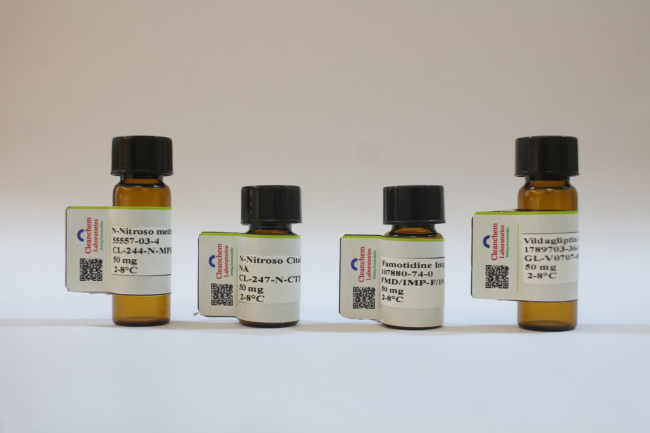


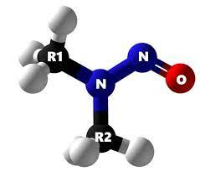

Intellectual Properties
Total research Articles published
Patents - 18
Research Papers/Articles - 10
Technology ready for 500+ Nitrosamines and NDSRI’s.
Technology ready for 4000+ Impurities and other products.
Trained team of 100+ Scientists including Ph.D.'s & Post Graduates.
4000+
Impurities Ready stock
500+
Nitrosamines
Ready Stock
500+
Clients Worldwide
100%
Quick Delivery
Product Specific Packaging

Slide 7

Our Team
Dr. Bapu Gawade (Managing Director)
M.Sc. Ph.D - Chemistry (ICT / UDCT Mumbai) Research Experience: 18 years
Mr. Nitin Bondre (Operational Director)
M.Sc. Organic Chemistry (Pune University), Pursuing Ph.D Research Experience: 18 years
Dr. Anil Gawade (R&D Director)
M.Sc. Ph.D - Chemistry (ICT / UDCT Mumbai) Research Experience: 14 years
Technical Strength with Qualification (Total: 100+)
  PhD: 06
  M.Sc / M.Pharm: 90+

Slide 8

Organogram
Dr. Bapu Gawade
(Founder & Managing Director)
Mr. Nitin Bondre
(Operations Director)
Dr. Bapu Gawade
(Managing Director)
Dr. Anil Gawade
(R&D Director)
Project Management
ARD
CRD
Safety
Finance
Sales & Business Development
Administrative Head
Administration
Stores & Material Management
Accounts
Quality Assurance
Purchase & Supply Chain Management
Maintenance

Slide 9


Dr. Bapu Gawade (Managing Director)
Experience:
Research Exp.- 18 Yrs.
Ph.D Chemistry: 2015, Institute of Chemical Technology, ICT (Formerly UDCT) Mumbai
M.Sc. Organic Chemistry: 2007, Ahmednagar College, Ahmednagar, Pune University
Visiting Researcher, University of Saskatchewan, Saskatoon, Canada , 2012-2013
Awards, Recognition & Professional Expertise:
Junior Research Fellow, CSIR-NMITLI, 2009
Special Meritorious Fellow, UGC (Green Technology Programme), 2010
Commonwealth Fellow, Govt. of Canada under INDO-CANADA Research and Cultural Exchange Programme,2012
“Healthcare leadership Award”, ABP News 2018
“100 Most Impactful Healthcare Leaders Award”, World Health & Wellness Congress, 2019
“Young Achiever Award” by UDCT Alumni Association, 2019
Contact Details: Email: bapugawade@cleanchemlab.com Mobile: +91-98921 69560

Slide 10
Mr. Nitin Bondre (Director - Operations)
Experience:
Research Exp.- 18 Yrs.
Ph.D. Chemistry: Pursuing Institute of Chemical Technology, ICT (Formerly UDCT) Mumbai
M.Sc. Organic Chemistry: 2007, Ahmednagar College, Ahmednagar, Pune University
Patents & Professional Expertise:
A process for the preparation of Avanafil and its novel intermediates (W02015177807A1)
Filed patent of preparation Apremilast impurities (Application ID 201621013195)
Stability-indicating related substances method of Apremilast by HPLC and synthesis and characterization of related impurities using Mass and NMR spectroscopy
(International Journal of Current Medical and Pharmaceutical Research February 28, 2017)
Synthesis, Characterization, Identification and Quantification of Sertraline HCL Related Impurities
(European journal of pharmaceutical and medical research October 14, 2016)
Contact Details: Email: nitinbondre@cleanchemlab.com Mobile: +91-98921 69512

Slide 11
Dr. Anil Gawade (Director - R&D)
Experience:
Research Exp.- 14 Yrs.
Ph.D. Chemistry: 2016, Institute of Chemical Technology, ICT (Formerly UDCT) Mumbai
M.Sc. Organic Chemistry: 2011, Ahmednagar College, Ahmednagar, Pune University
Awards, Recognition & Professional Expertise:
Special Meritorious Fellow, UGC (Green Technology Programme), 2012
Worked as a R&D Manager in Dharamsi Morarji Chemical Company (2017-2019)
Worked as a Research Scientist in Resonance Specialities Ltd. (2016-2017)
Worked as a Research Chemist in Ranbaxy Pharmaceuticals Ltd. (2011-2012)
Published 5 research papers in international peer-reviewed journals and granted 3 Indian patents
Contact Details: Email: anilgawade@cleanchemlab.com Mobile: +91-9702598044

Slide 12
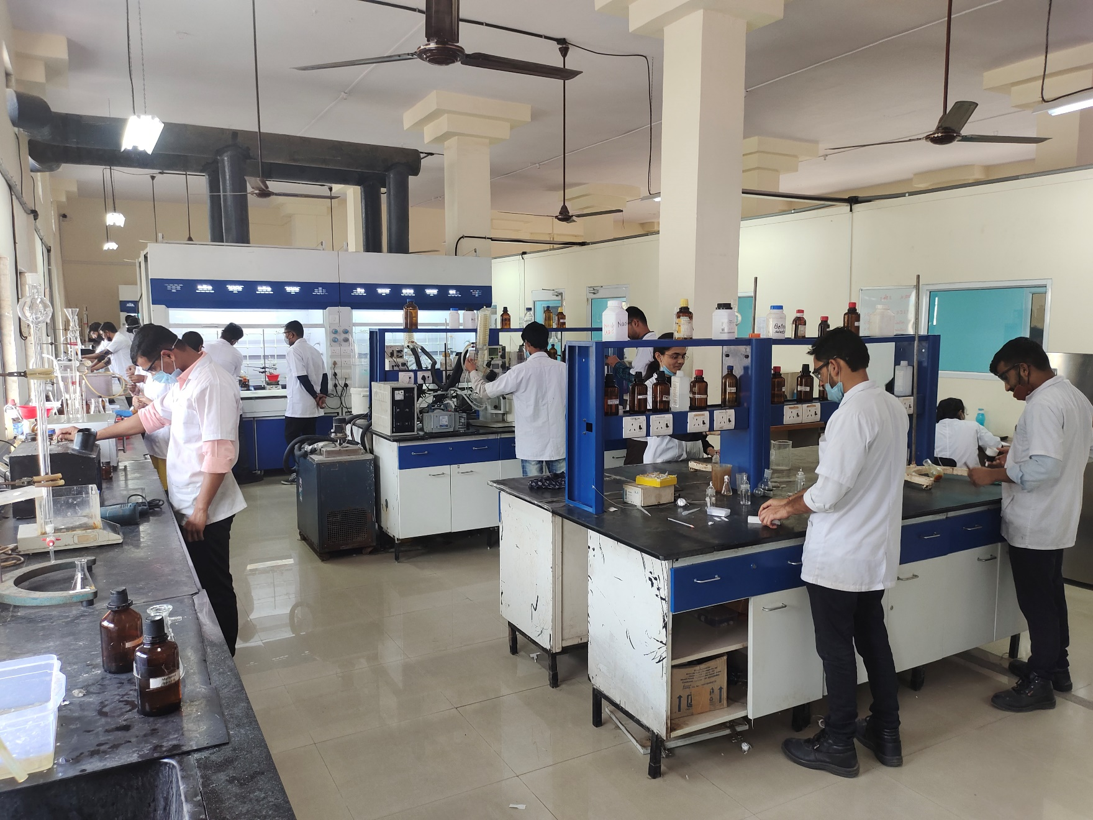
R&D Capabilities - Chemical Synthesis
Reaction Scale: Mg to Kg
Reaction Temp Range -80 to 200 °C
Laboratory Fume Hood (16)
Rotary Evaporator (1L to 20L)
Fix Glass Reactors (25L to 50L)
High Pressure & Gas Phase Reaction
Microwave Reactions
Pyrophoric & Moisture Sensitive Rxns
Flow Chemistry

Slide 13
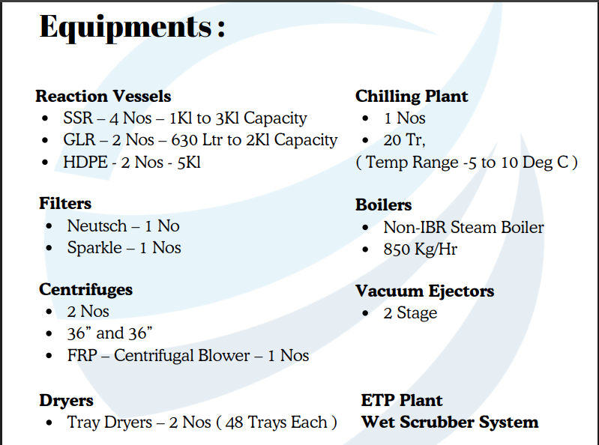
Manufacturing Capabilities

Slide 14
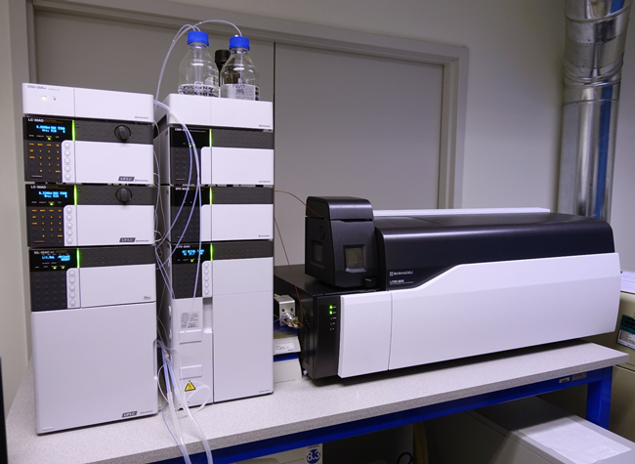
Analytical Instrumentation Facility
HPLC with UV & PDA Detector (10)
Gas Chromatography (01)
LCMS-MS -Triple Quadruple (03)
Karl Fischer Titrator
Titrimetric Analysis
Volumetric analysis
Gravimetric Analysis

Slide 15

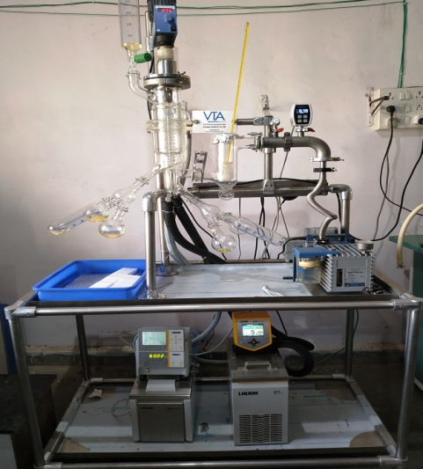
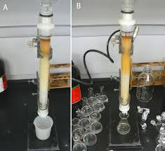
Advance Purifications / Bio-processing
Chromatographic Purification with Silica & Resin
Preparative HPLC Purification
Flash Chromatography
Lyophilization Facility
Short Path Distillation / Thin Film Evaporation
Steam Distillation
High Vacuum Distillation
Unknown Impurity Identification

Slide 16

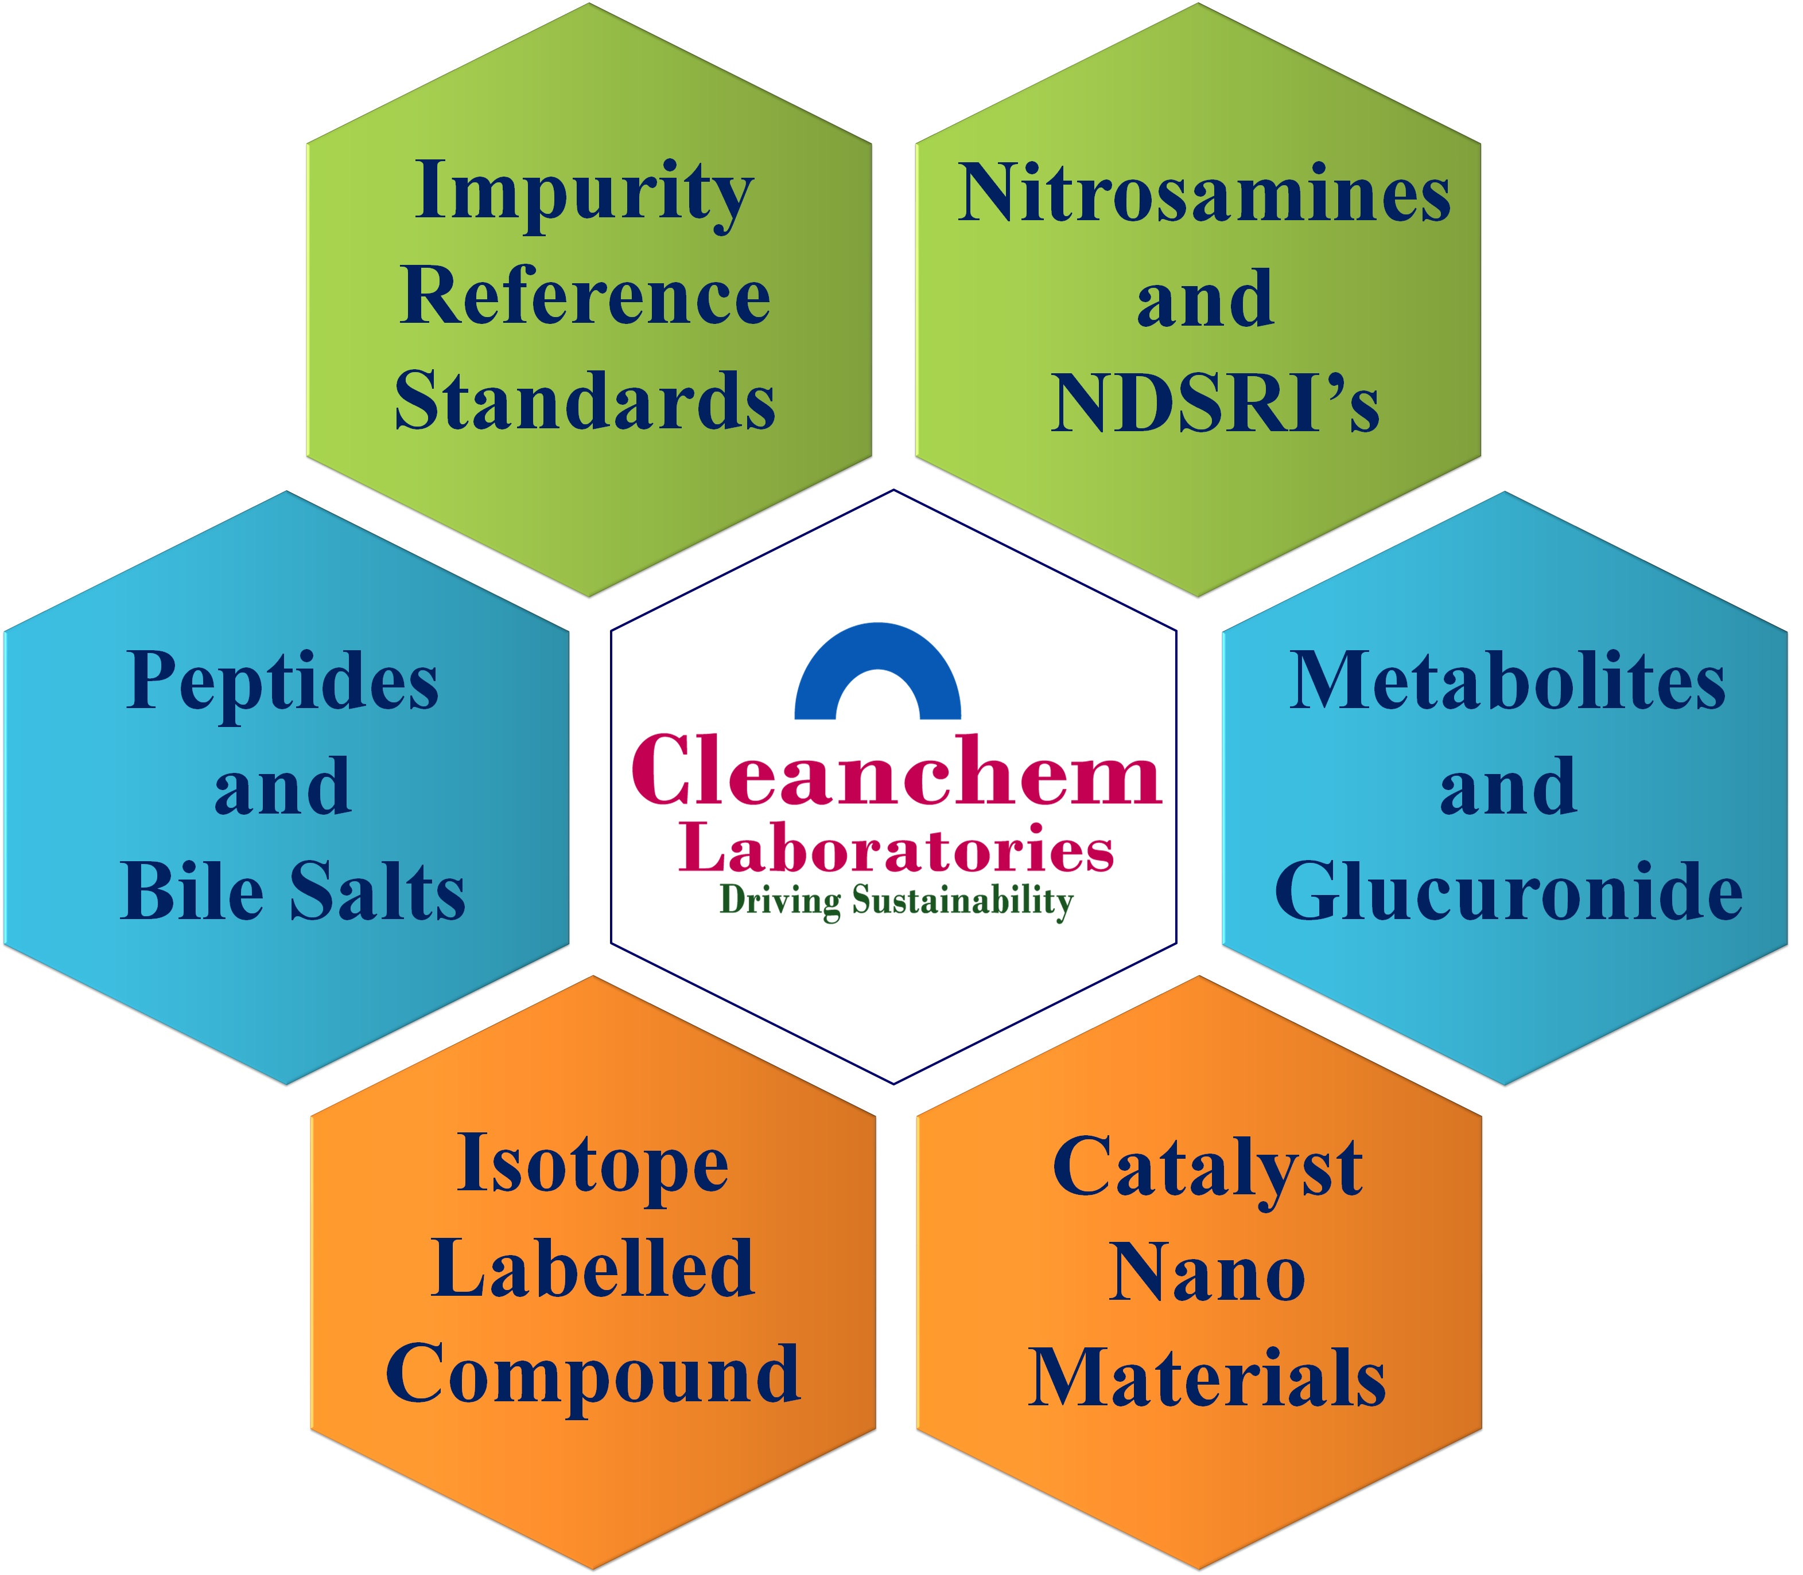
Our Products
API, Intermediates & KSM
Impurity Reference Standards
Working standards
Nitrosamines & NDSRI’s
Metabolites & Glucuronides
Genotoxic Standards
Isotope Labelled Standards
Peptides & Bile Salts
Catalysts & Nano Materials

Slide 17

Services Offered
Custom Synthesis Services (CRO/ CDMO)
Drug Discovery Support
KSM Synthesis
FTE & FFS based R&D Services
Short Path Distillation (SPDU) & Thin Film Evaporation
High Pressure Reactions on Autoclave (R&D Scale)
Advance Purification Services
Unknown Impurities Identification

Slide 18
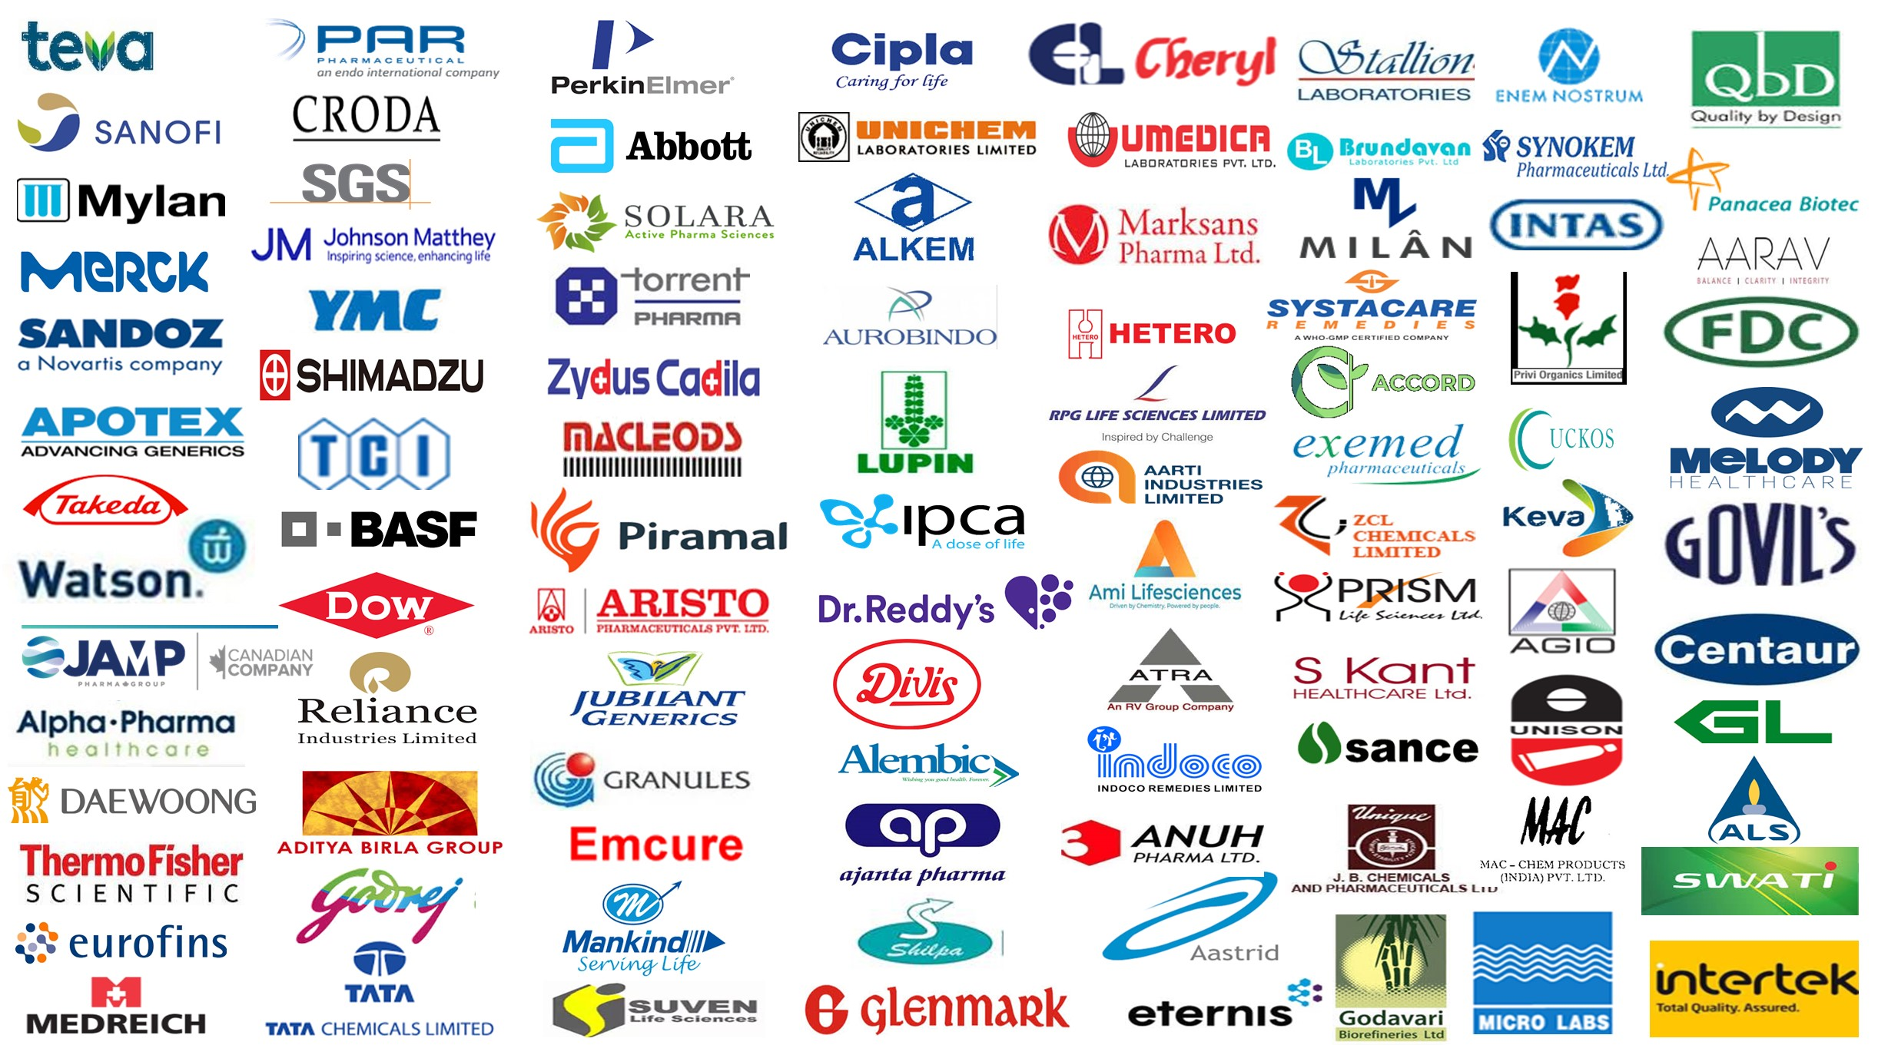
Our Esteemed Clients

Slide 19














































International Clients

Slide 20

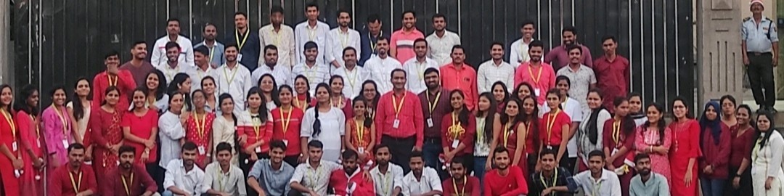
Thank You

