Slide 1

Welcome
To
SHAKTI BIOSCIENCE LIMITED

Slide 2
Shakti Bioscience Limited
DIRECTORS
Mr. Sadashiv K. Shetty – Company Promoter
Mrs. Sujata Shetty – Director
Ms. Shreya Shetty – Director

Slide 3
Shakti Bioscience Limited
Shakti Bioscience Limited was established in the year 2006 for manufacturing of Pharmaceutical Intermediates, APIs and some special chemicals at Vapi GIDC, Gujarat (India).
The facility has infrastructure distributed in three blocks, Block-1 and Block-2 while Block-3 is powder processing clean area. We have a strong orientation towards Quality Control & Quality Assurance.

Slide 4
Shakti Bioscience Limited
Site details
Particulars | Details
Year of Establishment | 2006
Area | 3901 Sq. M.
Nearest City | Valsad (18 KM)
Nearest Town | Vapi ( 4 KM )
Nearest Highway | NH18
Nearest Railway station | Vapi (4 KM )
Nearest Airport/ Airbase
Domestic Airport - Surat | Rail- 93 KM, Road- 105 KM
International Airport - Mumbai | 160 KM
Height from sea level | 27 Meter

Slide 5
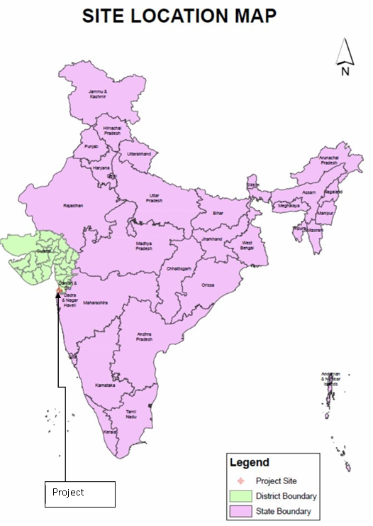
Shakti Bioscience Limited
Site details

Slide 6
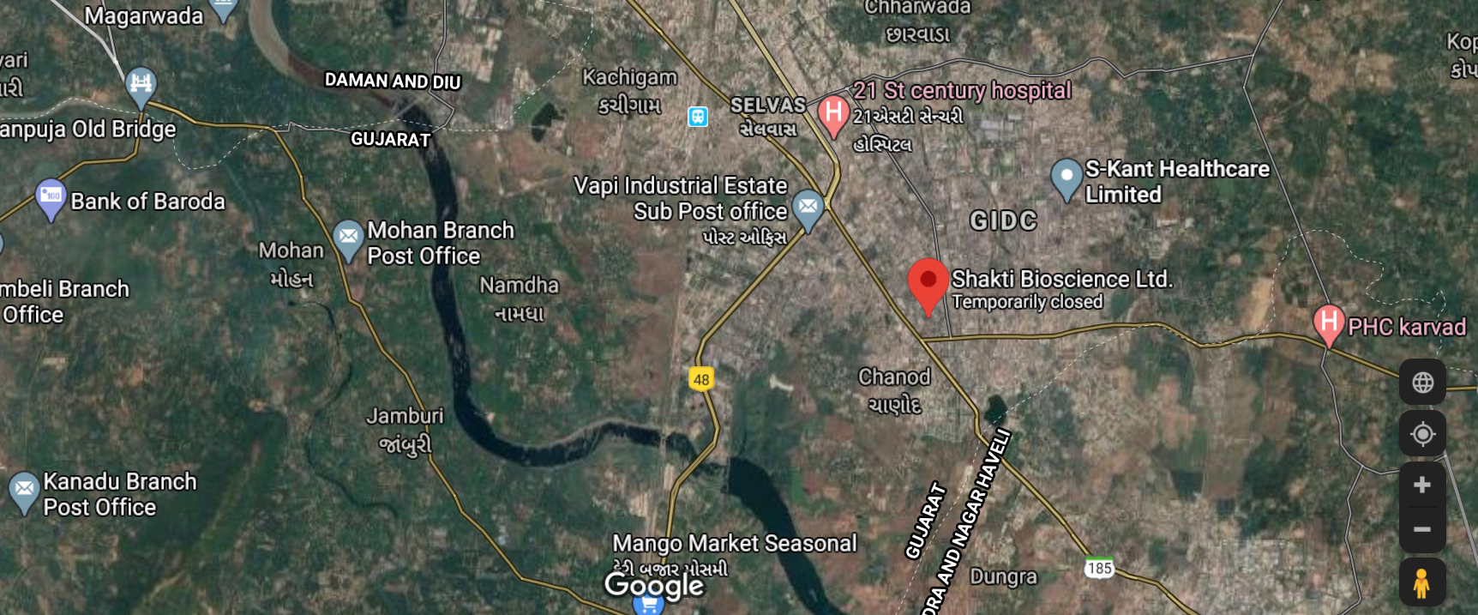
Shakti Bioscience Limited
LOCATION MAP

Slide 7
Shakti Bioscience Limited
QUALITY POLICY
We at “Shakti Bioscience ltd.” shall aim to achieve and sustain excellence in all our activities.
We are committed to total Customer satisfaction and continual improvement by providing quality products and services, which meet customer expectations at all times.
A motivated work with a sense of pride in the organization shall lead us to wards beating the best in harmony with the environment & safety.
Quality Objective
We at “Shakti Bioscience ltd.” Have identified following objectives in pursuit of our Quality Policy.
To achieve customer satisfaction level of at least 90%.
We shall provide 48 hours training during year to all ours employee for improving skill & productivity in all our activity.
Reduce break down hours by at least 10% compared to last years.

Slide 8
Shakti Bioscience Limited
Environment, Health & Safety Policy
Complying with all applicable EHS laws, regulation, standard and procedures of the respective clients and apply more standard and procedures where it is considered to do so.
Incorporating appropriate EHS criteria in to business decision.
Providing a safe and healthy work place for all it’s employees including sub contractor’s employees through operational procedures safe systems and method of work.
Identifying and eliminating / controlling hazards and pollution that could cause accident, illness or environmental harm.
Ensuring suppliers & Subcontractors to follow the company’s EHS rules, procedures and safe practices.
Providing training to all employees to maintain EHS system.
Ensuring appropriate and adequate resources are available to fully implement the EHS policy.
Undertaking reviews to ensure continual improvement in EHS performance.
Working safely and in an environmentally appropriate manner are conditions of employment.

Slide 9
Shakti Bioscience Limited
Manpower details
Department | No. of Employees
Production | 22
Project | 1
Utilities & engineering | 10
Quality assurance | 3
Quality control | 6
R&D | 2
EHS | 1

Slide 10
Shakti Bioscience Limited
Organogram
Chairman & Managing Director
Director Commercial
Plant Head
Director Supply-chain
Manager Account & Finance
Manager Commercial
Manager HR
Manager Marketing & BD
Manager Procurement - SCM
Assistant
Assistant
Assistant
Assistant
Assistant
Manager Stores
Manager Production
Manager R&D, QA & QC
Manager Maintenance
Assistant
Chemist
Chemist
Electrical & Mechanical Officer
Operator

Slide 11
Shakti Bioscience Limited
OUR STRENGTHS
Strong presence and consistency in manufacturing of our products since 2006.
Well equipped modern, excellent & multipurpose facilities meeting GMP standard.
Independent Quality control & Quality Assurance Department.
We have dedicated manufacturing facilities in two blocks and one clean area. We have a strong orientation towards Quality Control & Quality Assurance.

Slide 12
Shakti Bioscience Limited
Approvals
GOOD MANUFACTURING PRACTICES
DRUGS [API] MANUFACTURING
FDCA Gujarat.
ISO 9001-2015

Slide 13
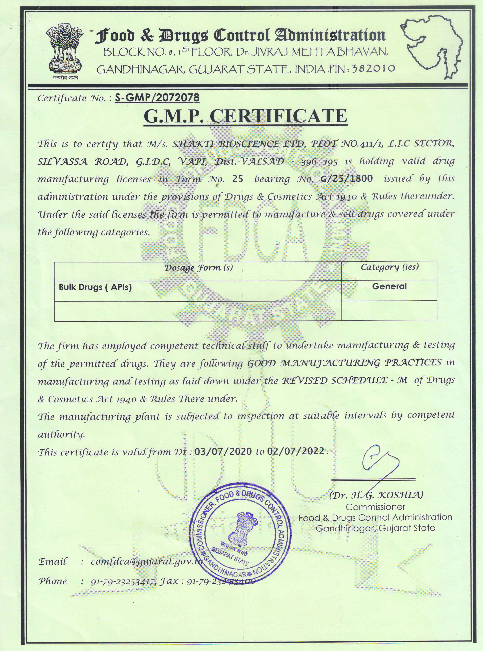
Shakti Bioscience Limited

Slide 14
Shakti Bioscience Limited
FACILITY AUDITED BY
Gufic Bio
Cadila Healthcare Limited
Dishman Pharmaceutical Ltd
Aarti Drugs Limited
Sterling Biotech
Allchem Laboratories
Arch Pharmalabs Limited
IPCA Laboratories Ltd
Sagar Lifescience Pvt. Ltd
Elixir Pharma
Medilux Laboratories Pvt. Ltd
Megafine Limited

Slide 15
Shakti Bioscience Limited
PRODUCT LIST
Name of API | Grade | Therapeutic Use
Lidocaine HCl | BP/IP/USP | Anaesthetic
Lidocaine | EP/BP/IP/USP | Anaesthetic
Meloxicam | IP/BP/USP | Anti-inflammatory
Piroxicam | IP/BP/USP | Anti-inflammatory
Mefenamic Acid | IP/BP/USP | Anti-inflammatory
L phenylephrine HCl | EP/IP/BP/USP | Alpha- Adrenoceptor Agonist
Amlodipine Besilate | BP/IP | Calcium Channel blocker
Granisetron HCl | BP/USP | Prevent nausea and vomiting caused by cancer chemotherapy and radiation

Slide 16
Shakti Bioscience Limited
Intermediate
Metachloropropiophenone | In- House | Pharma Intermediate for Bupropion
List of Special Chemicals
Denatonium Benzoate | USP-NF/In-house | For veterinary Use, used as Bitterant
PRODUCT UNDER PIPELINE
Name of API | Grade | Therapeutic Use
Albendazole | IP/BP/USP | Anthelmintic
Articaine HCl | BP/USP | Local Anaesthetic
Bupivacaine HCl | IP/BP/USP | Local Anaesthetic
Prilocaine | IP/USP | Local Anaesthetic
Prilocaine HCl | BP/USP | Local Anaesthetic
Pantoprazole Sodium | BP/USP | Proton pump inhibitor
Venlafaxine HCl | BP/USP | Antidepressant

Slide 17
Shakti Bioscience Limited
Our Infrastructure is equipped to carry out the following reactions
Acetylation | Acylation | Alkylation
Bromination | Chlorination | Chloro -Sulphonation
Condensation | Cynation | Cyclisation
Diazotization | Esterification | Friedel Craft
Hydrolysis | Hydroxylation | Methylation
Oxidation | Reduction | Sulphonation
Cryogenic | Grignard

Slide 18
Shakti Bioscience Limited
Plant Equipment
Type | Capacity | Quantity | Total Volume
S.S. 316 Reactor | 0.6 KL to 10KL | 12 Nos. | 60 KL
Glass Lined Reactor | 100 Litre to 6.3 KL | 14 Nos. | 70 KL
Nutsche Filter | S.S. - 300 Kgs & P.P. – 800 kgs | 02 Nos.
S. S. 316 Centrifuge | 36 ,48 & 60 Inch Dia | 07 Nos.
Agitated Nutsche Filter Dryer | S.S.- 3 KL | 1 No.
Agitated Nutsche Filter | S.S.- 2 KL | 1 No.
Tray Dryer | 196 Trays –SS | 01 No.
Multi mill | 200 Kg/Hrs | 01 No.
Blender | 500 litre | 01 No.
Sifter | 100 kgs / hour | 01 No.
FBD | 300 kgs – 02 Nos. & 120 Kgs-1No. | 03 No.
Rot cone Vacuum Dryer | 2.5 Kl | 02 No.
Vacuum Tray Dryer | 96 Trays –SS | 01 No.

Slide 19
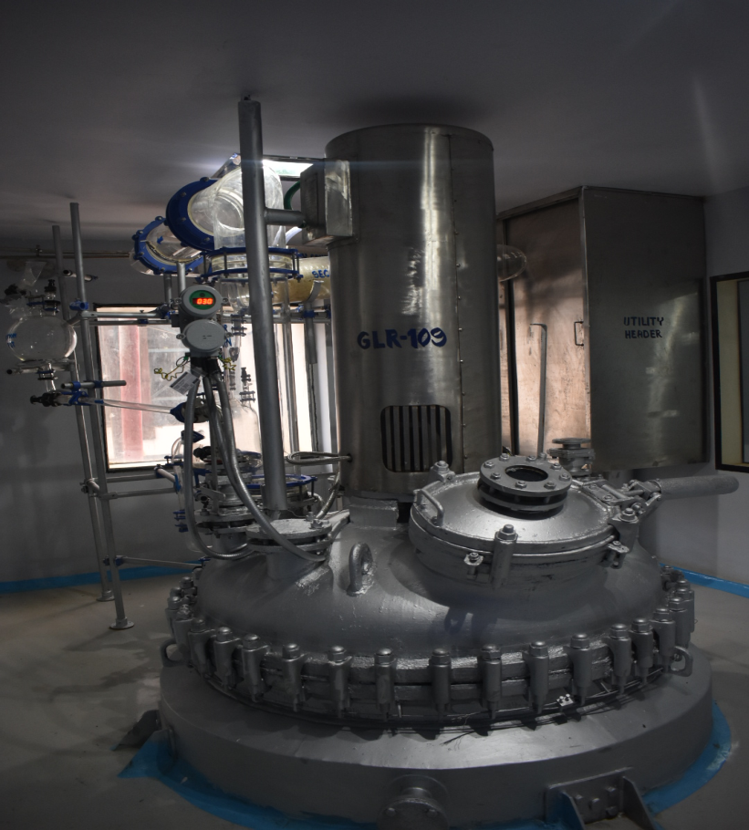
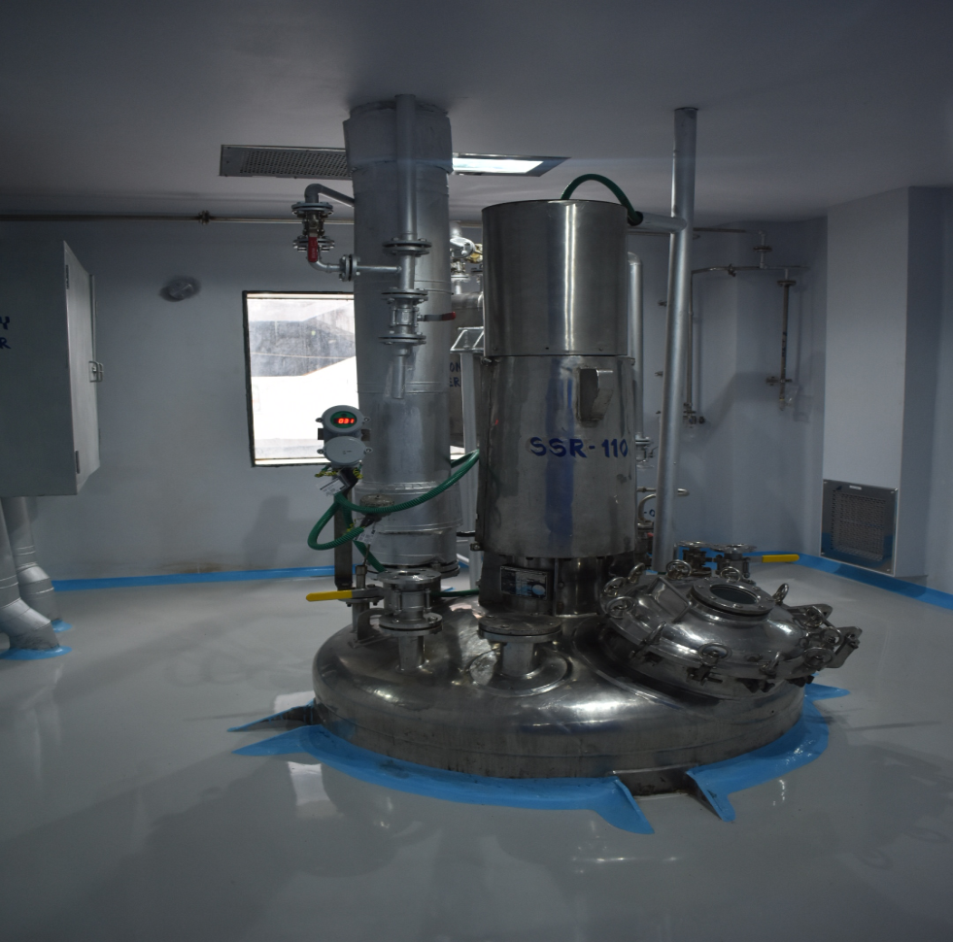
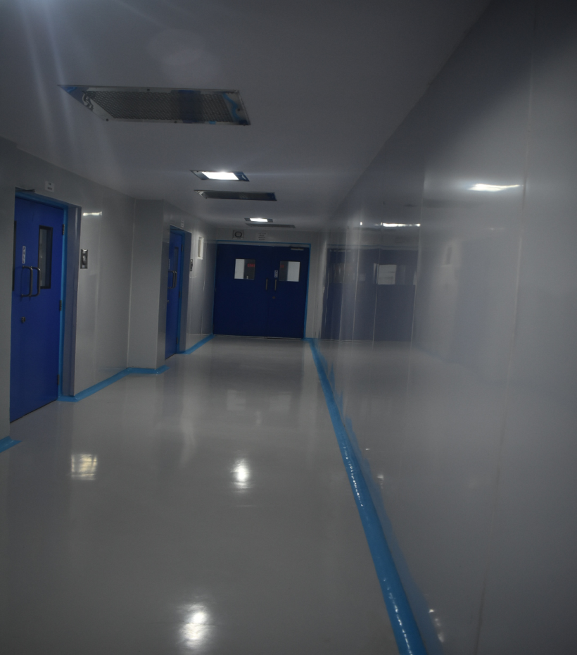
Shakti Bioscience Limited
TOTAL VOLUME IN TERMS OF REACTOR CAPACITY :- 130 KL TOTAL VOLUME IN TERMS OF MATERIAL OUTPUT :- 50 MT/MONTH We have 2 No. of Clean Room facilities having SS & GL reactor, Centrifuge, Vacuum tray dryer, Fluid Bed Dryer, Multi mill & Shifter. Separate Bounded Storage Area for finished good. Some Pictures of Clean Room:-

Slide 20
Shakti Bioscience Limited
QC Instrument List
Instrument Name | Quantity | Instrument Name | Quantity
HPLC ( Shimadzu make) | 01 No. | Melting Point Apparatus | 01 No.
GC ( Shimadzu make) | 03 Nos. | Ultrasonic Bath | 01 No.
UV (Shimadzu make) | 01 No. | Oven | 01 No.
Analytical Balance (Shimadzu make) | 01 No. | Muffle Furnace | 01 No.
Stability Chamber | 03 Nos. | Hot Plate | 01 No.
Karl Fischer Titrator | 01 No. | Magnetic Stirrer | 01 No.
Potentiometer | 01 No. | Hot Sealing Machine | 01 No.
pH meter | 01 No.

Slide 21
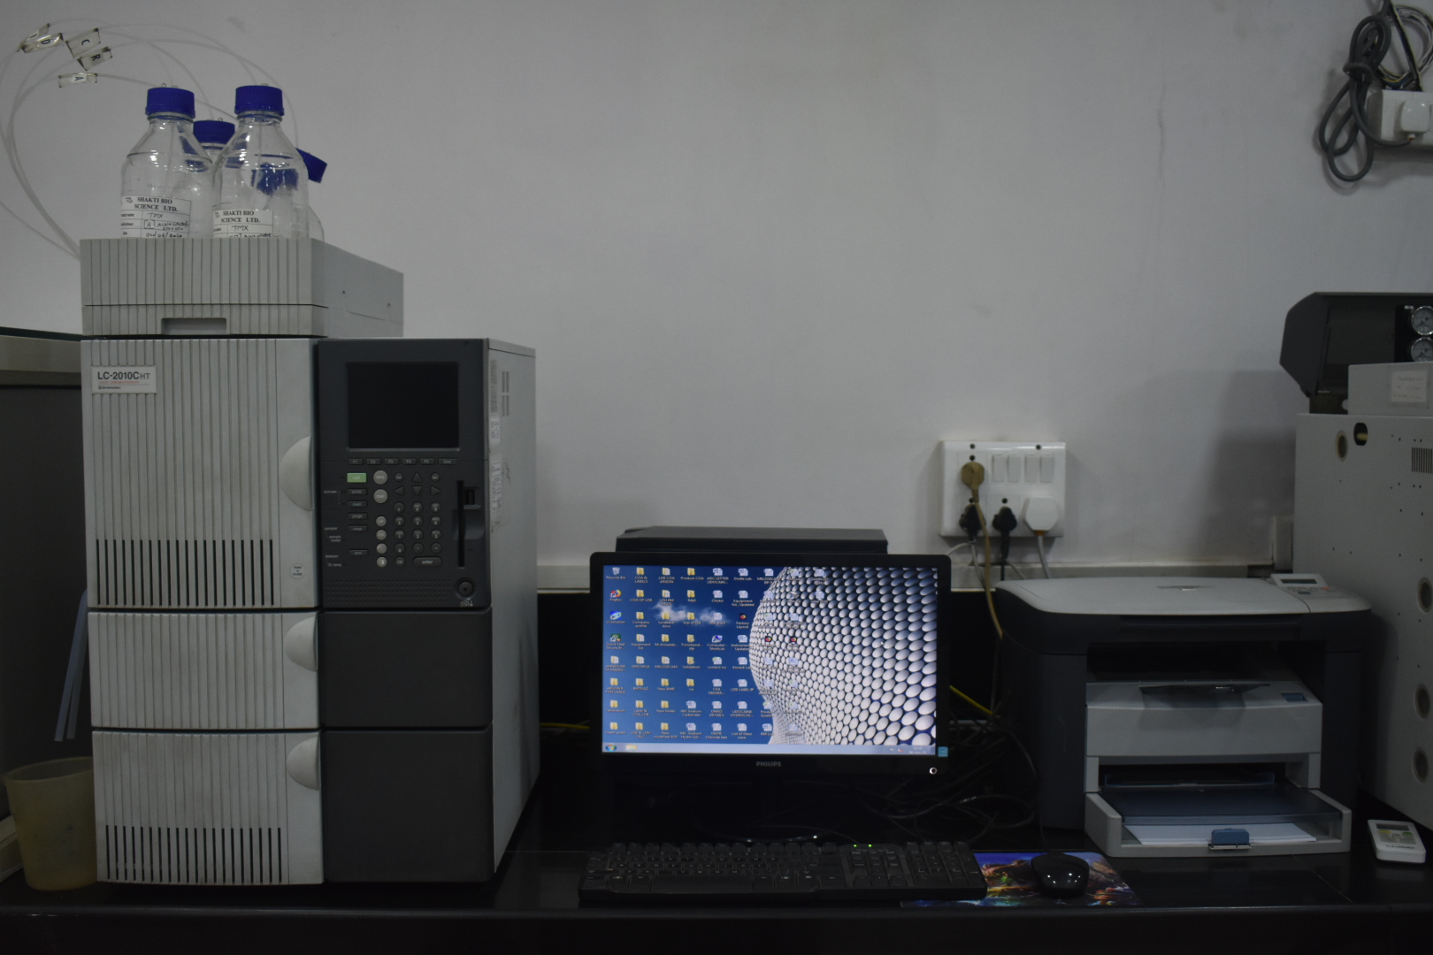
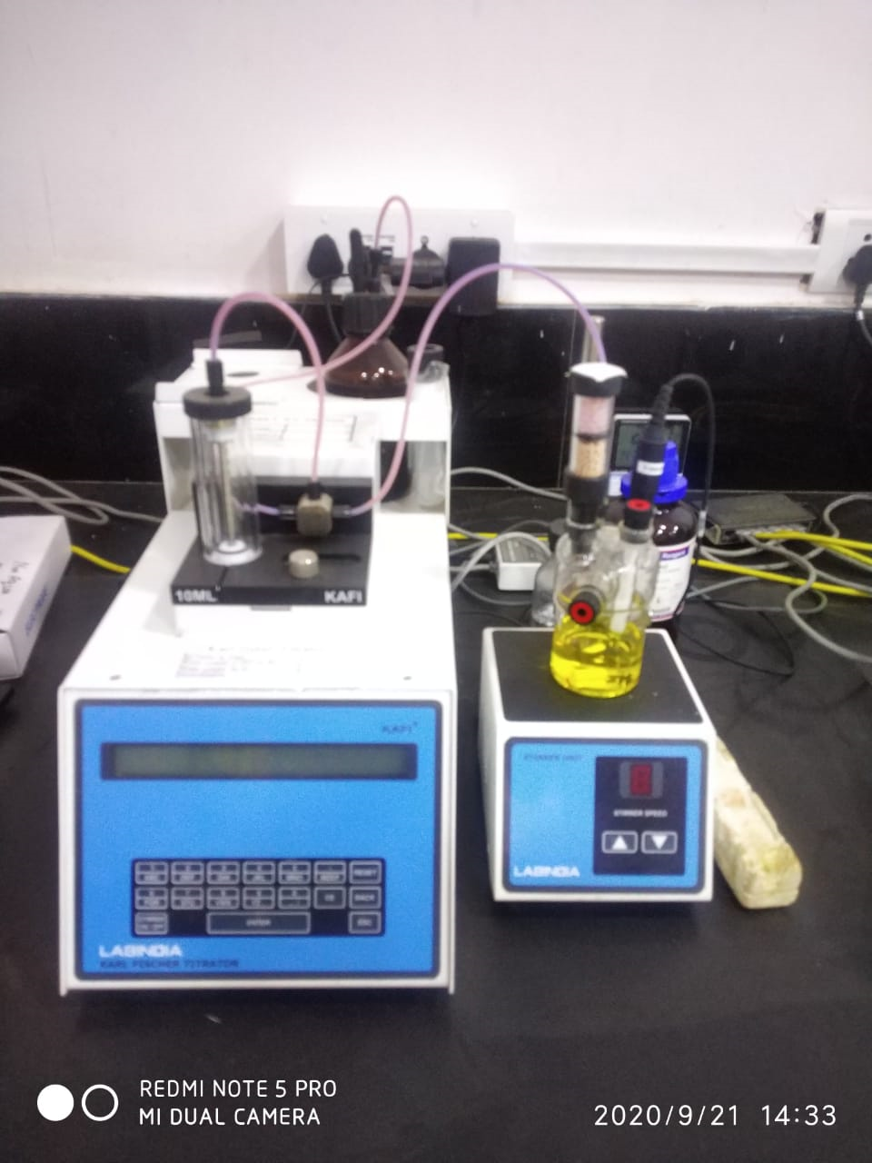
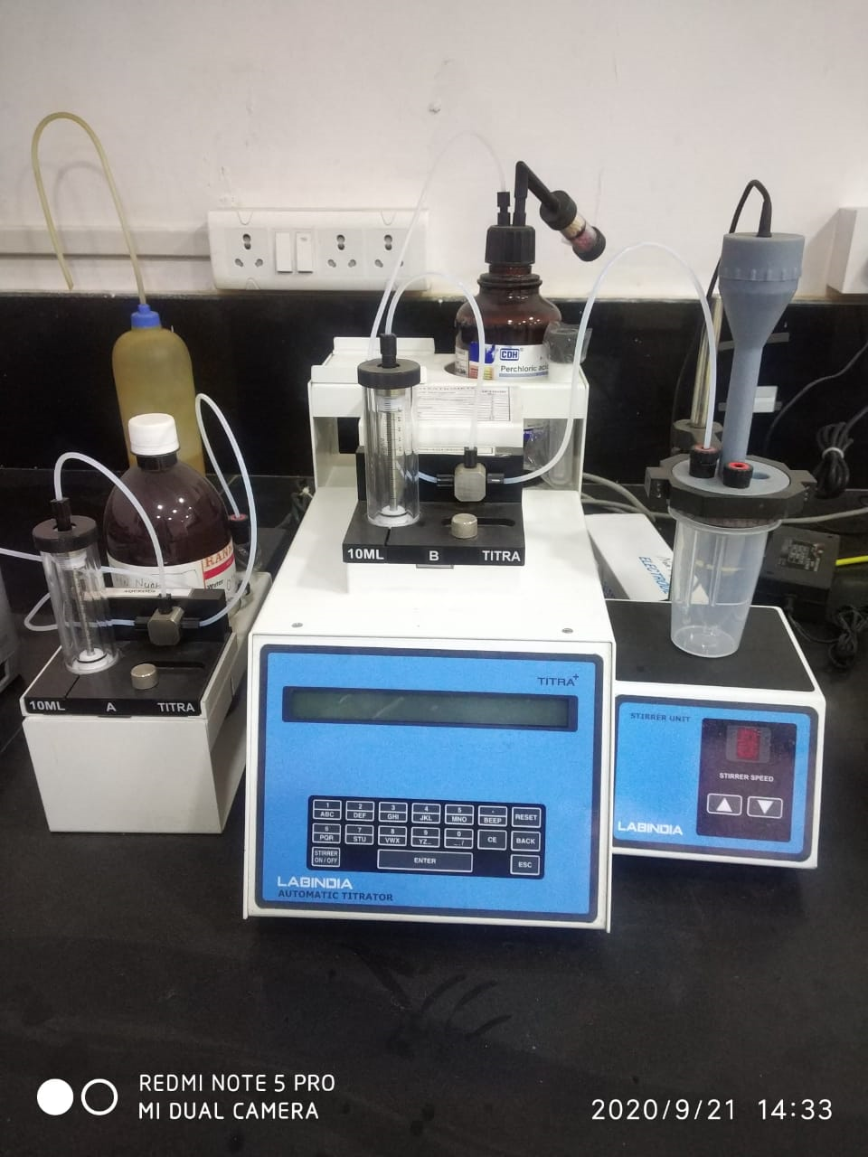
Shakti Bioscience Limited
QUALITY CONTROL & MICROBIOLOGY LABORATORY INSTRUMENT PICS :-
HPLC
KARL FISCHER
POTENTIOMETER

Slide 22
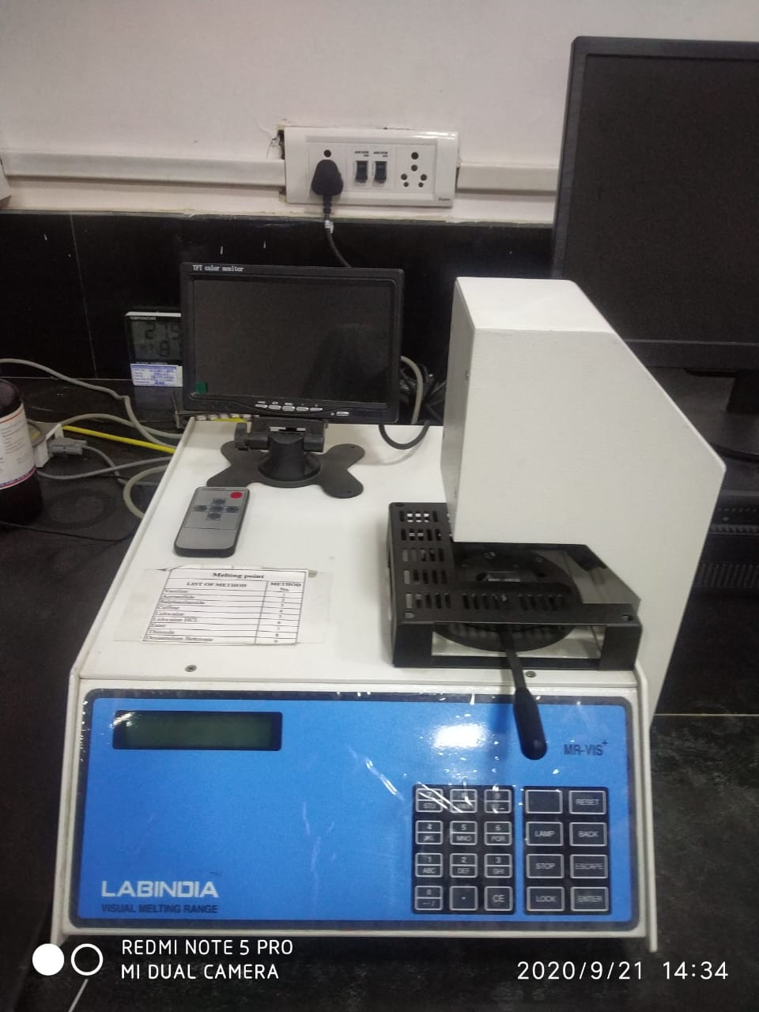
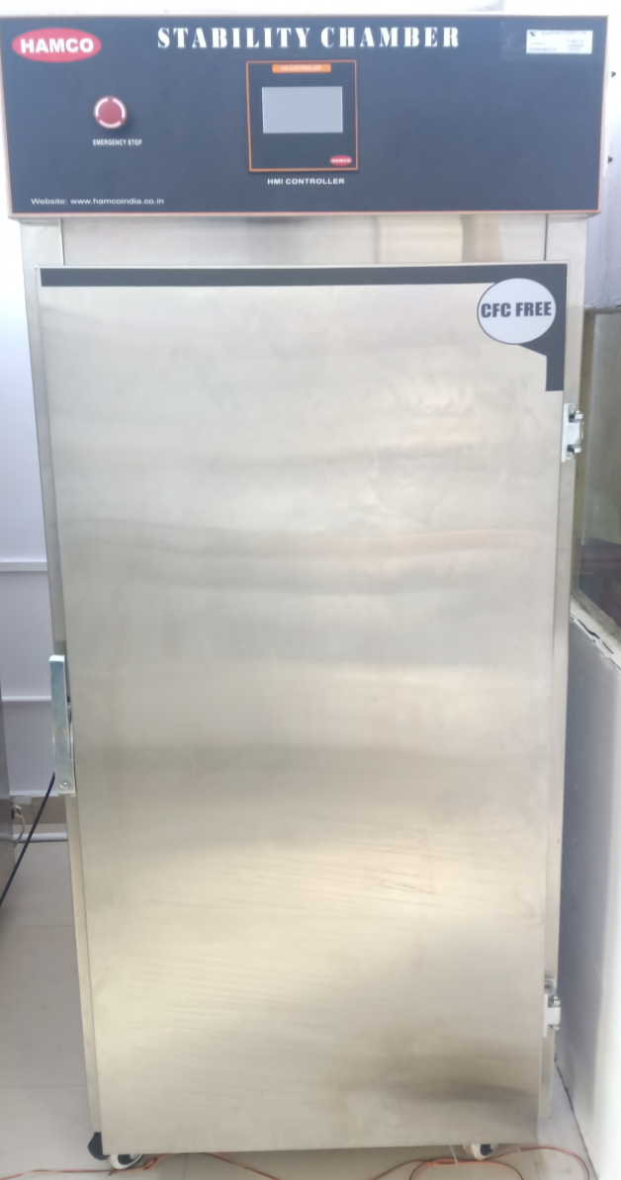
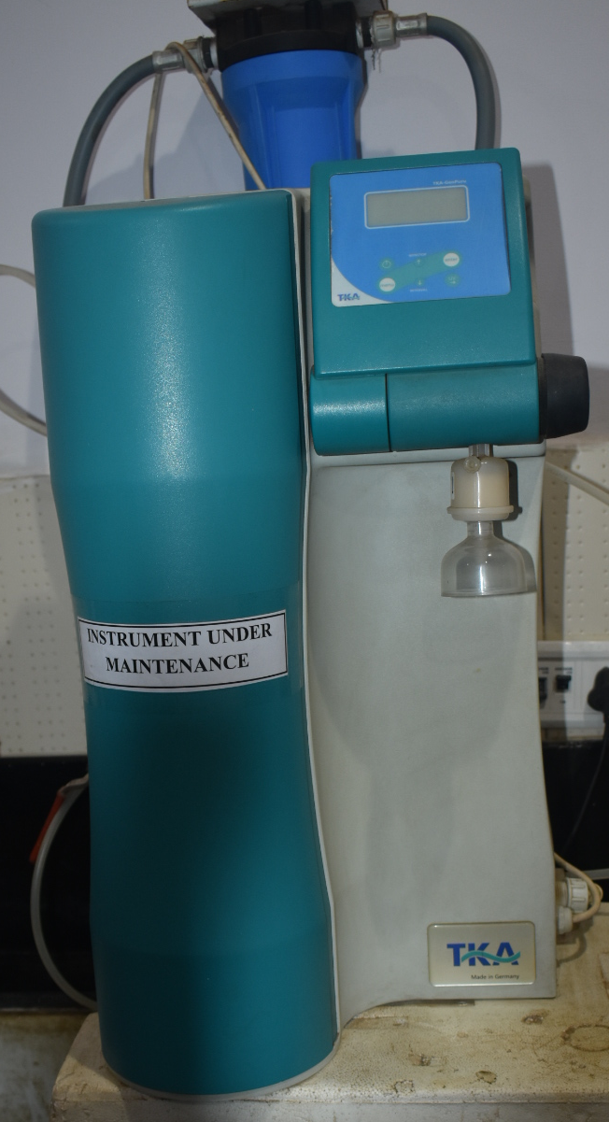
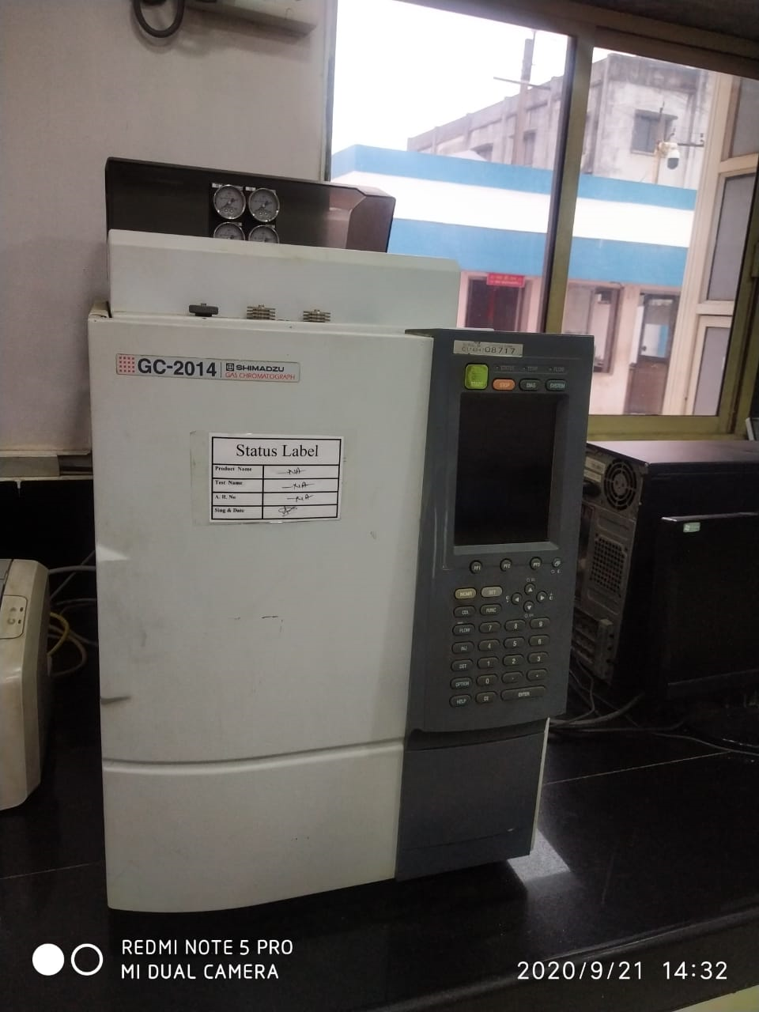
Shakti Bioscience Limited
QUALITY CONTROL & MICROBIOLOGY LABORATORY INSTRUMENT PICS :-
MELTING RANGE
STABILITY CHAMBER
HPLC WATER SYSTEM
GC

Slide 23
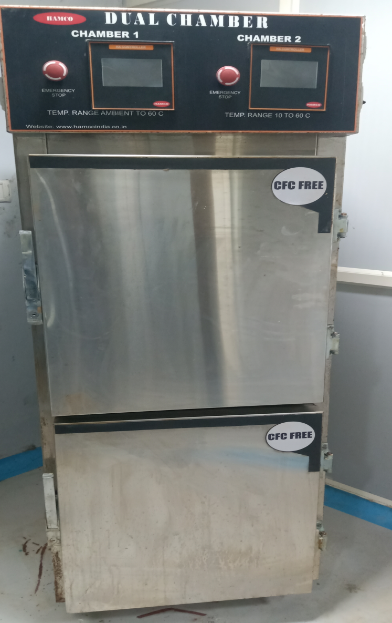
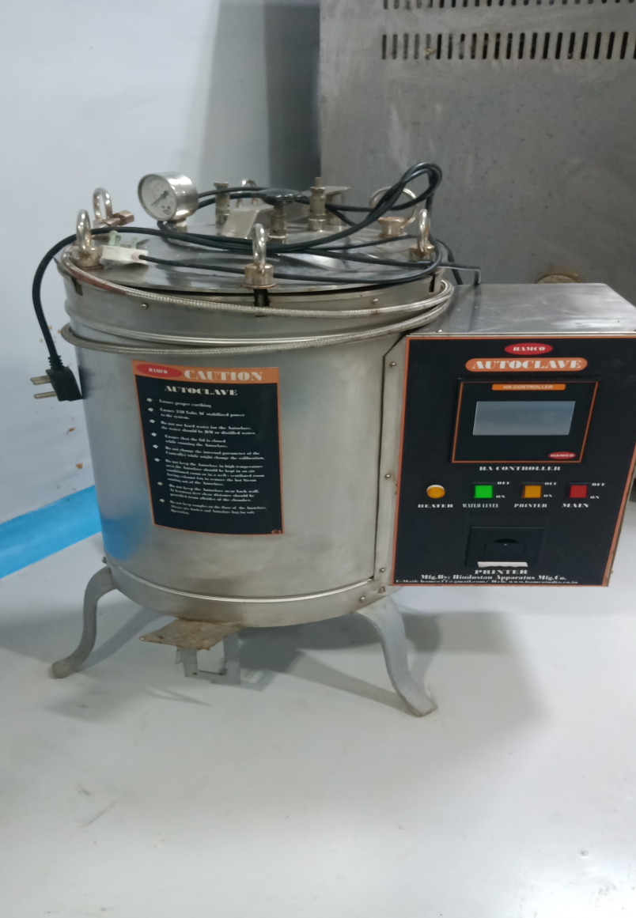
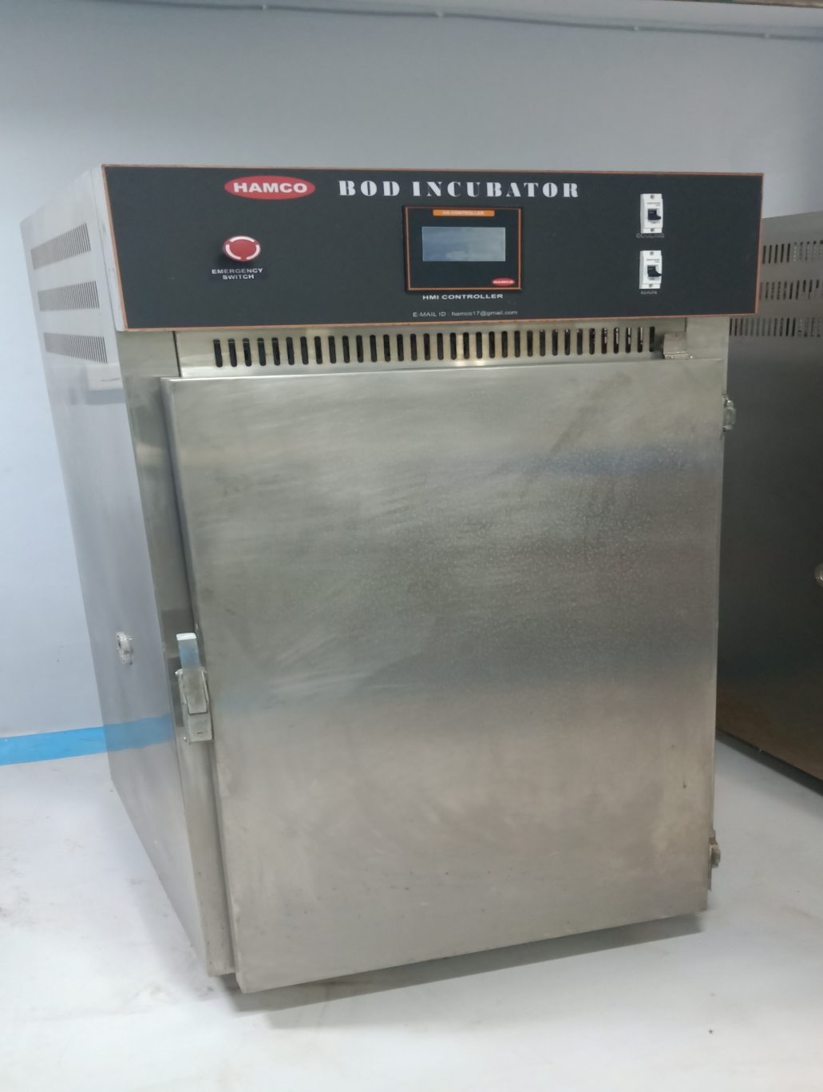
Shakti Bioscience Limited
QUALITY CONTROL & MICROBIOLOGY LABORATORY INSTRUMENT PICS :-
MELTING RANGE
AUTOCLAVE
BOD INCUBATOR

Slide 24
Shakti Bioscience Limited
Major Utilities List
Type | Capacity | Quantity
IBR Steam Boiler | 2000 kg/hr | 01 No.
Cooling Tower | 500 TR & 250 TR | 02 Nos.
Chilling Plant | 100 TR | 01 No.
Brine Plant | 60 TR | 01 No.
Vacuum System | 1 Water + 2 Steam Ejector | 5 Nos.
High Vacuum System | Oil Vacuum | 01 No.
Purified water System | 1 KL/hr | 01 No.
HVAC System | 5000 CFM- 1 No., 10000CFM- 1 No., 2000CFM- 1No. & 1000 CFM – 1 No. | 04 No.
FDV System | 5500 CFM | 01 No.

Slide 25
Shakti Bioscience Limited
I Quality Management
Principles:
Quality is the responsibility of all persons involved in manufacturing.
Established documentation procedure for managing quality with active participation of management & manufacturing personnel.
All quality related activities are defined & documented.
Quality units are available & are independent of Production.
Persons authorized to release all products are specified.
Deviations are documented & investigated.

Slide 26
Shakti Bioscience Limited
I Quality Management
(B) Responsibilities Of Quality Unit
Quality unit is involved in all quality related matters.
Quality unit reviews all quality related documents.
Main responsibilities of Quality units are Releasing & Rejecting of all RM / PM, Intermediates, In process sample , Final API, Control of Documents & Review of completed Batch Records.
Investigation of deviations & OOS.
Approving of all specifications & master production instruction.
Approving all procedures affecting the quality of the products.

Slide 27
Shakti Bioscience Limited
I Quality Management
(B) Responsibilities Of Quality Unit
Carry out internal audits.
Approving change controls.
Review & approving of validation protocols & records.
Investigation of complaints.
To make sure effective systems are used for maintaining & calibration of equipment.
Appropriate testing & reporting of results.
Stability study of API.
Annual product quality reviews.

Slide 28
Shakti Bioscience Limited
I Quality Management
(C) Responsibilities Of Production
To produce API as per approved procedures.
Review of all production batch records.
Reporting of deviations & investigation.
Maintaining cleanliness in the production facility.
Review of validation protocols & reports.
(D) Internal Quality Audits
Internal quality audits are conducted.
Internal quality reports are reviewed & corrective actions are taken to close the non-conformances.

Slide 29
Shakti Bioscience Limited
I Quality Management
(E) Product Quality Review
Critical test results, deviations or non-conformances & rejected investigations.
Any changes in process or analytical methods.
Results of stability monitoring program.
Market complaints, returns & recalls.

Slide 30
Shakti Bioscience Limited
II Personnel
(A) Personnel Qualification
Adequate number of qualified persons are available for manufacturing & controlling of API.
Their responsibilities in the manufacturing activity is specified & regular training is conducted for GMP & Safety.
(B) Personnel Hygiene
All employees in the factory practice good sanitation habits.
All manufacturing persons are provided with clean factory cloths. Direct contact with intermediates & API is avoided.
Smoking, eating, drinking, chewing & the storage of foods are not allowed in manufacturing area.
Persons suffering from infectious disease or having lesions are not allowed in manufacturing area.

Slide 31
Shakti Bioscience Limited
III Building & Facility
(A ) Purified Water System
Samples are taken every day for analysis

Slide 32
Shakti Bioscience Limited
III Building & Facility
(B) Lighting
Adequate lighting is provided in all areas.
(C) Maintenance & Sanitation
Building maintenance are followed.
Regular cleaning of manufacturing areas are done.

Slide 33
Shakti Bioscience Limited
IV PROCESS EQUIPMENTS
(A) Equipment Maintenance & Cleaning
Schedule for preventive maintenance of equipment are in place & followed.
Written procedures for cleaning of equipment are available. Responsibilities are assigned and cleaning schedule available.
(B) Calibration
All weighing balances, critical measuring & testing equipment are calibrated regularly as per schedule & records maintained .
Equipment are calibrated against the standards traceable to Certified Standards.
The current calibration status is displayed on the equipment/instrument.

Slide 34
Shakti Bioscience Limited
V Documentation & Records
(A) Documentation System & Specification
Standard Operating Procedures are in place for all departments & all operations are carried out as per the SOPs.
All documents related to manufacturing of intermediates or APIs are prepared, reviewed, approved by QA/QC & distributed to all concerned departments.
Retention period of all Quality related documents are defined as below:
The production, quality & distribution records are retained for one year after the completion of product shelf life.
All documents & SOPs are controlled as per the respective Standard Operating Procedures.
The original obsolete copies of quality related documents are retained for future references.
Specifications for RM, PM, FP ,In process & Intermediates are established.

Slide 35
Shakti Bioscience Limited
V Documentation & Records
(B) Equipment Cleaning & Usage Records
Equipment Cleaning Records are maintained which includes, Date & Time of cleaning. Previous product & its batch no., Person performing the cleaning activity.
Equipment Cleaning & Usage logs are maintained.
(C) Batch Manufacturing Record
Batch manufacturing records are in place. These includes, The name of intermediates & API manufactured, List of RM & intermediates used, Major Equipments used for production & Detail manufacturing instructions.
(D) Laboratory Control Records
Laboratory control records are in place. These includes, Description of sample received for testing, A complete record of raw data including the graphs, Record of all calculations performed & Results of all tests are reviewed.

Slide 36
Shakti Bioscience Limited
V Documentation & Records
(E) Batch Production Record Review
Written procedure for review & approval of batch production records are in place.
Review & approval of batch production record is done by QA.
All deviations & its investigations are reviewed prior to release of the batch.

Slide 37
Shakti Bioscience Limited
VI Materials Management
(A) Receipt & Quarantine
All incoming materials are inspected visually for correct labeling, physical condition & sealing.
Before using the material is tested & approved by QC.
(B) Storage
Materials are stored as per their storage condition on pallets.
Designated area for storing of rejected RM is defined.
(C) Re-evaluation
Retest period of RMs are defined.

Slide 38
Shakti Bioscience Limited
VII Production Controls
(A) Production Operation
RM & intermediates are weighed & measured by production person before use for next step.
Actual yields are compared with standard yields. Deviation observed during production is documented & investigated.
(B) Inprocess & Intermediates Sampling & Controls
Written procedure for in-process & Intermediates sampling & quality testing are established & approved by QA/QC. All in-process & Intermediates results are recorded
(C) Blending Of Batches
Passed batches are blended to make a bigger batch. The back traceability of individual batches are recorded in batch records.

Slide 39
Shakti Bioscience Limited
VIII Packing & Labeling
(A)General
Written procedure for receipt, quarantine, sampling, testing & release of PM is defined.
(B) Packing Materials
The containers used for packing of intermediate & API are not reactive, additive or absorptive.
(C) Packaging & Labeling Operations
Documented procedure for use of packaging & labels used are in place.

Slide 40
Shakti Bioscience Limited
IX Storage & Distribution
(A) Warehousing Procedures
Sufficient storage area is available for storage of RM & PM. Separate storage area for quarantine, rejected, returned or recall materials are defined.

Slide 41
Shakti Bioscience Limited
X Laboratory Controls
(A) General Controls
Procedures for sampling, testing, recording, approval or rejection are in place.
(B) Certificates Of Analysis
Certificate of analysis for each batch of API is prepared & issued to customers .
(C) Stability Monitoring Of APIs
Stability program are established to confirm appropriate storage condition & expiry date. The procedures used for stability testing are validated.
(D) Reserve/Retention Samples
Samples are retained for the purpose of potential future evaluation of the quality of batches as per procedure.

Slide 42
Shakti Bioscience Limited
XI Validation
(A) Validation Policy
Master Validation plan is in place.
Documented procedure for validation of cleaning procedure, production processes, analytical methods are in place.
(B) Validation Documents
Written validation protocols are established by defining how validation of a particular process will be conducted.
(C) Qualification Of Equipments
Performance Qualification of all critical Equipments is carried out.

Slide 43
Shakti Bioscience Limited
XI Validation
(D) Process Validation
Validation of production process is carried out by including, critical quality attributes & critical process parameters, appropriate in-process acceptance criteria & controls & monitoring of critical process parameters.
(E ) Analytical Method Validation
All analytical test methods used for assay, related substances & residual substances are validated.
(F) Cleaning Validation
Cleaning procedures are validated. The selection of cleaning agents are decided based on the solubility of API. Rinse & Swab samples are taken. Swab samples are taken from the area where the cleaning of equipment is difficult to clean.

Slide 44
Shakti Bioscience Limited
XII Change Control
Change control system is established to evaluate all changes that affect the quality of intermediate & API.
Change controls are reviewed & approved by QA/QC.
Before implementing change, QA ensures the documents affected by the changes are revised.

Slide 45
Shakti Bioscience Limited
XIII Rejection & Re-use Of Material
(A) Rejection, Reprocess & Rework
Written procedure for rejection, reprocess, rework is established & recorded.
(B) Returns
Designated storage area is defined for storage of return materials.
XIV Complaints & Recalls
Quality related complaints are recorded investigated.

Slide 46
Shakti Bioscience Limited
XV Contract Research , Analysis & Micronisation
Out side approved Analytical laboratories are used for analysis for some parameters like IR, Particle size distribution, microbiology etc.
Out side approved Microniser’s facilities are used for micronisation of products.
Laboratories & Microniser’s facilities are audited by QA of Shakti Bioscience Ltd..
A contract has been prepared with these Laboratories & Microniser’s facility.

Slide 47
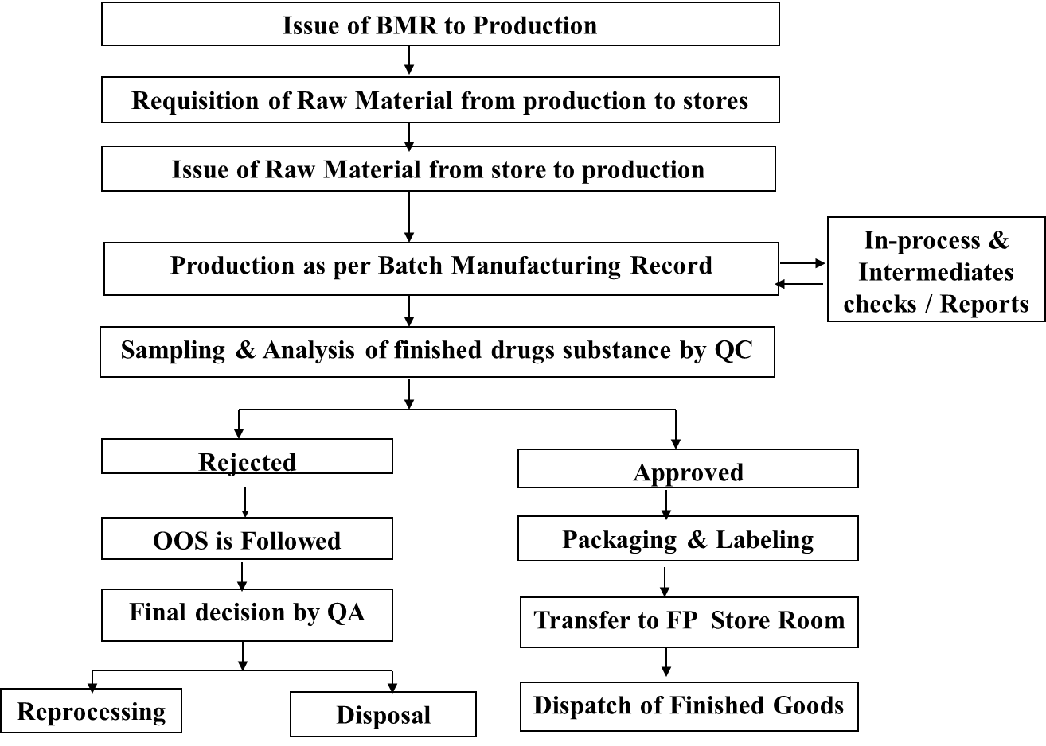
Shakti Bioscience Limited
PROCESS OPERATIONS

Slide 48
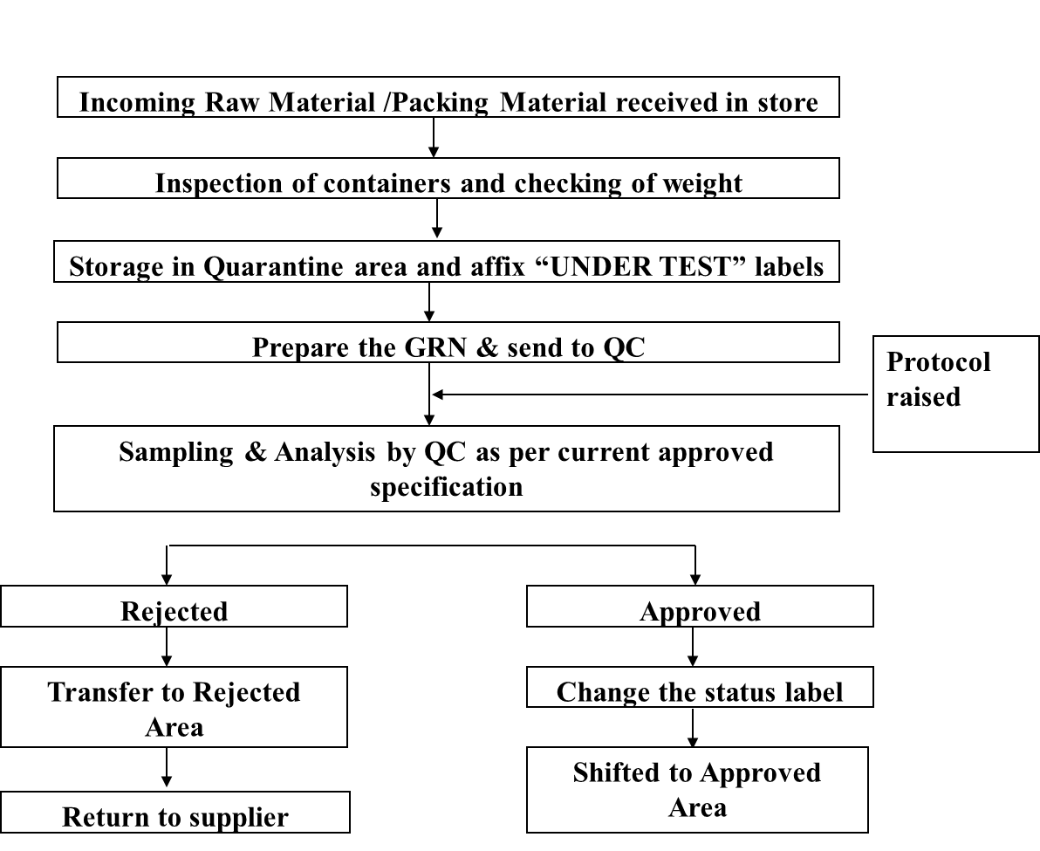
Shakti Bioscience Limited
SAMPLING & ANALYSIS OPERATION

Slide 49
Shakti Bioscience Limited
Thank you

