Slide 1


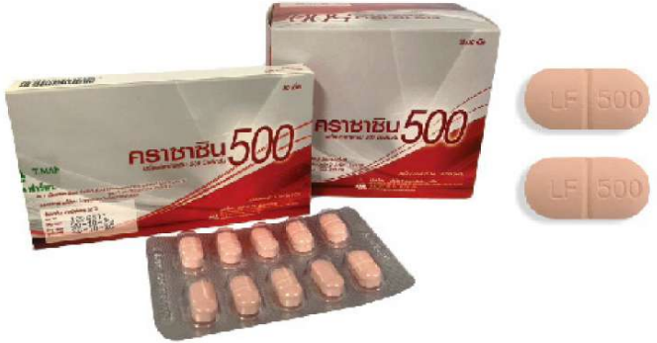
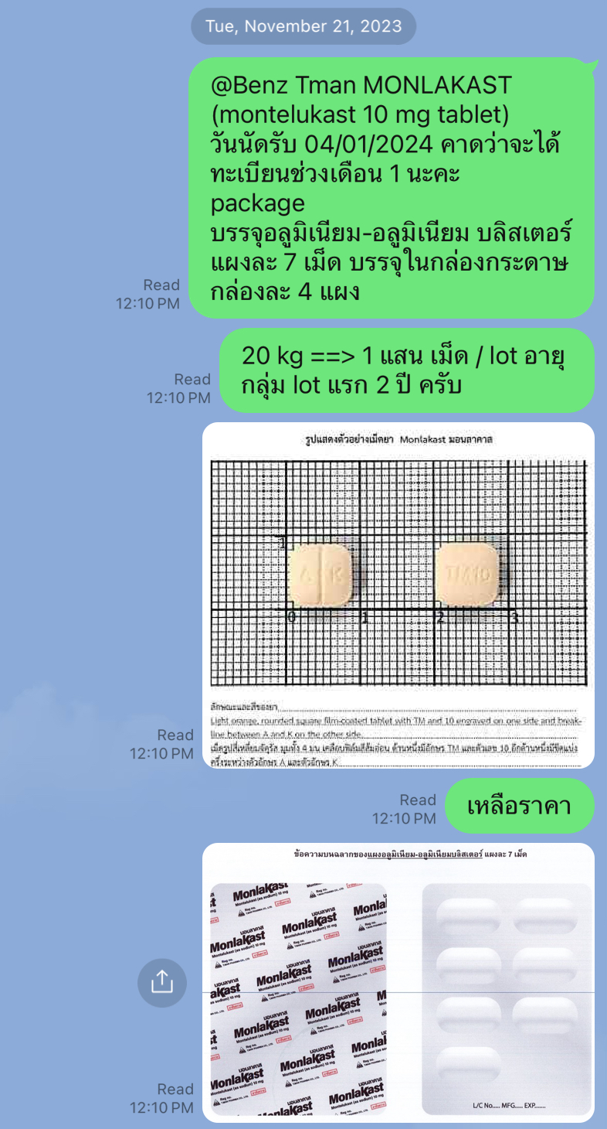
BA : bioavailability
BE : bioequivalence
Shelf Life : 3 yrs.
CODE | NAME | INGREDIENT | REFERENCE
GTC0122DBA | CRAXACIN500 (1x10x10’s) (10 blisters/box) | Levofloxacin hemihydrate 512.476 mg eq. to Levofloxacin 500 mg. | USP42
Shelf Life : 2 yrs.
CODE | NAME | INGREDIENT | REFERENCE
- | MONLAKAST (1x4x7’s) (4 blisters/box) | Montelukast 10 mg. | In-house and USP 42

Slide 2
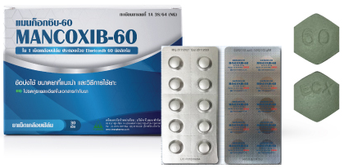
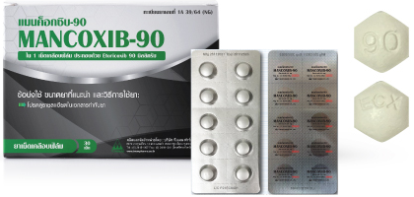
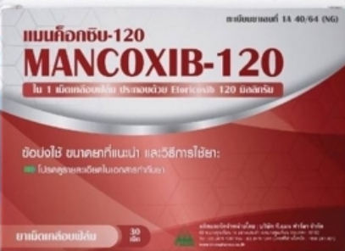
BA : bioavailability
BE : bioequivalence
Shelf Life : 2 yrs.
CODE | NAME | INGREDIENT | REFERENCE
GTM0524FSA | MANCOXIB-60 (1x3x10’s) (3 blisters/box) | Each tablet contains Etoricoxib 60 mg. | In-house, no PV
CODE | NAME | INGREDIENT | REFERENCE
GTM0525FSA | MANCOXIB-90 (1x3x10’s) (3 blisters/box) | Each tablet contains Etoricoxib 90 mg. | In-house, no PV
CODE | NAME | INGREDIENT | REFERENCE
GTM0526FSA | MANCOXIB-120 (1x3x10’s) (3 blisters/box) | Each tablet contains Etoricoxib 120 mg. | In-house, no PV

Slide 3
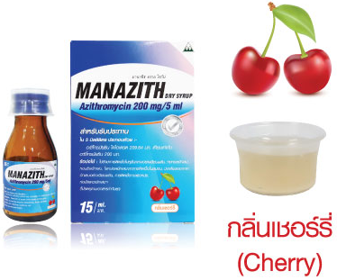
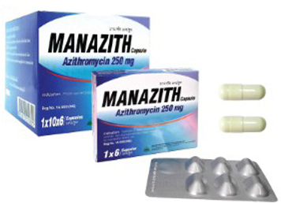
BA : bioavailability
BE : bioequivalence
Shelf Life : 3 yrs.
CODE | NAME | INGREDIENT | REFERENCE
GTM0229FVA GTM0229DNA | Manazith Dry Syrup (1x3x15ml.) Manazith Dry Syrup (1x12x15ml.) | Each 5 ml (When mix) contains : Azithromycin dihydrate 209.64 mg eq.To Azithromycin 200 mg./5 ml. | In-house, no PV
Shelf Life : 3 yrs.
CODE | NAME | INGREDIENT | REFERENCE
GTM0227CQA GTM0227DHA | Manazith Capsule ( 1x6x6's ) Manazith Capsule ( 1x10x6's ) | Azithromycin dihydrate 262.05 mg. eq.to Azithromycin 250 mg. | In-house, no PV

Slide 4
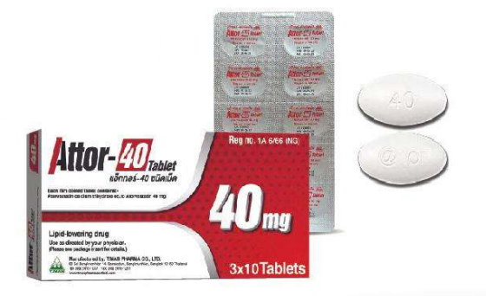
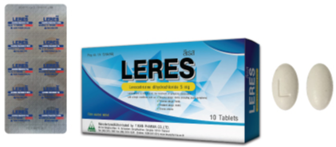
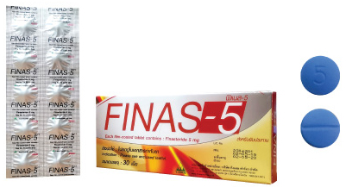
BA : bioavailability
BE : bioequivalence
Shelf Life : 2 yrs.
CODE | NAME | INGREDIENT | REFERENCE
GTA0115FSA | ATTOR-40 TABLET (1x3x10's) | Each 1 film coated tablet contains Atorvastatin calcium trihydrate eq. to Atorvastatin 40 mg. | In-house and USP 41
Shelf Life : 2 yrs.
CODE | NAME | INGREDIENT | REFERENCE
GTL0999FSA | LERES (1x3x10’s) 1 blister per box | Levocetirizine dihydrochloride 5 mg. | USP41
Shelf Life : 4 yrs.
CODE | NAME | INGREDIENT | REFERENCE
GTF0230FSA GTF0230GEA | FINAS-5 ( 1x3x10’s) FINAS-5 ( 1x50x10's) | Finasteride 5 mg. | API USP36 FP USP42

Slide 5
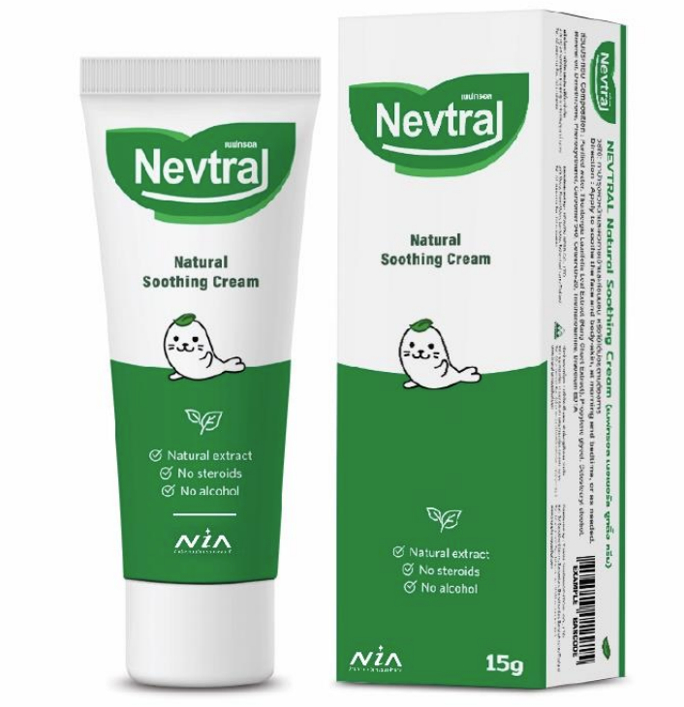
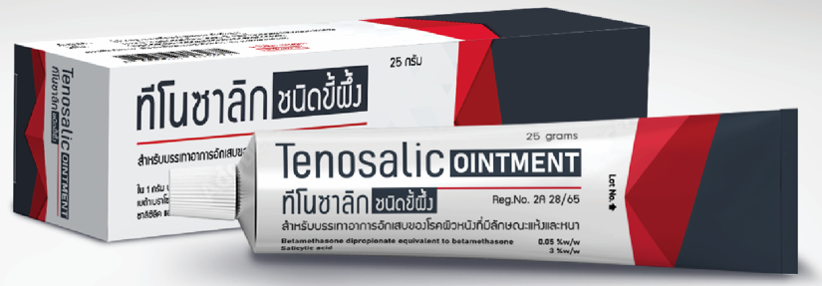
Shelf Life : 3 yrs.
CODE | NAME | INGREDIENT
GHN0002BZA | NEVTRAL NATURAL SOOTHING CREAM (1x3x15g.) | Each 1 gram contains Standardized Rangchuet Extract 75 μg
Shelf Life : 3 yrs.
CODE | NAME | INGREDIENT | REFERENCE
GTT0059HFA GTT0059CMA | TENOSALIC OINTMENT (1x6x5g.) TENOSALIC OINTMENT (1x6x15g.) | Betamethasone dipropionate 0.5 mg, Salicylic acid 30 mg. | In-house and USP 39

Slide 6
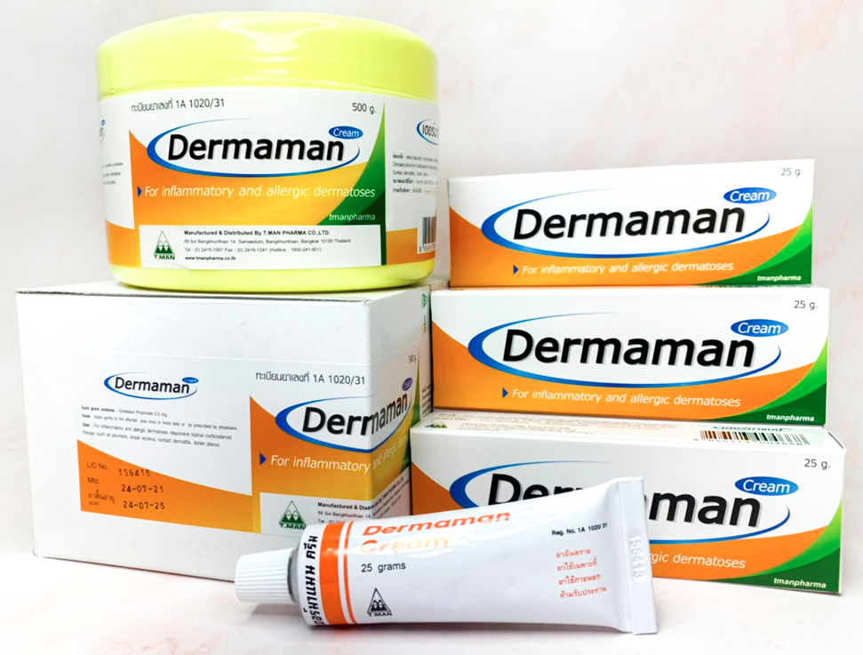
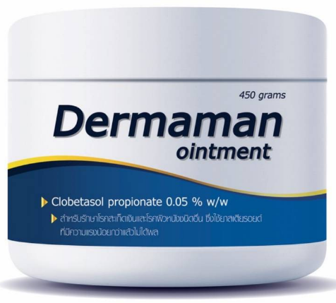
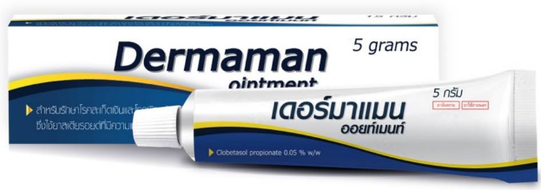
Shelf Life : 4 yrs.
CODE | NAME | INGREDIENT | REFERENCE
GTD0015DTA GTD0015BCA GTD0015AMA | Dermaman Cream (1x12x5g.) Dermaman Cream (1x12x25g.) Dermaman Cream (500g.) | each 1 g. contains: Clobetasol Propionate 0.5 mg. | USP43 (2020)
Shelf Life : 2 yrs.
CODE | NAME | INGREDIENT | REFERENCE
GTD0051DTA GTD0051DNA GTD0051HRI | DERMAMAN OINTMENT (1x12x5g.) DERMAMAN OINTMENT (1x12x15g.) DERMAMAN OINTMENT (1x1x450g.) | Clobetasol propionate 0.05%w/w ointment | In-house (USP43), no PV

Slide 7
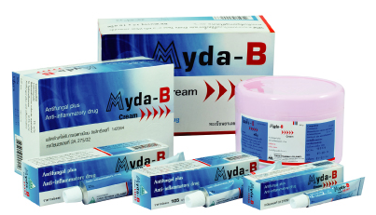
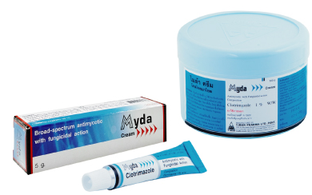
Shelf Life : 3 yrs.
CODE | NAME | INGREDIENT | REFERENCE
GTM0018DTC GTM0018DNB GTM0018DQA GTM0018AMA | Myda-B Cream (1x12x5g) Myda-B Cream (1x12x15g) Myda-B Cream (1x12x25g) Myda-B Cream (1x500g) | Clotrimazole1% w/w Betamethasone (as valerate ) 0.1%w/w | In-house (USP39), no ref. product
Shelf Life : 4 yrs.
CODE | NAME | INGREDIENT | REFERENCE
GTM0019DTA GTM0019AMA | Myda Cream ( 1x12x5g.) Myda Cream ( 500g.) | Clotrimazole 1% w/w | USP39 (2016)

Slide 8
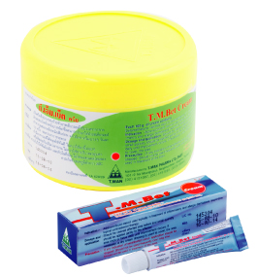
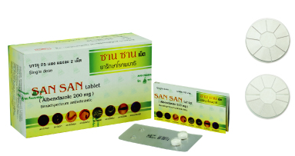
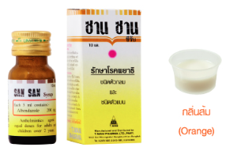
Shelf Life : 4 yrs.
CODE | NAME | INGREDIENT | REFERENCE
GTT0014BEA GTT0014AMA | T.M.bet Cream (1x12x5g) T.M.bet Cream ( 500g.) | Betamethasone (as valerate) 0.1% w/w | USP39 (2016)
Shelf Life : 4 yrs.
CODE | NAME | INGREDIENT | REFERENCE
GTS0711BSA | San San Tablet (1x25x2's) | Albendazole 200 mg. | API USP42 FP USP39 (2016)
Shelf Life : 3 yrs.
CODE | NAME | INGREDIENT | REFERENCE
GTS0029DKA | San San Syrup (1x12x10ml.) | Albendazole 200 mg./5ml. | USP2022, FP USP39 PV on going

Slide 9
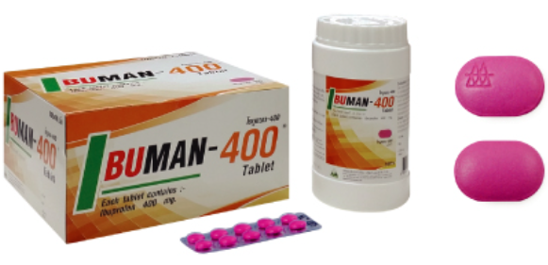
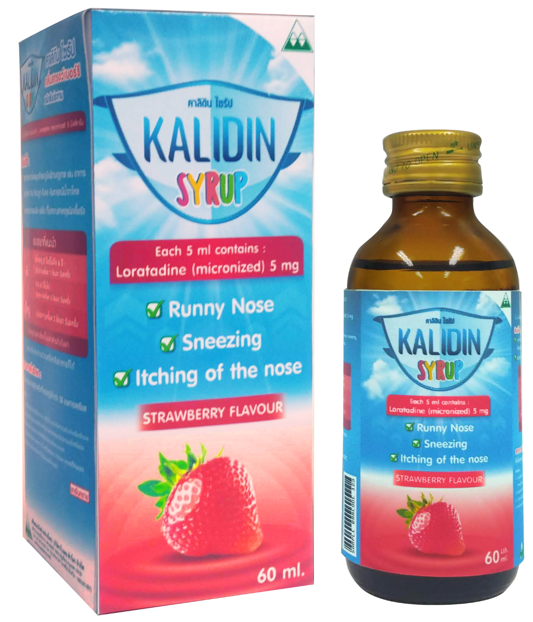
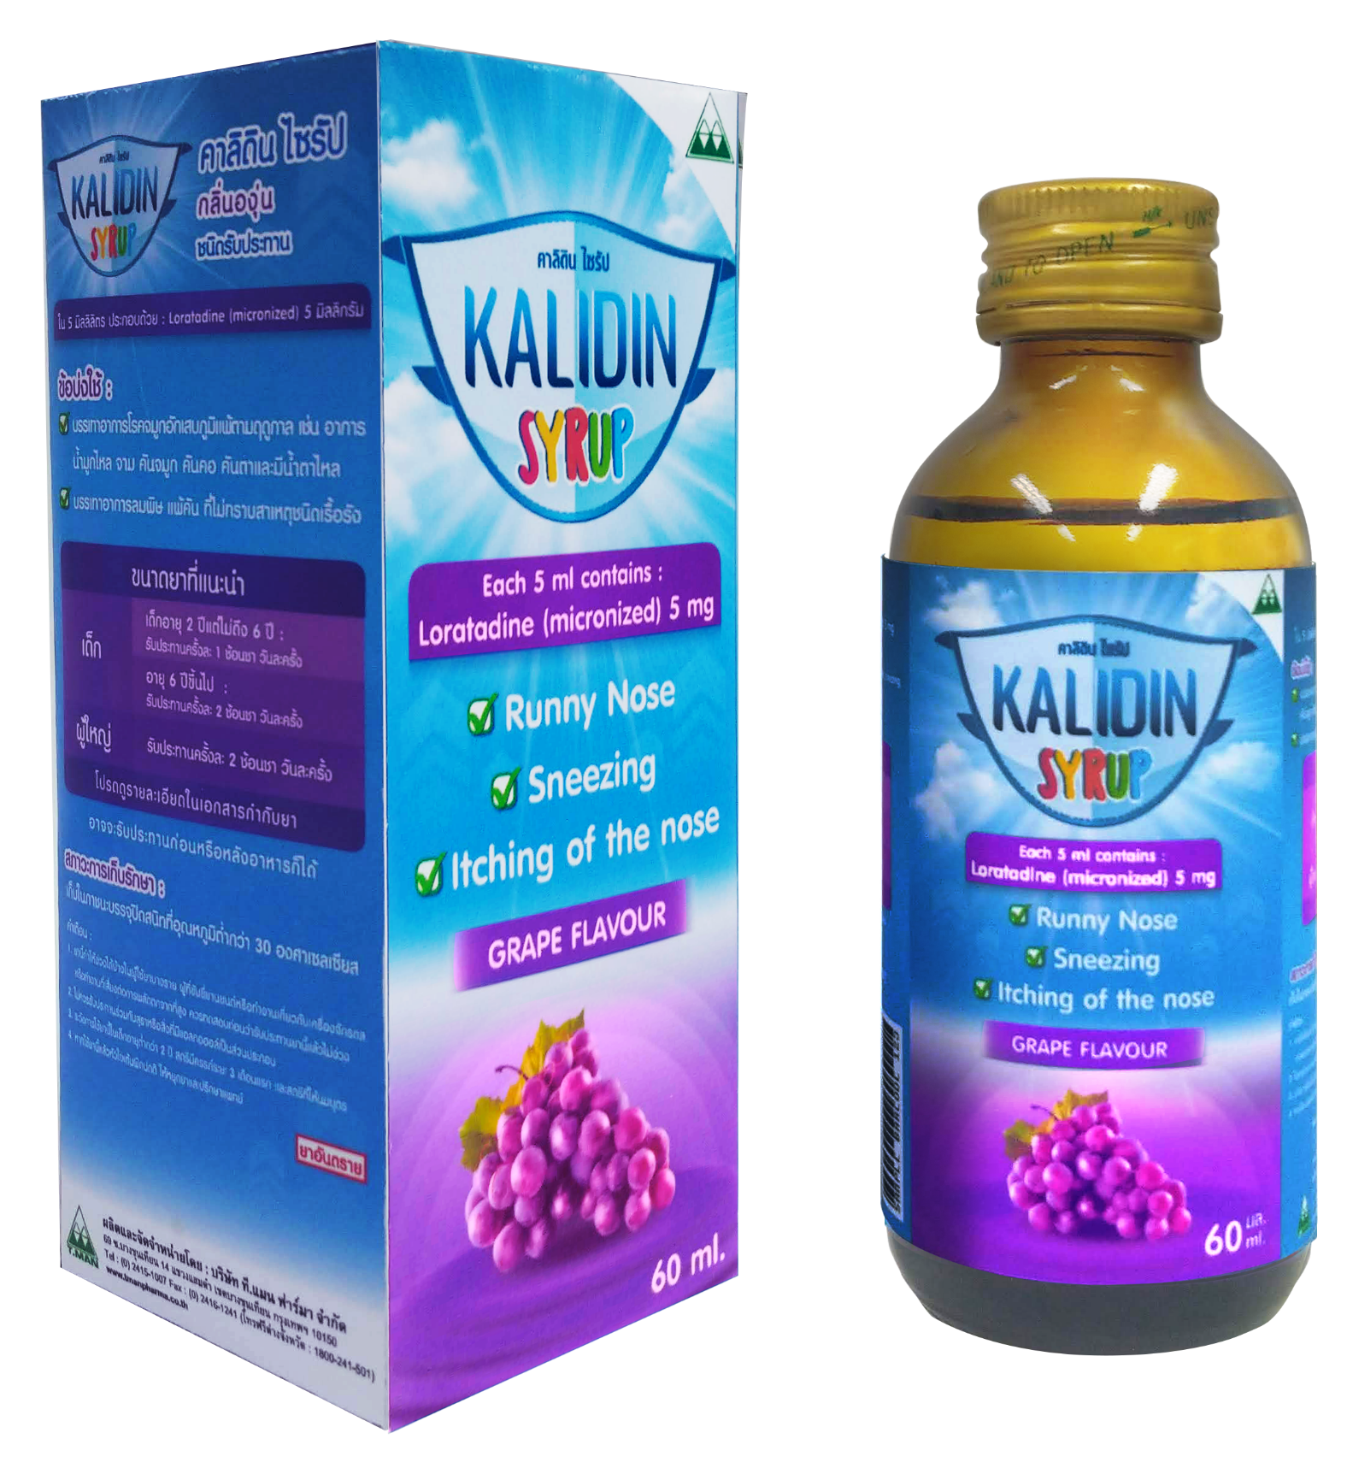
Shelf Life : 4 yrs.
CODE | NAME | INGREDIENT | REFERENCE
GTI0743AMA GTI0743CYA | Ibuman-400 Tablet Oval Purple (500's) Ibuman-400 Tablet Oval Purple (1x100x10s) | Ibuprofen 400 mg. | USP42 (2019)
Shelf Life : 2 yrs.
CODE | NAME | INGREDIENT | REFERENCE
GTK0054BGA | KALIDIN SYRUP STRAWBERRY FLAVOR GRAPR FLAVOR | Loratadine (micronized) 5 mg/5 ml | In-house (USP41), no PV

Slide 10
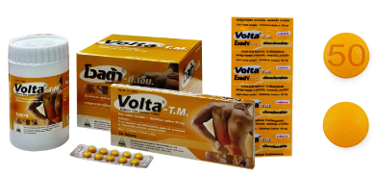
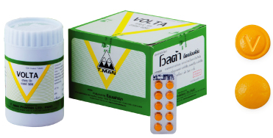
Shelf Life : 4 yrs.
CODE | NAME | INGREDIENT | REFERENCE
GTV0986DBB GTV0986CYA GTV0986APA | Volta- T.M. Enteric Film Coated Tablet (1x10x10's) Volta- T.M. Enteric Film Coated Tablet (1x100x10s) Volta- T.M. Enteric Film Coated Tablet (1000s) | Diclofenac sodium 50 mg. | In-house (BP2016), no DMF
Shelf Life : 4 yrs.
CODE | NAME | INGREDIENT | REFERENCE
GTV0889CYA GTV0889APB | Volta Enteric Film Coated Tablet(1x100x10s) Volta Enteric Film Coated Tablet (1000's) | Diclofenac sodium 25 mg. | In-house (BP2016), no DMF

