Slide 1

The Gold Standard
in Life Sciences Product
& Device Quality
WHEREVER YOU ARE ON YOUR QA JOURNEY, WE’VE GOT YOU COVERED

Slide 2
Quality that drives
your business forward
Our quality assurance services are designed
to deliver real, lasting business impact:
The pressure on quality has never been greater, but the organisations that are thriving are those that treat it not as a cost of doing business,
but as the foundation it's built on.
SUPPLIER
EXCELLENCE
Confidence in every link of your supply chain, from qualification to ongoing oversight
REGULATORY CONFIDENCE
Inspection-ready at all times, with the expertise and evidence to back it up
DIGITAL
ENABLEMENT
Smarter systems and stronger compliance, built around how you actually work
OPERATIONAL EFFICIENCY
Quality processes that reduce cost, minimise risk, and free your teams to focus on what matters
SMART MANUFACTURING
Quality embedded at every stage of production, not bolted on at the end

Slide 3
25 years.
Thousands
of partnerships
1,200+
SITES AUDITED
5,000+
CONSULTANCY PROJECTS
Across pharmaceutical, biotech,
and medical device organisations worldwide, companies trust Rephine to protect their quality, their operations, and ultimately their patients. Our track record speaks for itself.
1,000+
LIBRARY REPORTS AVAILABLE
3,000+
CUSTOMERS WORLDWIDE
10,000+
AUDITS PERFORMED
SHANGHAI
CHINA
BARCELONA
SPAIN
STEVENAGE
UK HEADQUARTERS
HYDERABAD
INDIA

Slide 4

Integrated services.
One quality partner
We combine specialised consultancy, digital innovation and world-class audit capabilities to help you solve your most complex quality challenges.
GXP
CONSULTANCY
CSV
GMP AUDIT
SERVICES
QMS
MEDICAL
DEVICE
Compliance Readiness Assessments & Gap Analysis
Remediation Planning & Implementation
Supplier & Internal Audits
Preparation for Regulatory Inspections
Validation Master Plans, Process & Cleaning Validation
Equipment Qualification
Training Services
CSV Projects & Methodologies
Data Integrity & Compliance
Data Migration & Management
Training & Development
Shared Audit Library
Bespoke Audits
Pre-Audit & Post-Audit Report Service
sCAPA Management & Follow-Up
Multi-client & Direct Channel Access
QMS Design, Development & Maintenance
Implementation & Digitalisation
Validation
Managed Services & Ongoing Support
Change Management & Training
Device Classification
Software as a Medical Device
Risk Assessments
Quality Management
Technical File Preparation
Post-Market Surveillance
Supplier & Internal Audits

Slide 5


GMP Audit Services
We have expertise to audit a breadth of global pharmaceutical drug suppliers, and audit to all the relevant local and global compliance standards.
ISO 15378 Primary
packaging materials
for medicinal
products
Applicable parts of
EU GMP Part I
21 CFR211
the Chinese GMP
Applicable parts of GDPs
of medicinal products for human use (2013/C 343/01) or GDPs of active substances for medicinal products for human use (2015/C 95/01)
API & GMP Intermediate
Manufacturers:
Applicable parts
of EU GMP Part II
/ ICHQ7
Excipients Manufacturers:
Applicable parts of 2017 IPEC – PQG Good Manufacturing Practices Guide for pharmaceutical excipients
ISO 13485
Medical Device
Applicable parts of
Good Pharmacovigilance Practice (GVP) guidelines
Risk based approach according the activities done in the auditee company or any other regulation that may be applicable
GCP Audits provided through our Trusted Partner Network

Slide 6

Rephine Global Audit Library
We offer a strong market presence and impact with our Global Audit Library.
From more than 1,000 sites, ensuring that we likely have what our clients need. We own one of the single largest repositories of valid GMP reports spanning over 5,000 individual products
Comprehensive audit library with ready data for customized reporting.
> 5,000 product reports available
Powering your Access to the global industry.
> 1,800 + customers worldwide
Trusted reputation built on customer and health authority satisfaction.
> 500 GMP audits per year
Sales of > 4,000 audit reports per year
Tailored audits
Impartiality & confidentiality
Dedicated CAPA Team

Slide 7

It's not just what we do, it's how we do it
REPHINE CONNECT
Everything in one place. Whenever. Wherever.
Your dedicated portal for complete audit oversight, available 24/7 from anywhere
in the world.
VALGENESIS
The first AI-enabled digital validation platform.
Run complex, multi-stakeholder validation programmes faster, with stronger compliance and data integrity.
Our expertise is amplified
by the tools we use and build. From proprietary platforms developed in-house to powerful partnerships with best-in-class technology providers.
REPHINE ACADEMY
A platform built to raise your quality standard.
Our proprietary training platform delivers structured, role-based learning, built around the real challenges your teams face.
REPHINE CONNECT - AUDITEES
Your data, made smart.
Intelligent access to your data as an auditee: track everything from the audits you've avoided thanks to Rephine's shared model to the CAPA plan management for the audit we performed.

Slide 8










VP CONSULTING
& GM SPAIN
CEO
CGO
CSO
GROUP FD
TIM HAWKINS
CLAIRE MEADOWCROFT
EDUARD CAYON
ALEX MURRAY
MARIAN ANGELS SAN
Meet our leadership team
Rephine is built on people.
Our leadership team brings together decades of specialist experience across every product type, regulatory framework, and global market, so you always have the right expertise working with you, wherever you need it.
VP COMMERCIAL
VP AUDIT SERVICES
GM CHINA
GM INDIA
HR DIRECTOR
CHRIS BURMAN
ALASDAIR LECKIE
VERA WANG
MAMTA CHAWLA
APRIL WILLIAMS

Slide 9







A network built to extend what we can do for you
We work alongside the most respected names in life sciences technology, quality management, and digital compliance, so you benefit not just from our expertise, but from an ecosystem of industry-leading solutions, all working in your interest.

Slide 10


Build the capability your compliance demands
Quality confidence starts with your people. We work
with you to develop strong, knowledgeable, and fully empowered teams, through the delivery of training that fits your organisation, roles, and the challenges you face.
Our training is flexible by design,
with three formats built to work around you:
FACE TO FACE
Personal, expert-led training delivered directly to your team. The most immersive format we offer, with real-time engagement, open Q&A, and the kind of honest, practical dialogue that only happens in the room.
IN LIVE
All the expertise and personal engagement
of face-to-face training, delivered digitally
in real time. Convenient, flexible, and just
as interactive, without the logistical overhead.
REPHINE ACADEMY
On-demand, modular learning through our purpose-built platform. Digestible, expertly produced video content, with role-based learning paths tailored to where your people are and where they need to get to.
Every format is delivered to our gold standard and fully integrated with your wider Rephine quality support.

Slide 11

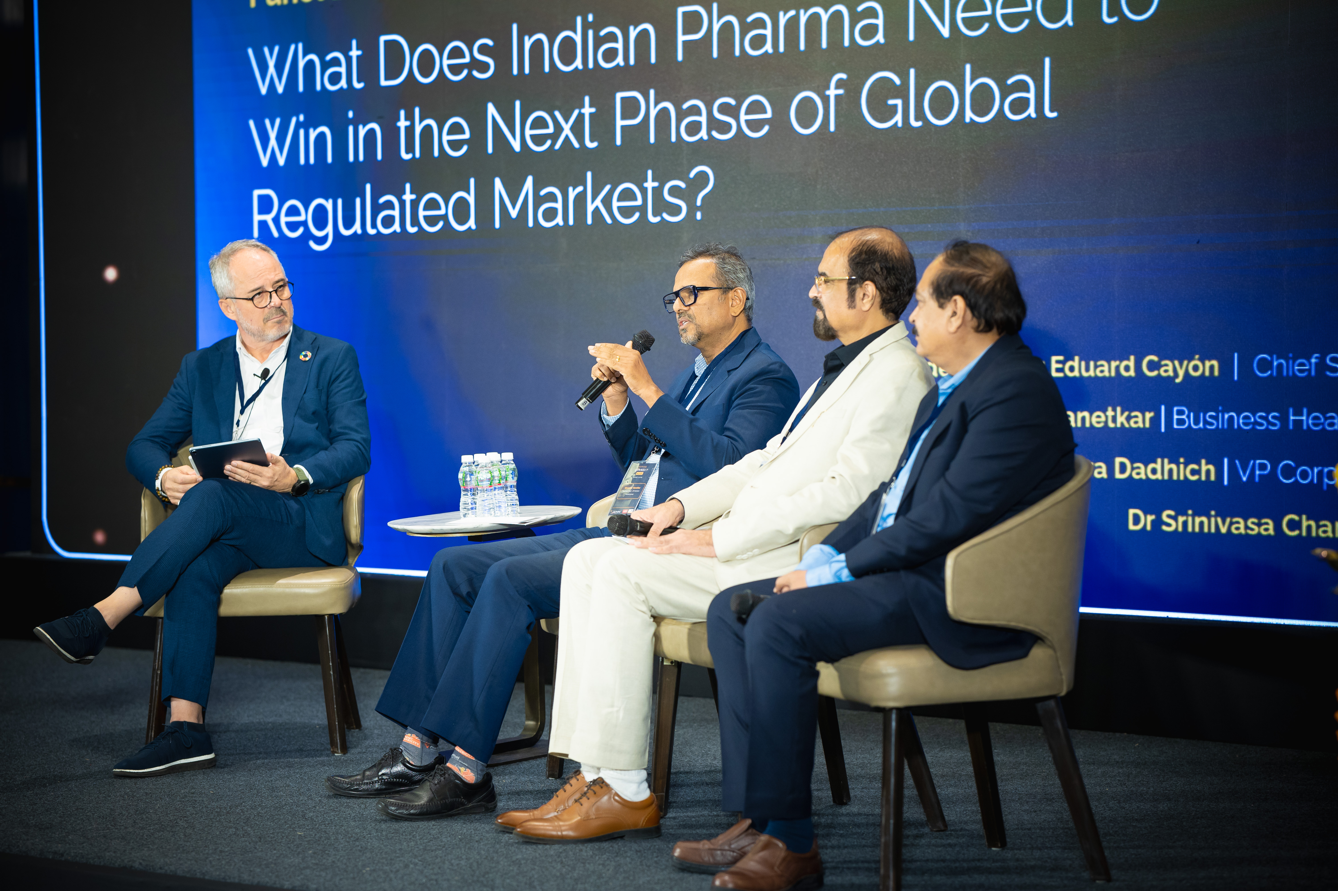
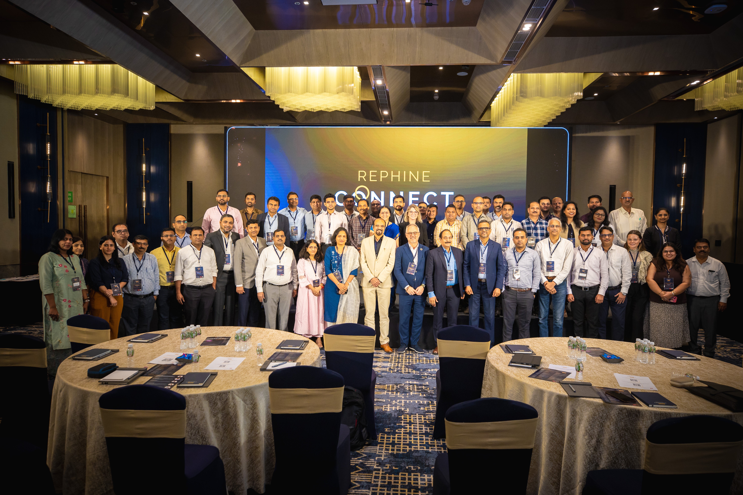
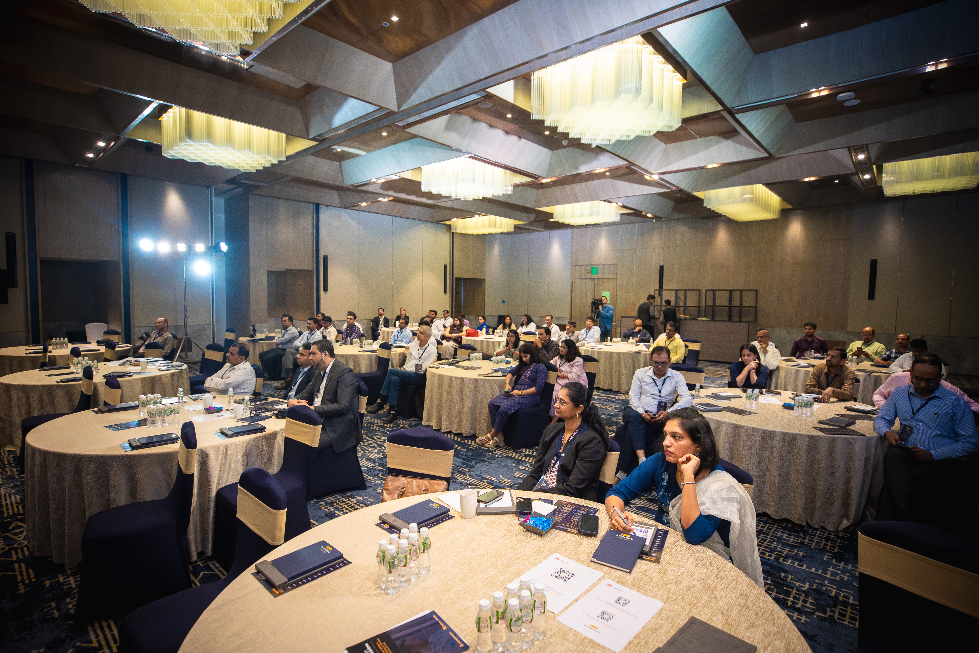
Events that bring our community together
REPHINE HOSTS A PRIVATE EXECUTIVE EVENT SERIES THAT FOCUSES ON KEY TOPICS RELEVANT TO THE FUTURE OF PHARMACEUTICAL QUALITY.
Rephine Connect Live brings together senior industry leaders for keynotes, panels and genuine peer to peer conversation on quality maturity, data integrity and the responsible adoption of AI. An invitation only platform where the people shaping pharma quality meet to exchange ideas.
MUMBAI, 2026

Slide 12
The partner you can rely on.
The standard you deserve.

Slide 13
Why choose Rephine?
END-TO-END SUPPORT
From initial gap analysis to full implementation and beyond, we are with you at every step.
IMPARTIALITY
& CONFIDENTIALITY
We always act in your best interests, with complete discretion and no conflicts of interest.
INNOVATIVE & DIGITAL-FIRST
Proprietary tools that make
your compliance smarter, faster,
and more resilient.
1
2
3
25 YEARS OF
PROVEN EXPERTISE
Deep technical knowledge across every major regulatory framework and product type.
TRULY CLIENT-LED
Your challenges shape
our approach, not the other way around.
VALIDATED BY
HEALTH AUTHORITIES
Our audit methodology is independently recognisedand trusted globally.
4
5
6

Slide 14
Are you looking for a partner trusted by global market leaders?
WHEREVER YOU ARE ON YOUR QA JOURNEY, WE’VE GOT YOU COVERED
enquiries@rephine.com
www.rephine.com
UK
SPAIN
CHINA
INDIA
+44(0) 1763 853135
+34(0) 934 178065
+86 (0)21 32200167
+xx (0)xx xxxxxxxx

