Slide 1

Shandong Dinghao Biotechnology Co., Ltd.
Make Life Better
2024.07.15

Slide 2
Contents
一 、Company Profile
二、 Technical Capability
三、 State of Operation
四、 Cooperative Partner

Slide 3
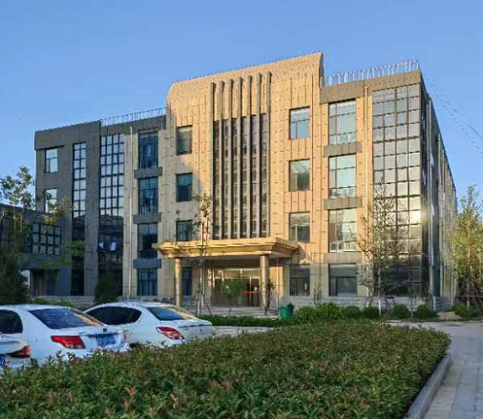
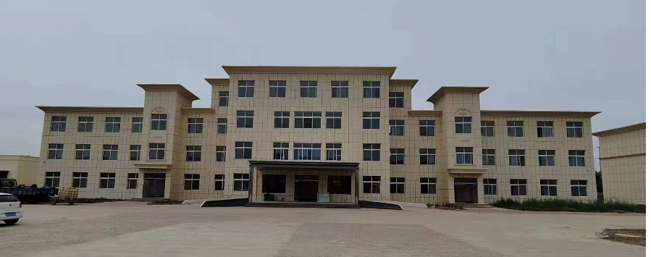
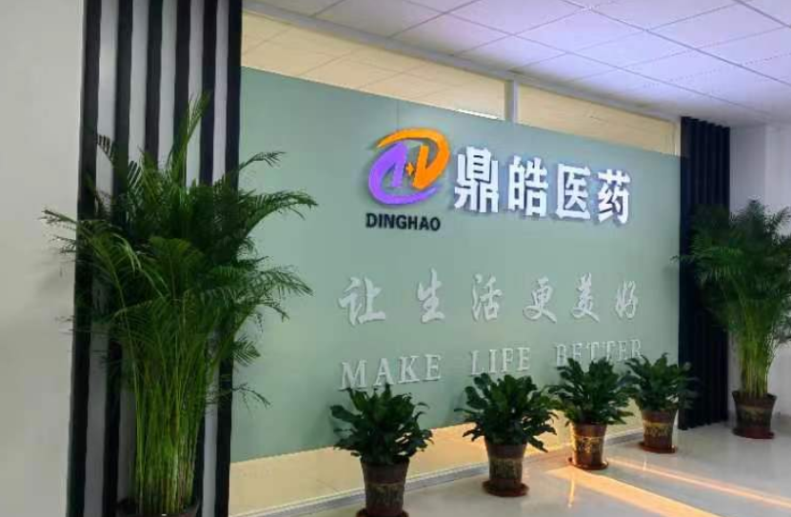
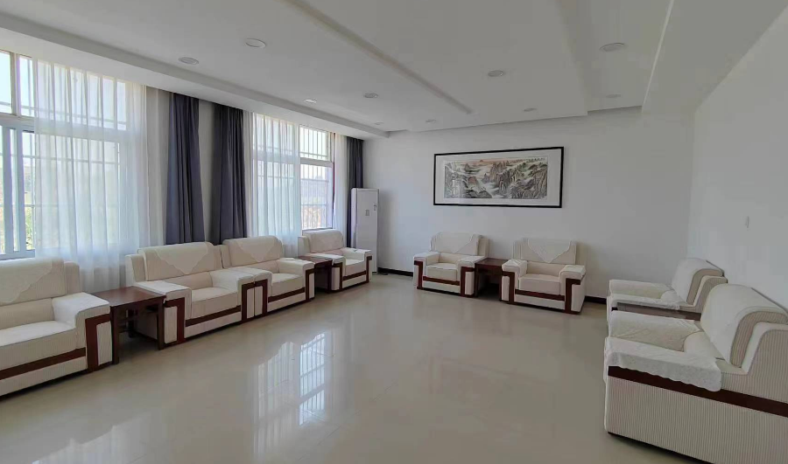
一. Company Profile-Overview
Shandong Dinghao Biotechnology Co., LTD., founded in 2018 and headquartered in Jinan, Shandong Province, is a high-tech enterprise engaged in the production and sales, technology development and service of APIs, pharmaceutical intermediates and fine chemicals. At present, there are over 160 employees, and 30 full-time R&D personnel.
The founding shareholders are composed of university professors, Taishan leading talents and professional managers. The company implements standardized management based on "institutionalization, processizing, digitization and humanization", and takes "harmonious coexistence and happy work" as the team vision; takes “achieving customers, enriching employees, serving health and benefiting mankind" as the core values, and focuses on brand building and technological innovation. It has maintained long-term cooperative relations with many colleges and universities in China.
With complete laboratory and experimental facilities and high-level R & D team, we have maintained good cooperative relations with many large chemical, pharmaceutical and electronic enterprises in domestic and overseas, and have excellent customer satisfaction.

Slide 4
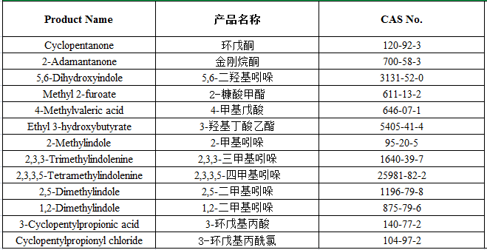
一. Company Profile-Leading variety
The company has strong production and transformation ability, first-class quality control ability of similar enterprises, and currently there are more than 80 commercial varieties, including the metal ions of Cyclopentanone and Adamantanone can be controlled at ppb level, and has established supply relationships with Osaka Organic and TSMC.
High purity sodium bisulfite has established long-term supply relationship with Kao of Japan.
1-methylindole has established long-term supply relationship with Astrazeneca.
2-Methylindoline and 4-Chloro-3-sulphamoylbenzoic acid have been established long-term supply relationship with Servier.
Fine Chemicals

Slide 5
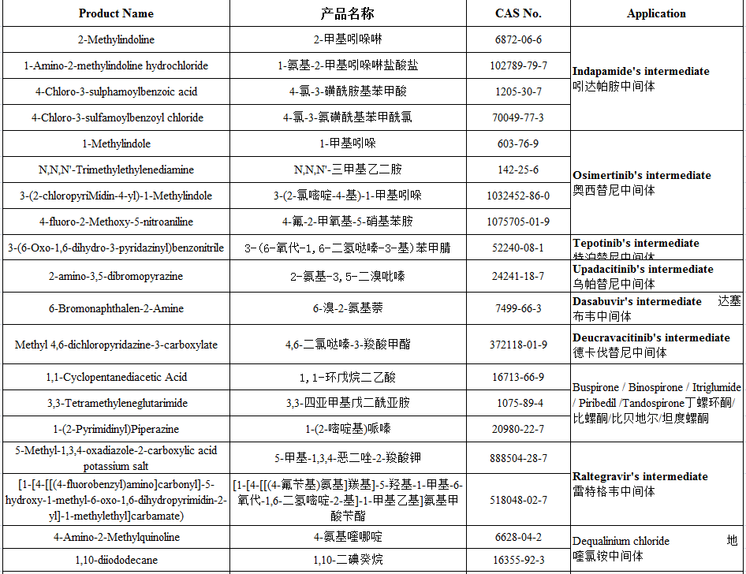
一. Company Profile-Leading variety
Pharmaceutical Intermediates

Slide 6
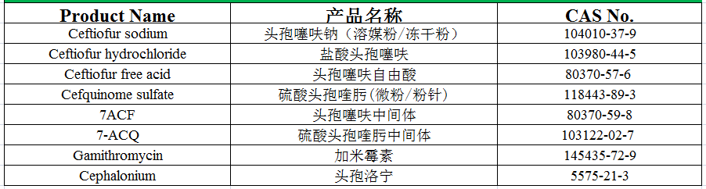
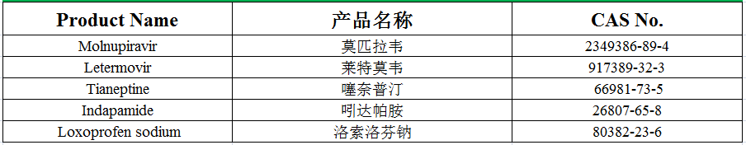
一. Company Profile-Leading variety
Veterinary APIs
Active Pharmaceutical Ingredients

Slide 7
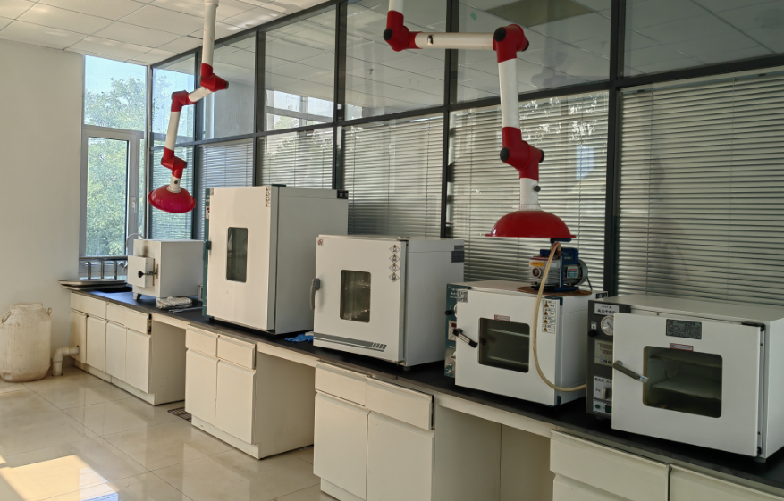
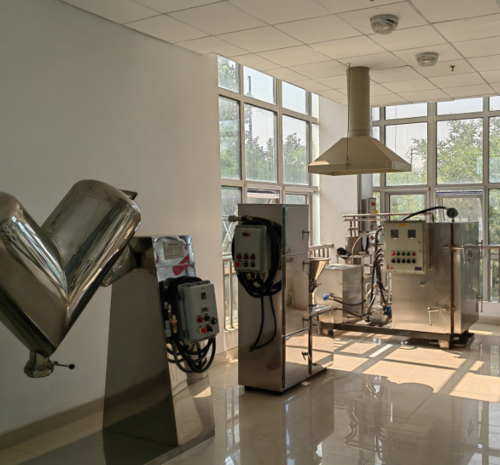
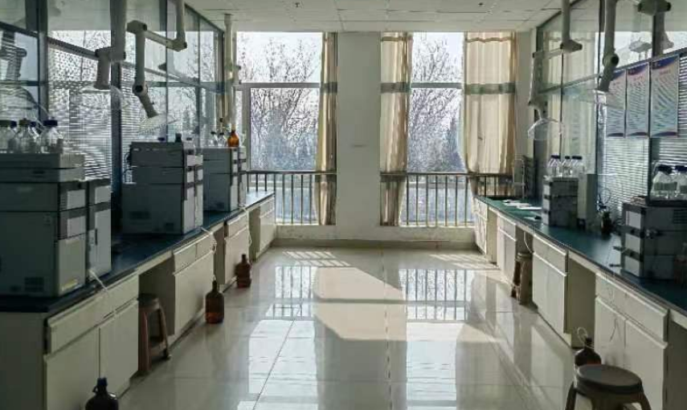
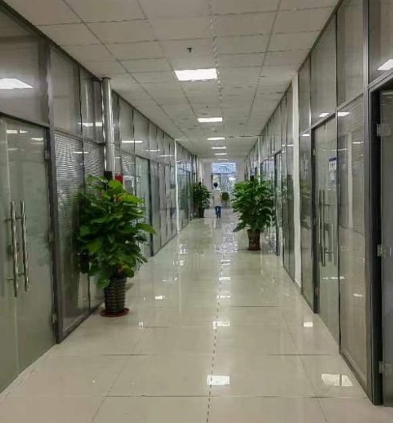
一. Company Profile-R&D Center
The R&D Center is situated in High-end chemical API Base, Shanghe Chemical Industry Park, responsible for the company's new project product technology development, pilot scale and product process optimization work, while providing customized services for domestic and foreign customers.
The R&D Center covers an area of 2000m², with complete procedures, equipment and facilities and perfect functions. It can complete all kinds of synthetic reactions with a volume of 250ml-3000L, also equips with dozens of testing equipments, such as, Shimadzu, Agilent chromatograph and other types. It is equipped with 30 professional R & D personnel, including 1 doctor, 5masters, 1 "Taishan Industry leader", 8 person with intermediate titles.

Slide 8
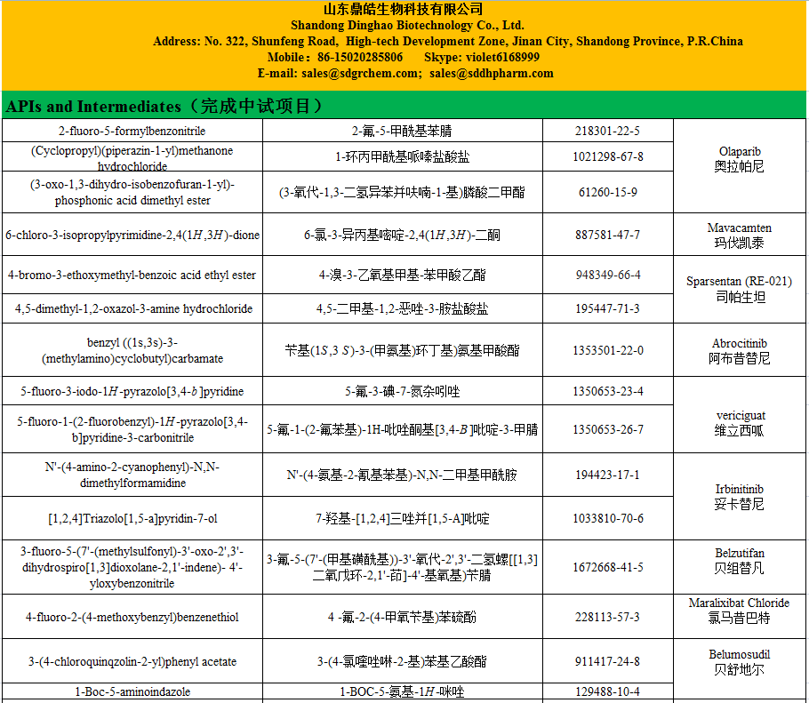
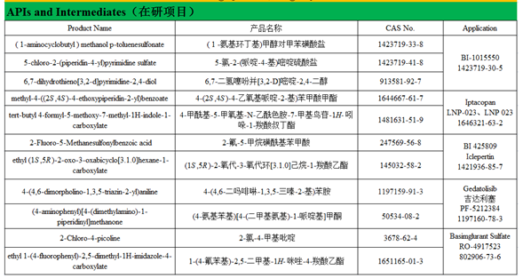
一. Company Profile-R&D Center
The R&D key personnel are from the synthesis and pilot departments of Pharmatech, Pharmaron, Kelaein and other pharmaceutical companies, familiar with oxidation, reduction, substitution, coupling and other reaction types, with a strong ability to quickly transform and scale up, providing a strong guarantee for timely and stable supply.
The R&D Center has completed the following projects in the past 2 years:

Slide 9
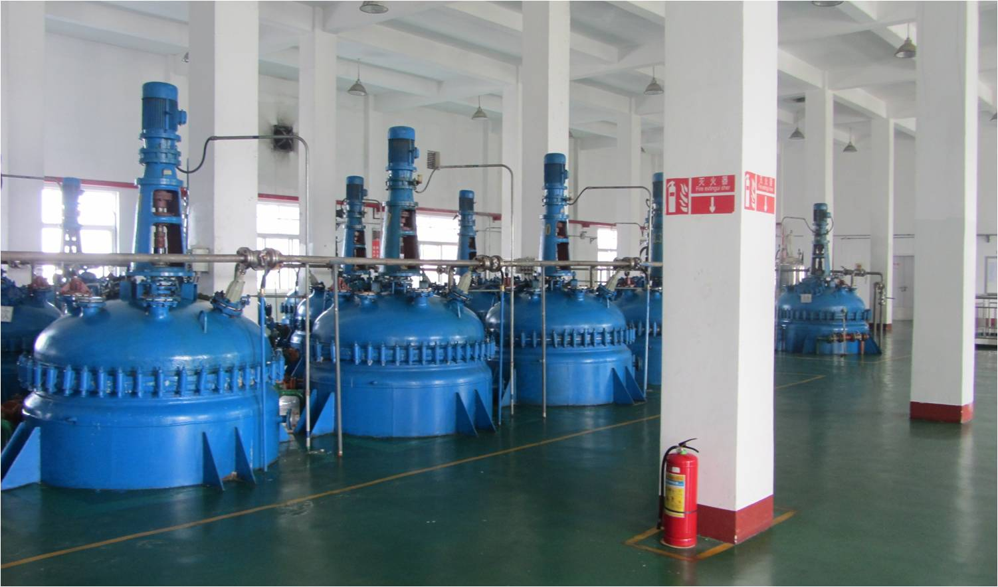
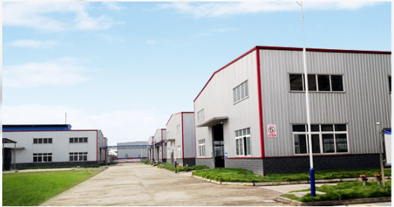
一. Company Profile-Manufacturing Base
Each base has complete procedures, standardized management, and can accept on-site audit.
Jinan Dinghao Pharm
Shandong Helichang New Material
Undertake new product R&D, the pilot, scale-up production of new varieties
Cyclopentanone 5000 Tons/year, 2-Methylindoline 50 Tons/year, 4-Chloro-3-sulphamoylbenzoic acid, 50 Tons/year
Four Bases
Shandong Dinghao Pharmaceutical
Shanxi
Veteriary APIs: Ceftiofur sodium, Cefquinome sulfate, Ceftiofur hydrochloride, Ceftiofur free acid, 200Ton/year
1-Methylindole 20 Tons/year, 1-bromo-3-methyl-2-buten10 Tons/year

Slide 10
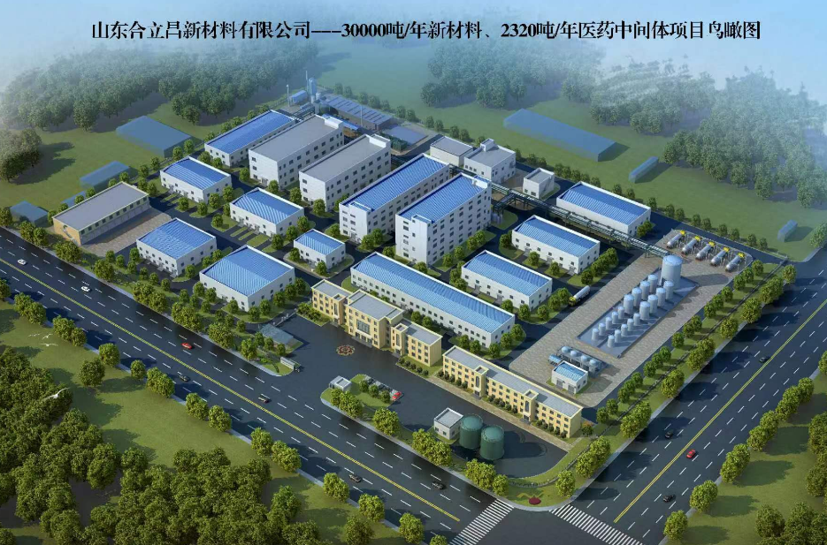
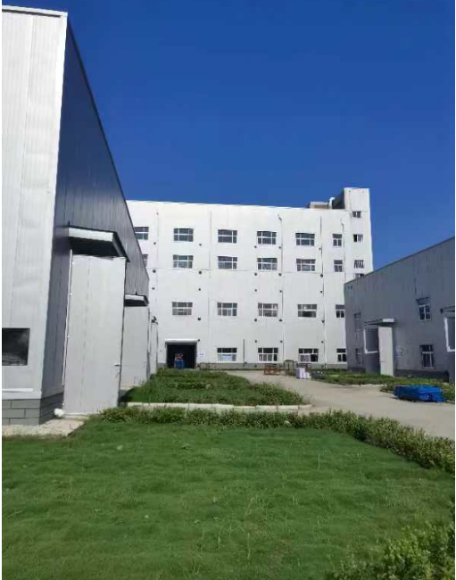
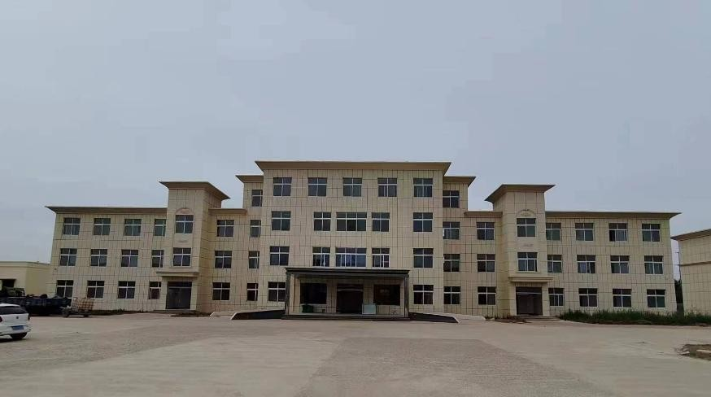
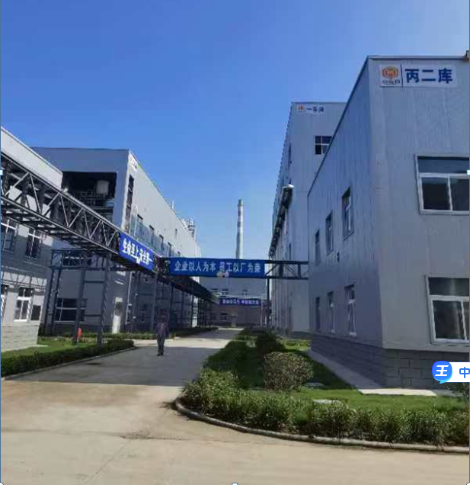
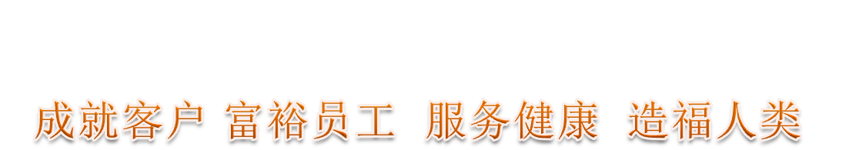

一. Company Profile-New Manufacturing(New plant)
Located in Juancheng chemical industry Park, Heze City
It covers an area of 70000 square meters
Registered capital 30,000,000 (CNY)
Capability：New materials: 30000 Tons/year, Intermediates: 2320 Tons/year
All kinds of equipment, management standards, in line with customer audit requirements, has been put into production in the end of 2023.

Slide 11
二. Technical Capability
Dinghao has provided customized production services for dozens of pharmaceutical companies, covering gram level to tonnage level supply capacity, with rapid and stable supply capacity, advanced QBD research and development concept, won a good reputation.
Technology advantage
High-temperature reaction:
300℃ 500L-3000L
Reaction under high pressure:
50 bar 500L-3000L
Fluoridation, bromination, chlorosulfonation, diazotization
Low-temperature reaction ：
-78℃ 500L-1000L
Liquid ammonia reaction
C-C coupling, catalytic hydrogenation
Reduced pressure distillation：tower height 20m, ~200 Pa
Indole series product
Cephalosporin antibiotics

Slide 12
三. State of Operation
The company is in good business condition, with sales of more than 200 million CNY for three consecutive years, and long-term rapid supply ability.

Slide 13
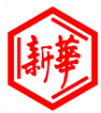













四. Cooperative Partner
Timely and efficient, rigorous and standardized, trustworthy
The company has established long-term cooperative relations with dozens of enterprises such as Astrazeneca, Servier, Qilu Pharmaceutical, Roxin Pharmaceutical, Kao, Osaka Organic, etc., and has been audited by domestic and foreign customers for many times and won high praise.

Slide 14
