Slide 1


Virus Counter® Plus Platform
Automated, benchtop system for rapid and direct virus quantification
Customer Facing Presentation

Slide 2
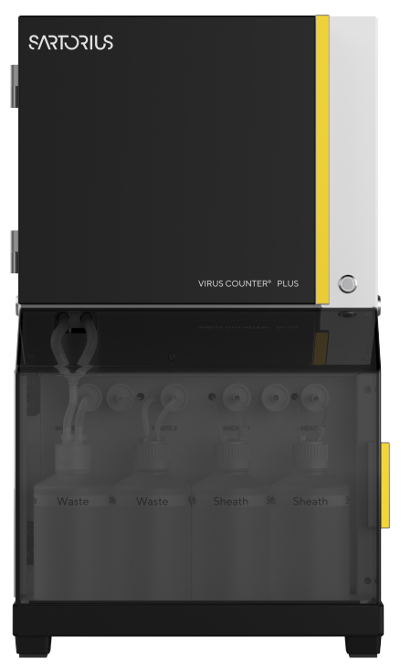
Agenda
Challenges in Virus Particle Quantification
About the Virus Counter® Plus
Virus Counter® Plus Technology
Applications in the Bio-Pharma Industry
Customer Benefits
Summary

Slide 3
Challenges in Virus Particle Quantification

Slide 4




Modern Virus Quantification Needs
Challenges in Virus Particle Quantification
Viruses play crucial roles as essential components and tools in numerous modern therapies
Cell Therapy
Gene Therapy
Vaccines
Recomb. Proteins
Higher viral product yield Shortened time-to-market Increased patient safety

Slide 5



Drawbacks of Traditional Virus Quantification Drawbacks
Challenges in Virus Particle Quantification
Research
Subjectivity Some methods rely on visual interpretation, which can introduce subjectivity
and variability in results.
Labor-Intensive Manual handling and procedures lead to resource-intensive workflows.
Development
Variability Traditional assays are complex, time consuming, and require technical expertise.
Time-Consuming Results can take days or weeks which lead to increased development costs.
Production Delays Time-consuming methods lead to delays during manufacturing.
Batch-to-Bach Variability Traditional techniques may result in inconsistent production batches.
Manufacturing

Slide 6
Why Precise and Fast Counting Methods Are Necessary
Challenges in Virus Particle Quantification
Customer need to gain virus titer insight rapidly and with high precision to optimize their production processes and monitor manufacturing to ensure high yields and quality.
Accuracy of Results
Process Optimization
Cost Efficiency
Decision-taking
Precise Titer is crucial for validation of experiments
Ensure product quality
Early detection and correction of deviations in virus concentration
Precise monitoring and control of production
Avoid no-added value work and reduce labor costs
Fast and precise counting directly contribute to profitability
Fast decision-taking to speed up process
Confidents with reliable insights

Slide 7
About the Virus Counter® Plus

Slide 8
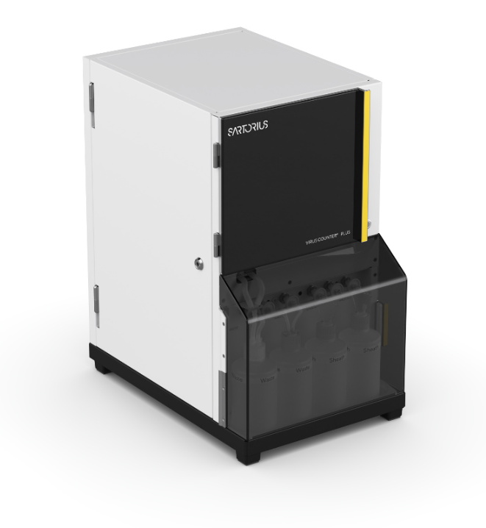
Product Introduction
About the Virus Counter® Plus
The Virus Counter® Plus platform specializes in the rapid, direct, and precise quantification of small virus-sized particles using antibody and dual label assays.
It enables customers to gain real-time insights into their viral vector manufacturing processes.

Slide 9
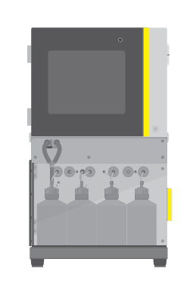
The Virus Counter® Plus Platform
About the Virus Counter® Plus
The Virus Counter® Plus platform featuring the Virus Counter® Plus instrument, highly specific reagents and integrated software, makes virus quantification rapid, precise and simple.
Virotag® Reagents
Virus Counter® Plus Instrument
Virus Counter® Plus Software

Slide 10

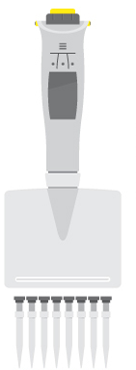
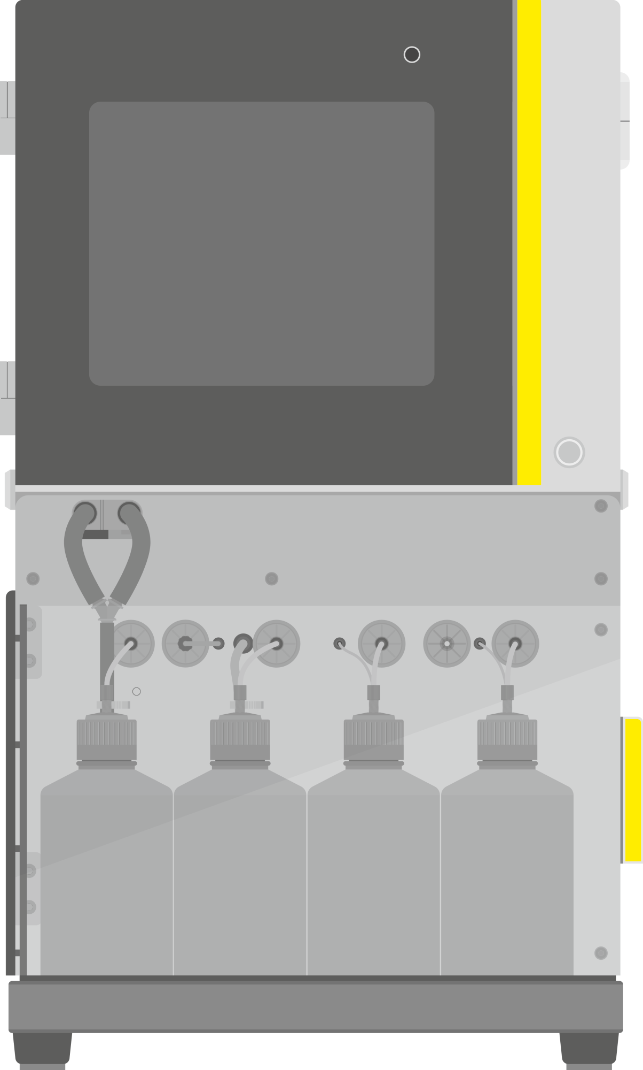

Sample Preparation and Analysis Workflow
About the Virus Counter® Plus
Simple, No Wash sample staining process for rapid virus quantification
Virotag® Reagent
Virus sample
Labeled Virus Sample
Mix virus samples with Virotag® reagents
Add labeled virus samples and incubate
Place 96-well plate in Virus Counter® Plus, and initiate walkaway analysis
Review and analyze data in the Virus Counter® Plus application

Slide 11





5 Benefits of the Virus Counter® Plus Platform
About the Virus Counter® Plus
Walk-away Automation
Rapid Results
Simple Workflows
Automated sample processing in 96-well format reduces hands-on time and human errors, ensuring consistent and reproduceable results across all samples. This leads to increased throughput, time efficiency and cost savings.
Accelerate time-to-result and process development timelines with rapid titer insights. Instrument can process high number of samples (96-well format) in a short amount of time (5 min/sample).
The Virotag® assay kits provide ready-to-use, and specific quantification solutions with straightforward, no-wash assays. The labeling reagents enable the direct counting of virus particles through fluorescence.
High Precision
Robust Design
The Virus Counter® Plus provide accurate and reliable measurements of virus concentrations. High reproducibility for confidence in the results to make critical decisions. Performance verification solutions verify optimal instrument performance. Coefficient of variation (CV) typically below 10%.
Easy to clean surfaces and re-design of critical components including a fully improved optical deck provide a more robust and efficient system that arrives in alignment. The modular design greatly enhances the hardware's accessibility, simplifying troubleshooting, service and maintenance tasks.

Slide 12
Virus Counter® Plus Technology

Slide 13
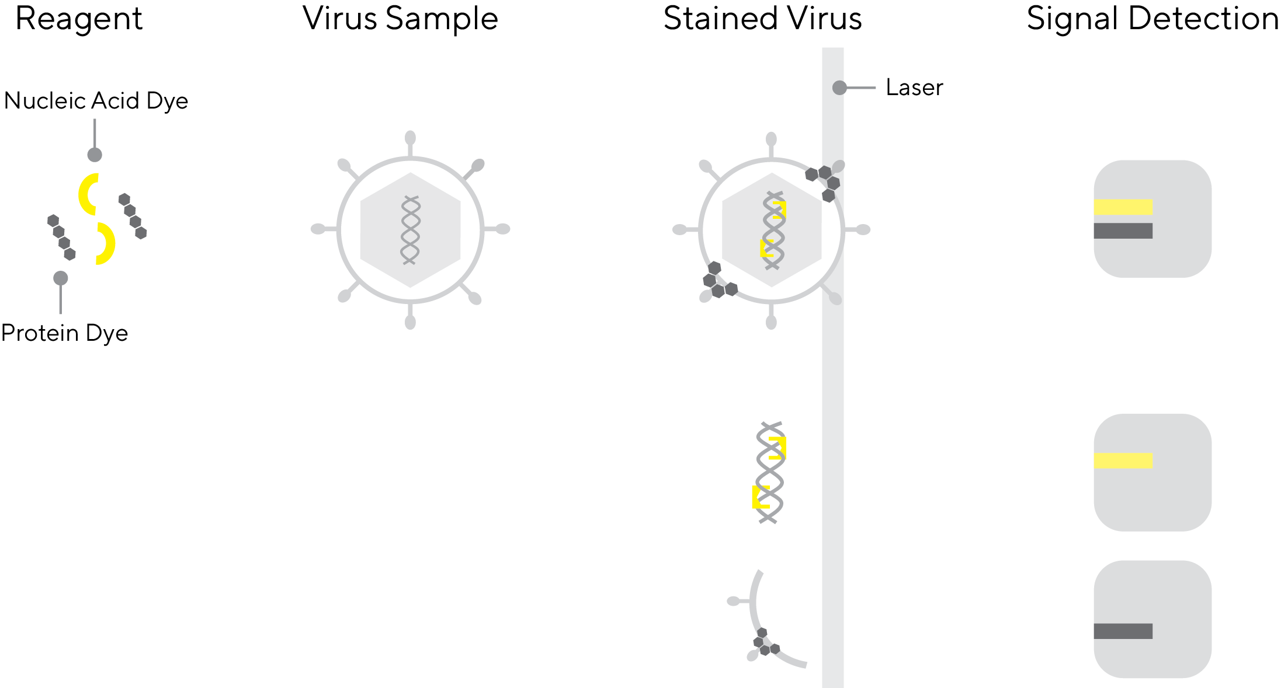




Quantification Using Laser Excitation of Fluorescent Dyes
Virus Counter® Plus Technology
Laser light
Excitation
Light Emission
Signal Detection
Stained Virus Sample
Hydrodynamic Focusing
Sheath Fluid
Sample Introduction

Slide 14
Virotag® Reagents
Virus Counter® Plus Technology
2 Types of Reagents
Virotag® DY Reagents
Virotag® AB Reagents
Universal Dual Stain Labeling of Viruses
Nucleic Acid dye
Protein Dye
Antibody Based Labeling of Viruses
High Affinity
High Specificity
Reagent | Virus / vector
Virotag® DY ENV | All enveloped viruses
Reagent | Virus / vector
Virotag® BCVB | Baculovirus
Virotag® INVA | Influenza virus A
Virotag® INVB | Influenza virus B
Virotag® VSVG | Lentivirus (VSVG, pseudotyped Lenti VSV-G, BacMam VSV-G)

Slide 15
Virus Staining with Virotag® DY Reagents
Virus Counter® Plus Technology
Reagent
Virus Sample
Stained Virus
Signal Detection
When viruses labeled with Virotag® DY pass through the Virus Counter® Plus, a laser excites two fluorophores emitting light at different wavelengths. The instrument detects a simultaneous signal from both protein and nucleic acid stains, counting it as an intact virus particle.
Simultaneous Signal
from protein and
nucleic acid dye
Intact Virus Particle
Free nucleic acid is stained by the dye but emits light on only one channel, which is detected but not counted. Similarly, detected fragments of the virus, if large enough, are also not counted as complete virus particles.
Single Signal
of either protein or
nucleic acid dye
Virus Fragment

Slide 16
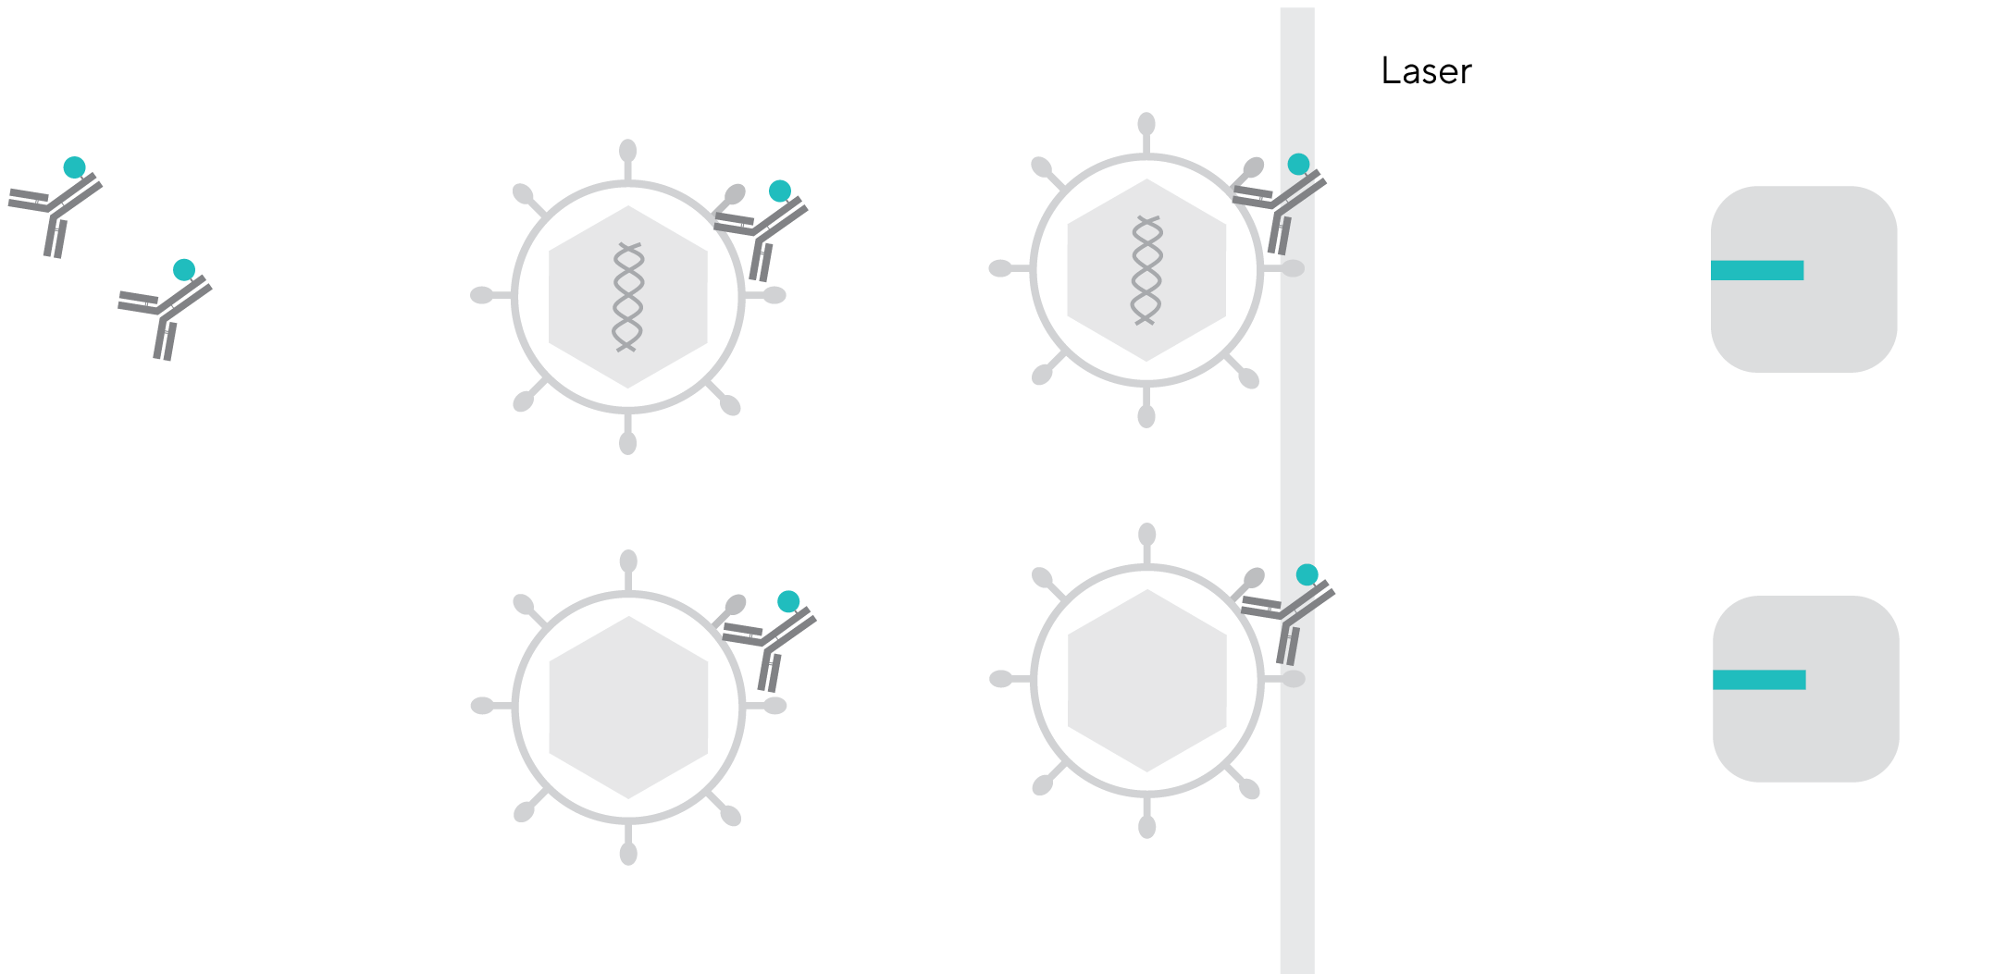

Virus Detection with Virotag® AB Reagents
Virus Counter® Plus Technology
Reagent
Virus Sample
Stained Virus
Signal Detection
Signal
from multiple
bound antibodies
Detection of empty
and full capsids
The antibody-based (AB) Virotag® reagents bind to specific epitopes on the virus surface, regardless of whether the virus contains nucleic acid within the capsid. This method uses a single signal to indicate the presence of a virus particle.

Slide 17
Applications in the Bio-Pharma Industry

Slide 18




Challenges in Bio-Pharma Industry
Applications in the Bio-Pharma Industry
Your
Challenge
Our
Solution
The
Benefits
Achieving high virus yields and titers is crucial for cost-effective production. Optimizing viral vector constructs to maximize virus production can be challenging and may require extensive experimentation.
The Virus Counter® Plus delivers specific, precise and direct virus quantification. It reduces hands-on time and increases reputability with full walk-away operation. This addresses the customer need to gain direct insights in real-time to understand their processes.
Process development acceleration and optimization with an increased product safety and quality by in-depth sample characterization. Walk-away sample measurement (96-well plate) with CVs below 10%. Automation reduces the labor and increase overall operational efficiency.

Slide 19
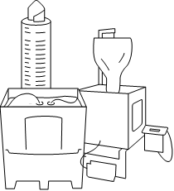
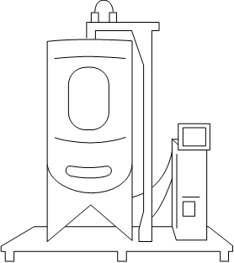
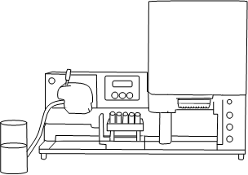
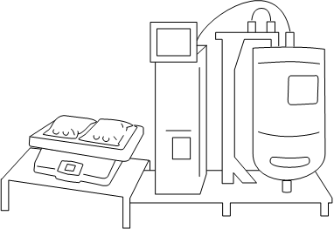
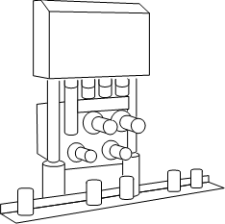
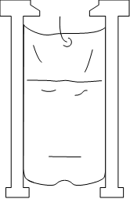


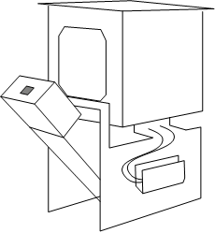
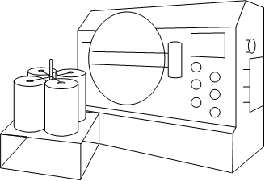
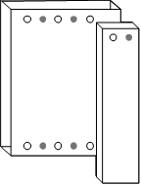
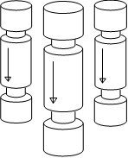
Virus Quantification in Process Development and Manufacturing
Applications in the Bio-Pharma Industry
Basic Research
Pre-Clinical
Clinical Dev
Manufacturing
User Application
Optimization of growth conditions
Real-time virus titer
Upstream
Production of the desired drug
Culture media
preparation
Seed cultivation
Scale-up
Production
Downstream
Isolation & filling of the desired drug
Final
filling
Cryo-preservation
Sterile
filtration
Concentration
Virus removal
filtration
Polishing
Viral
clearance
Clarification and centrifugation
User Application
Characterize product in depth
Track purification
Optimize yield

Slide 20


Scenarios in Which the Virus Counter® Plus Is Used for Virus Quantification
Applications in the Bio-Pharma Industry
Fully automated and rapid virus particle quantification offers significant value by saving time, increasing throughput, improving data accuracy, and reducing labor costs. It enables researchers and production to efficiently analyze virus samples, accelerating research progress and facilitating the development and production of viral-based therapeutics and vaccines.
A
Vaccine Development
Assessing the viral particle concentration in vaccine formulations during development to ensure the desired dosage and efficacy.
Assessment of purification efficiency and the determination of virus yield
B
Viral Vector Manufacturing
Monitoring the yield of viral vectors used in gene therapy or vaccine delivery systems to optimize production processes and ensure high titers.
A
B
Precise quantification is essential for ensuring product consistency
Real-time monitoring of virus particle concentration
C
C
Virus Purification
Quantifying virus particles before and after purification steps to evaluate the efficiency of purification processes and ensure product purity.

Slide 21
Customer Benefits

Slide 22

What
are the core
benefits?
1
Rapid Results
Titer insights rapidly to accelerate customers time to result and process development timelines
2
Biologically Relevant
Derives virus titer from total particle count with high affinity and precision reagents
3
High Precision
High reproducibility for confidence in customer results to make critical decisions
4
Automation
Automated sample processing in 96-well format reduces hands-on time for customers and increase reliability
5
Direct Measurement
Direct enumeration of stained virus particles by measurements of emitted fluorescence

Slide 23
Summary

Slide 24





Virus Counter® Plus Platform
Summary
Solution
The Virus Counter® Plus platform allows
virus titer insight rapidly and with high precision to optimize their production processes and reduce time to market
Higher product yield and quality
Optimization of development and manufacturing processes
Quicker development timelines
Accelerated time-to-result and gain critical insights immediately
Increased confidence
Precise sample characterization to make the right decisions
Improvements
Automation
Redesigned optical deck
Internal pump eliminating need for external gas
Robust construction
Modular design enabling serviceability
Features
Quicker time-to-result: Faster Bioprocess PD
High reproducibility: Reliable result
Less hands-on time: Increased productivity
Ease-of-use: Reduced user training & error
High Specificity: Confidence in the readout

Slide 25

Thank you.

