Slide 1

CONVICTION.
COMMITMENT.
QUALITY.

Slide 2
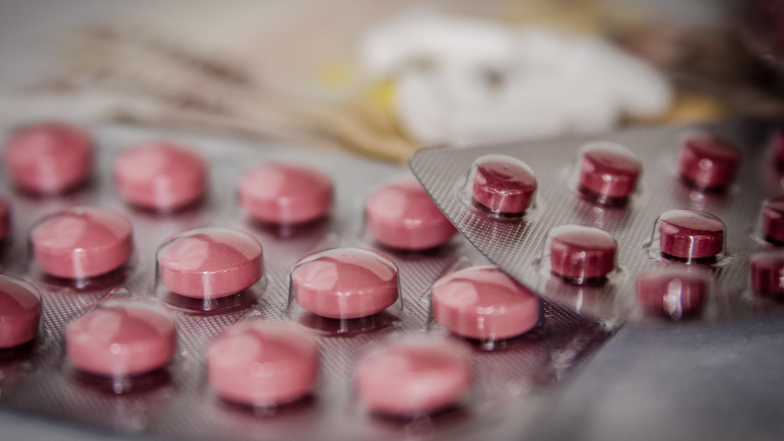
Incorporated in the year 2001.
Promoted by professionals having industry experience of more than 40 years.
Year 2001 - 2003: Started as first few Soft Gelatin Capsule Manufacturers in India. Commenced manufacturing of Tablets, Hard Gelatin Capsules & Oral Liquids with the key focus of supplying to International Markets.
Year 2009: Commenced manufacturing of Sachets.
Year 2012: Established R&D center for Formulation & Analytical Development.
Year 2015: Commissioned state of the art Soft Gelatin Capsules manufacturing facility in Neemrana, Rajasthan.
Year 2017: Decision to enter regulated markets like UK, EU, Australia, Brazil, Singapore etc.
Year 2020: First Marketing Authorization grant in European Union.
Year 2021: First Marketing Authorization grant in the United Kingdom.
Year 2021: First Marketing Authorization grant in Australia.
Year 2022: First Marketing Authorization grant in Singapore.
Headquartered in New Delhi and International Offices in Singapore, Vietnam and Philippines.
Journey
so far

Slide 3

2014
FDA Philippines
2016
SAUMP Ukraine
and
FMHACA Ethiopia
2017
EUGMP for HG Caps and Sachets
2017
EU GMP for Soft Gelatin Capsules
Regulatory
Achievements
2018
TGA Desktop Clearance
2019
EU GMP for Tablets and Oral Liquids
2022
EUGMP for Tablets, HG Caps, Sachets and Oral Liquids
2023
SBDMA – Yemen for All Dosage Forms
2023
ANVISA – Brazil for Soft Gelatin Capsules

Slide 4


Conviction for Quality
Commitment to Make a Healthier Mankind
Vision
Quality Medicines for all at Affordable Prices

Slide 5
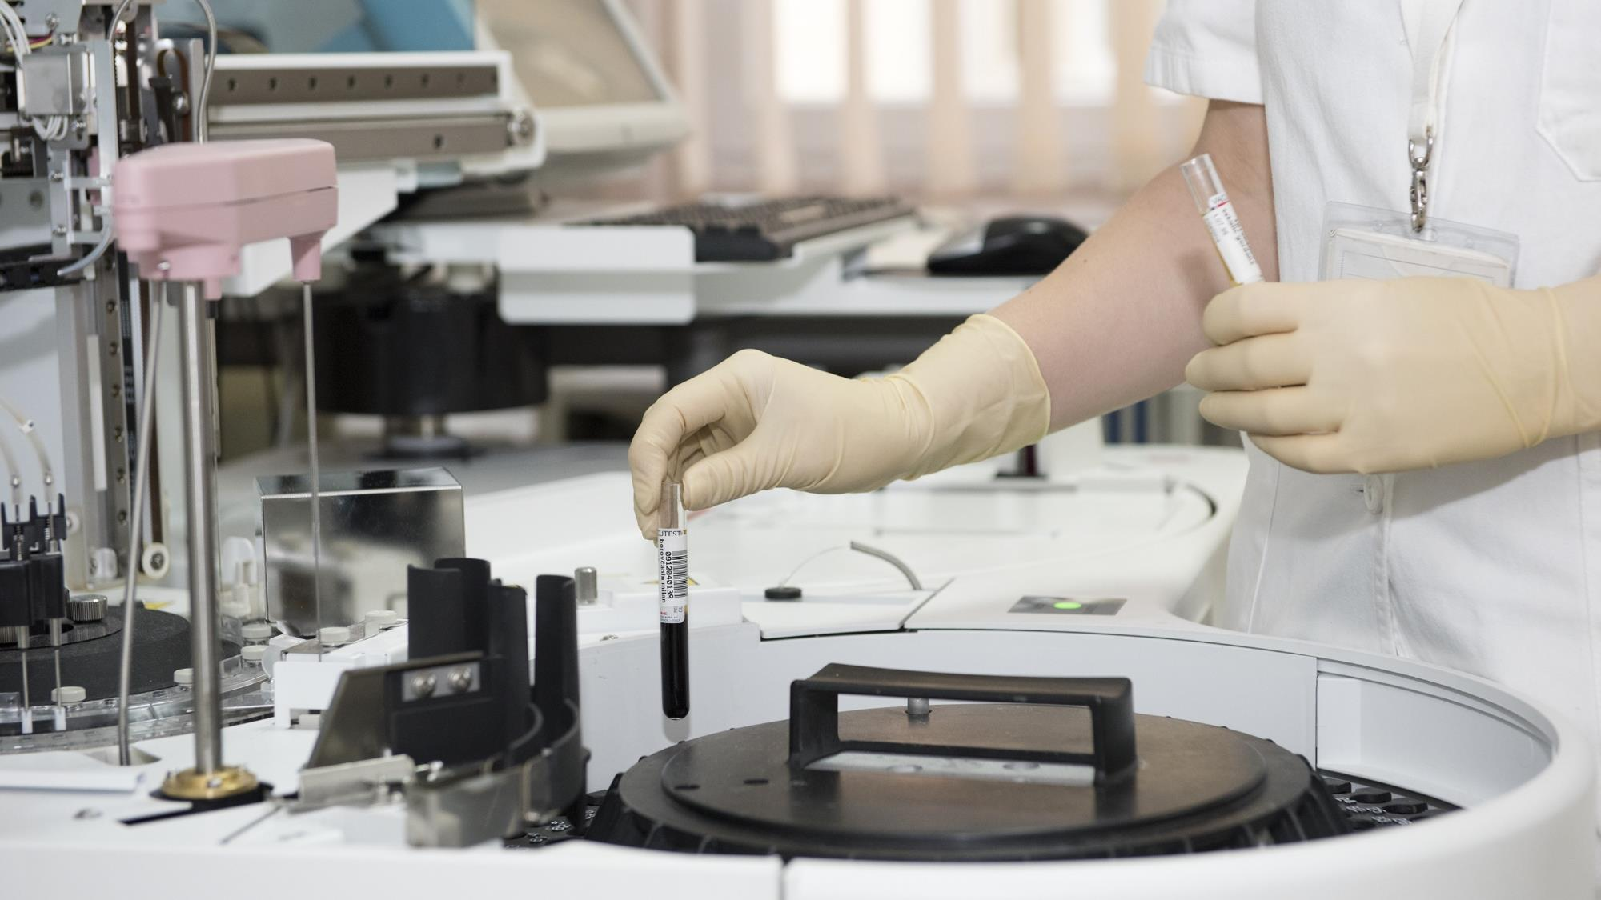


QUALITY
POLICY
We are committed to protect the environment, health & safety of our employees, suppliers, customers & the public by conducting our plant operation of manufacturing in a safe & environmentally sustainable manner.

Slide 6


BEYOND
BOUNDARIES

Slide 7

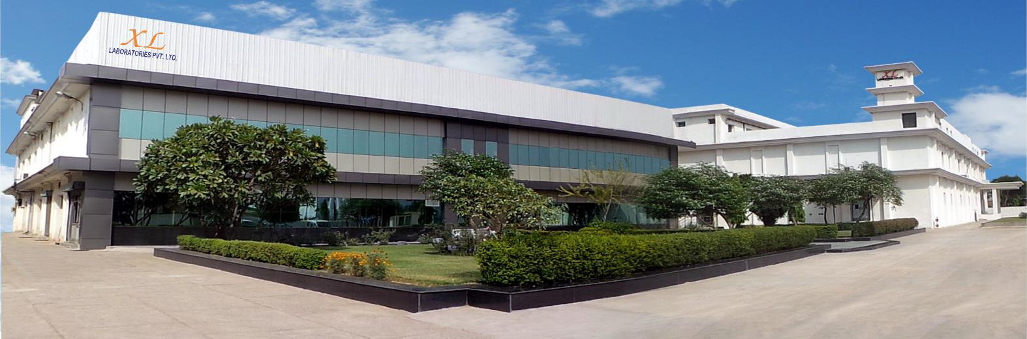
BHIWADI
MANUFACTURING FACILITY
TABLETS.
HARD GELATIN CAPSULES.
SOFT GELATIN CAPSULES. ORAL LIQUIDS.
SACHETS.

Slide 8

BHIWADI
PLANT
Regulatory Approvals & Accreditations: EU GMP, TGA-Australia (Clearance), PIC/s (SAUMP, Ukraine), FMHACA - Ethiopia, FDA – Philippines, FDA – Ghana, NAFDAC – Nigeria, SBDMA – Yemen, WHO-GMP, GLP, ISO9001, ISO14001, HALAL.
Fully integrated granulation lines for Tablets, Hard Gelatin Capsules and Sachets.
Temperatures maintained at NMT 25⁰C.
Low RH manufacturing areas available for specific processes.
Automated processes wherever possible to eliminate human error.
Online check weigher for Capsule manufacturing.
Online metal detectors available.
Blister packing machines with online camera inspection systems.
End of line automation for all packing lines with cartonators, online check weighers and automatic shrink wrapping.
Serialization ready for Europe Markets for EU FMD compliance.

Slide 9
QUALITY ASSURANCE
FUNCTION
Site Quality Assurance is responsible for:
Quality Management System
Qualifications & Validations
In process Quality Assurance
Continuous Process Verification
Handling of Market Complaint
Handling of Investigation
Vendor Qualification
Handling of Out of Specification
Handling of Out of Trend

Slide 10
PRODUCTION
CAPACITIES*
Tablets: 1,500,000,000 tablets / annum
Hard Gelatin Capsules: 1,000,000,000 capsules / annum
Sachets: 65,000,000 sachets / annum
Oral Liquids: 200,000 ltrs. / annum
Soft Gelatin Capsules: 600,000,000 soft gelatin capsules / annum
*Based on single shift working

Slide 11
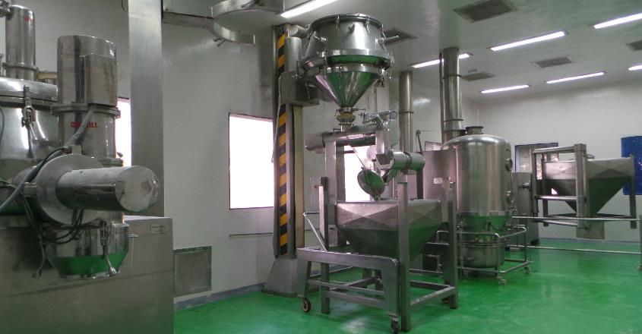
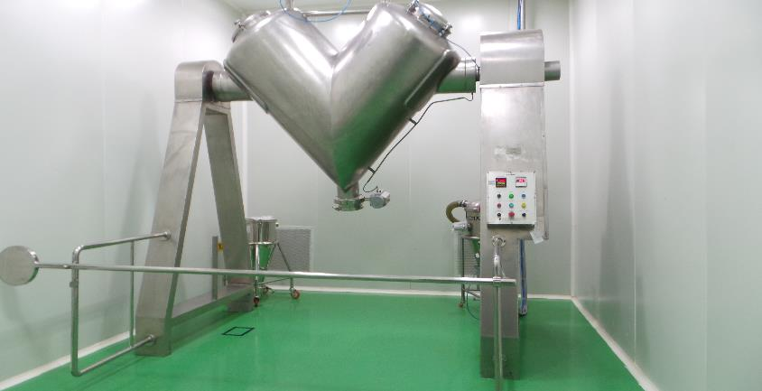
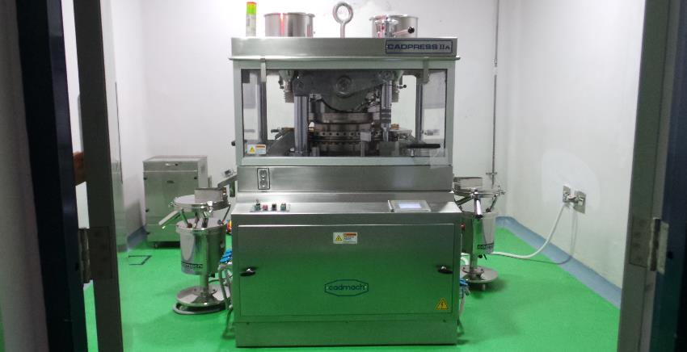
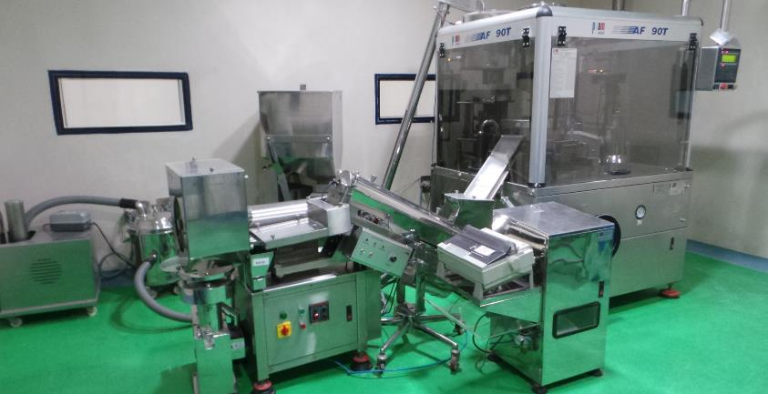

Slide 12
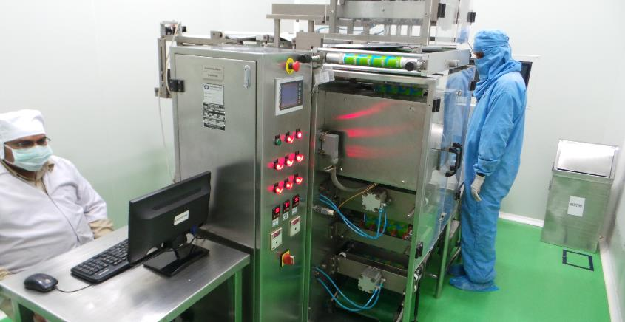
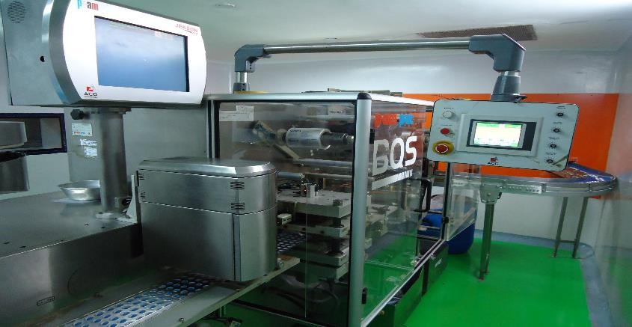
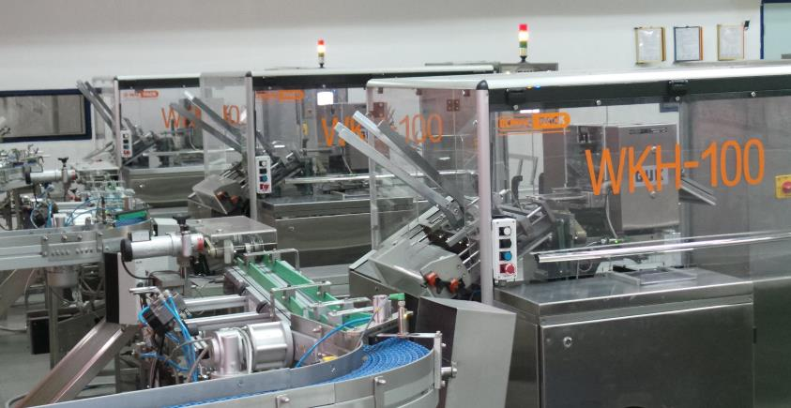
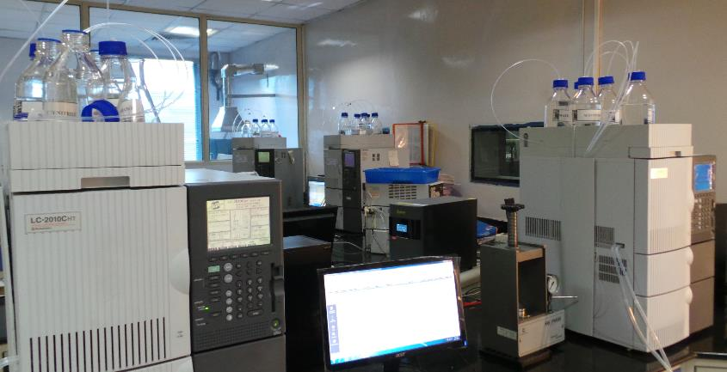

Slide 13
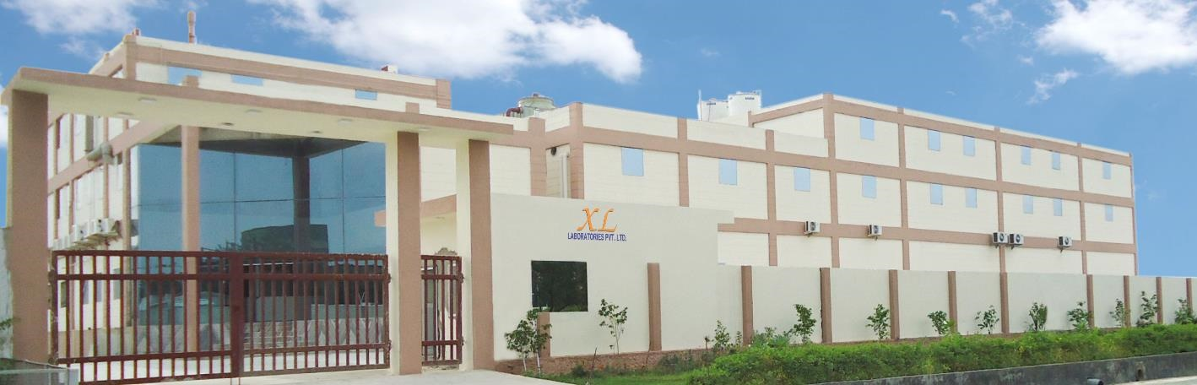
NEEMRANA
MANUFACTURING FACILITY
SOFT
GELATIN
CAPSULES

Slide 14
NEEMRANA
PLANT
Regulatory Approvals & Accreditations: EU GMP, TGA –Australia (Clearance), ANVISA – Brazil, WHO-GMP, HALAL.
Fully integrated encapsulation lines for Soft Gelatin Capsules.
Temperatures maintained at NMT 25⁰C.
Low RH maintained in manufacturing areas with product exposure.
Ultra low RH (15%) drying chambers for capsule drying.
Capsule sorting & polishing done prior to packaging operations.
High speed blister packing machines.
End of line automation for packing lines with cartonators and online check weighers.
Serialization ready for Europe Markets for EU FMD compliance.

Slide 15
PRODUCTION
CAPACITIES*
Soft Gelatin Capsules: 600,000,000 soft gelatin capsules / annum
*Based on single shift working

Slide 16
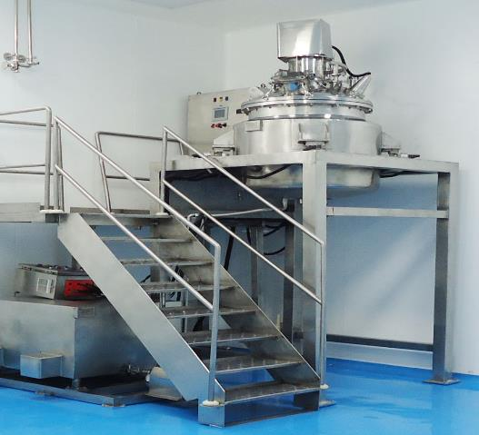
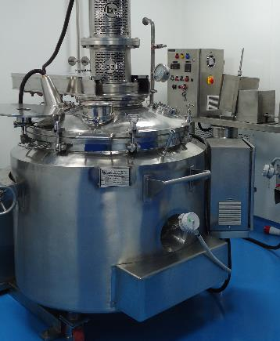
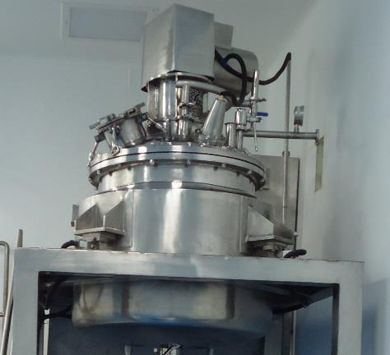
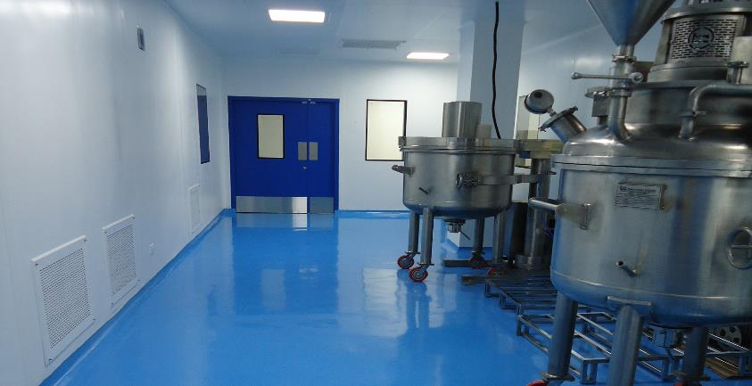
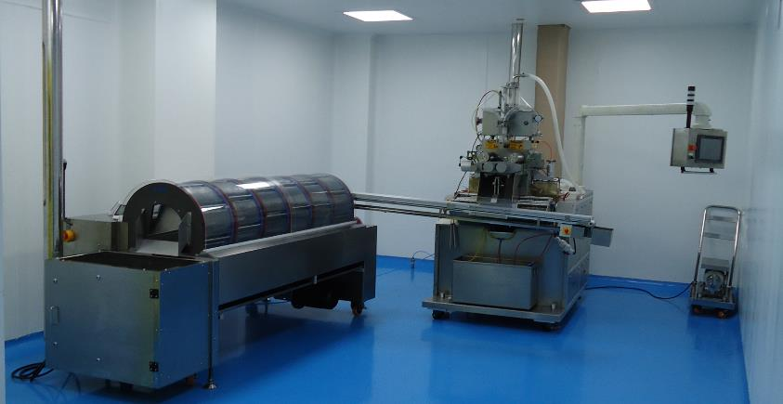
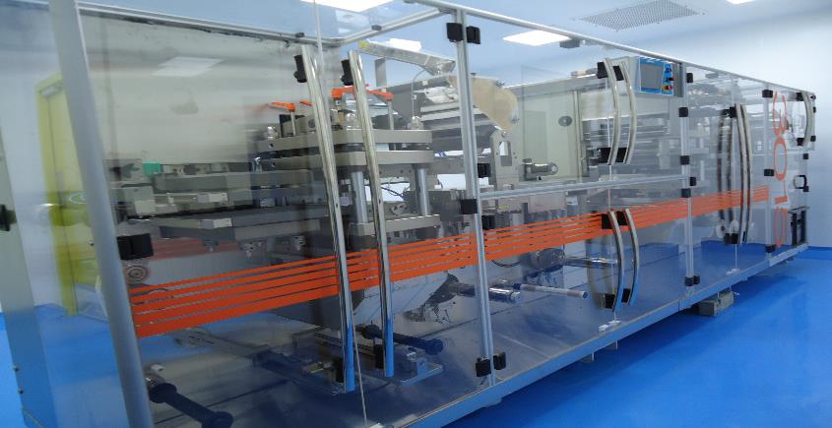

Slide 17
We have an in house R&D lab which has been accredited with Department of Science & Industrial Research, Govt. of India.
Projects undertaken are as under:
Formulation Development
Formulation Optimization
Analytical Method Development
Analytical Method Validation
Technology Transfer
Contract Development Services
RESEARCH & DEVELOPMENT

Slide 18
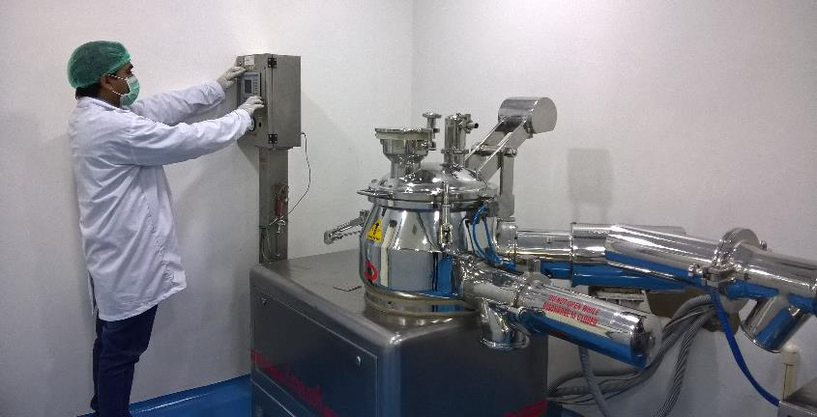
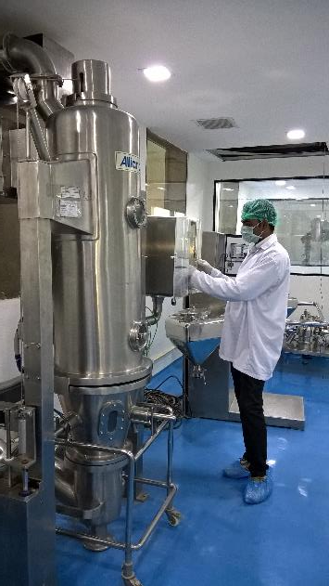
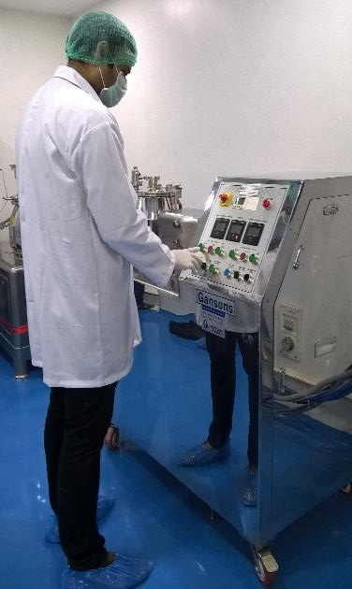
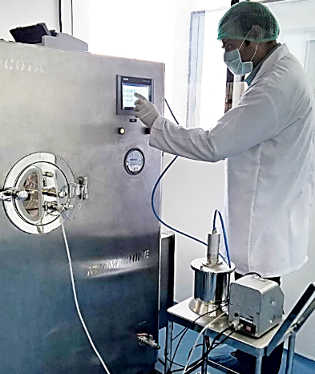
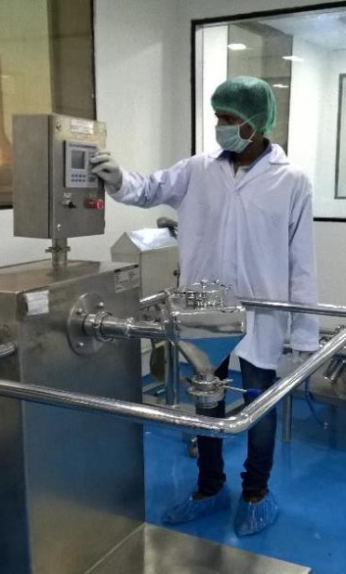

Slide 19

XL offers an array of services to the global pharmaceutical manufacturers, marketing companies, traders, agents etc. with the motive to touch human lives for better health for all.
Services Offered:
Out Licensing
Contract Development (Analytical / Formulation)
Stability Studies
Contract Manufacturing
For Tablets, Hard Gelatin Capsules, Soft Gelatin Capsules, Oral Liquids & Sachets from our EU GMP approved manufacturing facilities.
SERVICES

Slide 20

Your Partner on the Path of Making…
…a Healthier Mankind
Contact us at admin@xllaboratories.com

