Slide 1



www.avalonpharmaceutical.com

Slide 2

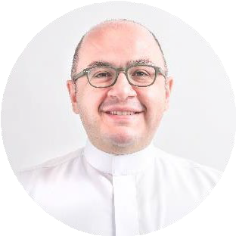
Avalon Pharma is an energetic company that develops, manufactures and markets a wide range of unique health and beauty brands and generic prescription medicines.
We are ambitious, competitive, innovative, dynamic and agile. Our focus is on serving the needs of the medical, pharmaceutical and scientific communities who prescribe, endorse and dispense our products.
We create win-win relationships with our commercial partners, (in both the private and public sectors), and we are committed to building long-term partnerships with likeminded healthcare companies in Saudi Arabia and around the world.
Maher Ghannam
Chief Executive Officer
www.avalonpharmaceutical.com

Slide 3
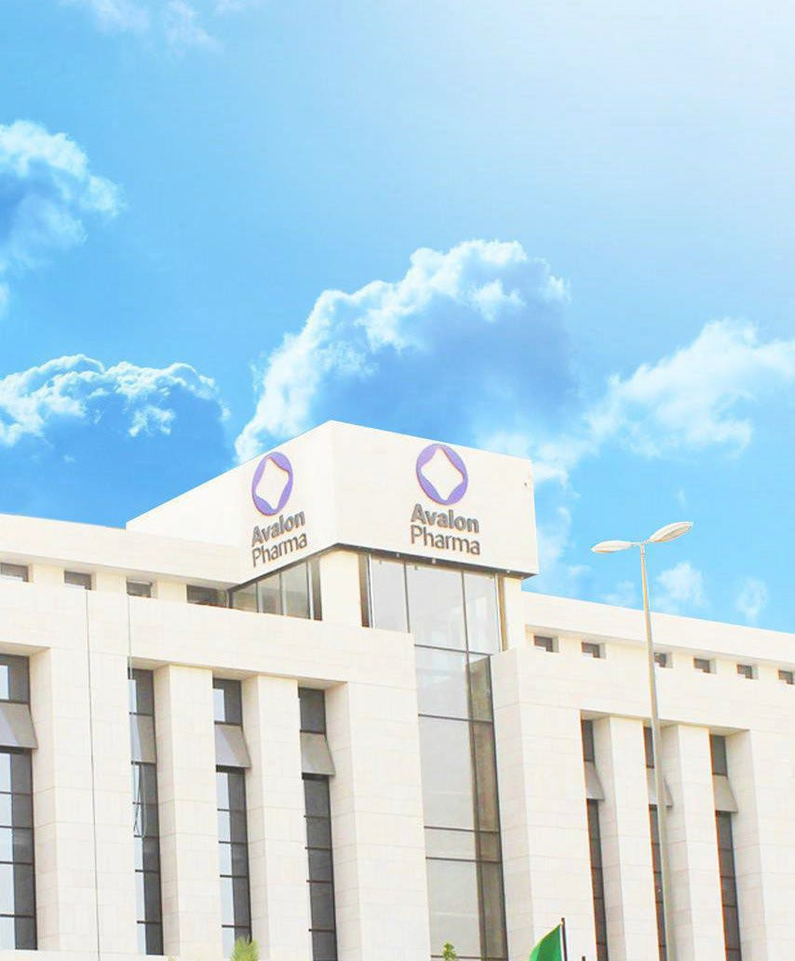

AVALON AT A GLANCE - ABOUT US
Avalon Pharma is a leading Saudi multidisciplinary company. Founded in 1998, Avalon Pharma has grown to become one of the region’s most preferred and trusted providers of formulation development, manufacturing, commercialization and export of a broad range of products in various fields including dermatology, respiratory, internal medicine, and consumer health care.
With a headquarter based in Riyadh, Saudi Arabia, branch offices in Jeddah, Dammam & UAE, and a strong network of distributors in different parts of the region, Avalon Pharma is currently the house for over 500 professionals.
Today, Avalon Pharma has significant presence in different therapeutic categories with a revenue of 338M SR. Through developing innovative solutions, maintaining highest manufacturing technology, and engaging qualified professionals, we continue to grow in the market within the various categories that we promote until we reach our goal.
www.avalonpharmaceutical.com

Slide 4













ONE OF THE FASTEST GROWING PHARMA COMPANIES IN KSA.
3+ OFFICES
500+ STAFF
250+ REGISTERED
SKUS IN KSA
REGISTERED
120+ SKUS IN OTHER
PARTS OF THE REGION
15+ EXPORT COUNTRIES
www.avalonpharmaceutical.com

Slide 5




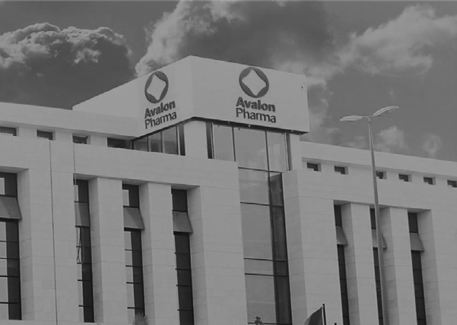
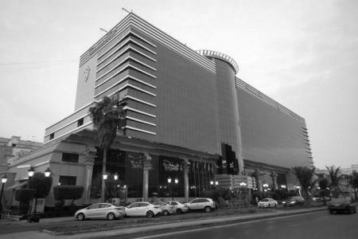
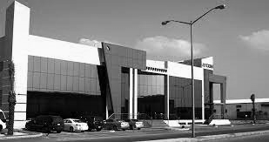



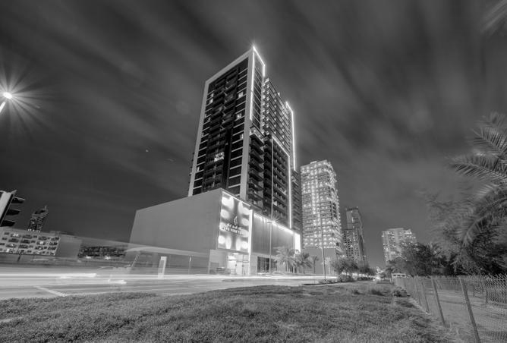
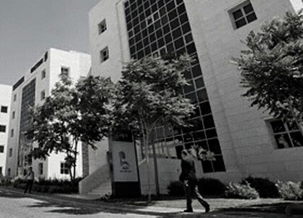
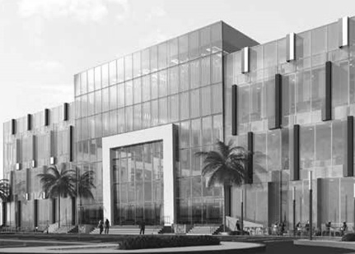
OUR OFFICES
COVERING MULTI-GEOGRAPHIES IN MIDDLE EAST
SAUDI ARABIA – RIYADH
Head Quarters
King Muhammad V –
Sulimayya, Olaya
SAUDI ARABIA - JEDDAH
Al Madina Al Monawara
Fast Road
SAUDI ARABIA - DAMMAM
Khalaf Bn Hesham street
UAE - DUBAI
Platinum Park – Umm
Saqeem Rd.
JORDAN - AMMAN
King Hussein Business Park,
Building, King Abdullah II St
KUWAIT - KUWAIT
Cube Mall – Sulimanya
Taawen Road
www.avalopharmaceuticals.com

Slide 6



VISION
Aspiring to be THE leading health, beauty and wellness company in our markets, and determined to leave our mark as a dynamic, customer centered organization.
MISSION
To develop, manufacture and market successfully a wide range of high-quality health and beauty brands and generic prescription medicines across the Kingdom of Saudi Arabia, the MENA region, Eastern Europe, Asia and Africa.
www.avalonpharmaceutical.com

Slide 7

OUR SHARED VALUES
A
V
VALUING
Appreciative and protective of the trust that our customers, stakeholders, and authorities extend to us
A
L
O
N
AGILE
Lively, quick, and well coordinated in every area of our operation
AMBITIOUS
In our commitment towards achieving market leadership in the pharmaceutical industry.
We aim to uphold the highest standard products that complement our dynamic environment
LEARNING
Training and developing our behavior and professional expertise everyday in order to deliver best practices across our organization and within our communities
OPTIMISTIC
Committed to attaining a positive future for our community, our kingdom, and the world, while seeking excellence in health & wellbeing for all
NURTURING
Supporting and encouraging one another, protecting the health and wellness of our customers and patients, while nourishing the ever- changing needs of our stakeholders and markets
www.avalonpharmaceutical.com

Slide 8

AVALON’S GOVERNANCE
Well governed to excel with a comprehensive corporate governance structure that shapes who we are, what we represent, and how we are seen by the world.
RISK MANAGEMENT
TRANSPERANCY
A governance structure that enables us to focus on fulfilling our goals, and above all help us focus on serving our customers’ needs; while balancing the interest of all our stakeholders and guiding our actions to
ensure we uphold the highest professional business standards.
RESPONSIBILITY
FAIRNESS
ACCOUNTABILITY
www.avalonpharmaceutical.com

Slide 9
STATE OF THE ART MANUFACURING FACILITIES
OUR MANUFACTURING CAPACITY
In million units
Semi-Solids
14.7
Avalon Pharma 1
Manufactures pharmaceutical tablets, capsules, nasal sprays, creams, lotions, topical solutions and cosmetic products.
Avalon Pharma 2
Fully equipped with an R&D center, a complete analytical
development laboratory. An advanced large scale oral solid forms, cream and topical liquid manufacturing facility.
44.2
Antiseptics & Disinfectants
Oral Solids
29.5
Avalon Pharma 3
This facility has made us the largest manufacturer of hand
sanitizers in Saudi Arabia. Also produces disinfectants, mouthwashes and large volume hygiene products.
Avalon Pharma 4, in 2026
Within this facility, injectables and ophthalmological products are to be produced.
35.3
Liquids
and we keep growing…
www.avalonpharmaceutical.com

Slide 10




Key Business Functions| WHY AVALON?
Our specialized functions at Avalon Pharma are always at the forefront in developing products that comply with the highest standard manufacturing practices through our end-to-end services. Furthermore, being an agile multi-disciplinary company, we support different collaboration models to meet the needs of our partners and the pharmaceutical community.
END-TO-END SERVICES
BUSINESS TO BUSINESS OPPORTUNITIES
RESEARCH & DEVELOPMENT | MANUFACTURING OPERATIONS
MARKETING | EXPORT
BUSINESS DEVELOPMENT | MEDICAL EXCELLENCE
COMMERCIAL SALES | REGULATORY AFFAIRS
OUT LICENSING
IN LICENSING
CONTRACT MANUFACTURING
PRIVATE LABEL
www.avalonpharmaceutical.com

Slide 11








AVALON’S EDGE-A Number 1 Leader in the
Derma Sector
Favorable market dynamics and regulatory framework
Pillars
Our Position
(a sample)
Consistent revenue growth
Attractive pipeline of products and growth prospects
Proven track record of launching leading products in different therapeutic categories
Comprehensive geographical and distribution channels reach
State of the art facilities geared for Growth
Strong leadership and experienced management team
Ranks 11 among all pharma corporates in the retail sector
Market leader in different TAs, including:
Being Number 1 in the Derma therapeutic category, a fast-growing category in Saudi
Being within the top three generic manufacturers in Respiratory therapeutic category
Strong presence in retail & tender market
Ranked 11 among all pharma companies operating in Saudi
Among the 5 largest Saudi pharma manufacturers
www.avalonpharmaceutical.com

Slide 12

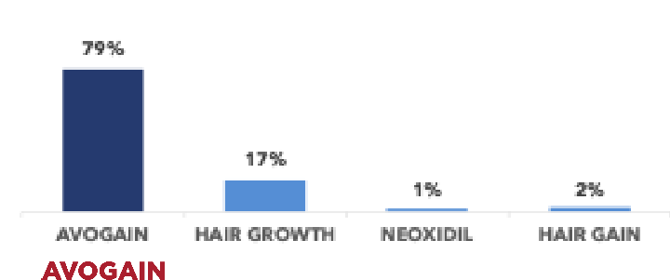
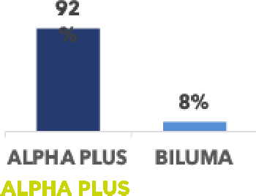
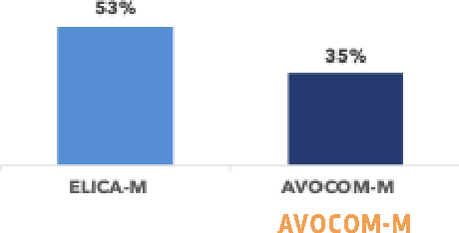


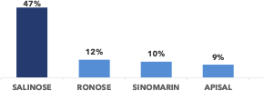
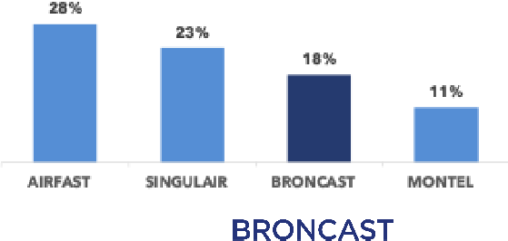
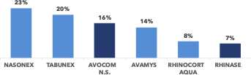

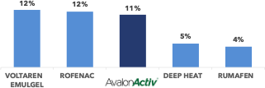


PROVEN TRACK RECORD OF SOME LAUNCHED BRANDS
Avalon has launched over the years successful brands in various therapeutic categories – below is a sample demonstration.
RETAILMARKET SHARE OF AVALON FLAGSHIP BRANDS
Dermatological
TOPICAL STEROIDS AND ANTIFUNGAL
ANTI HYPERPIGMENTATION
WOUND HEALING
HAIR-LOSS TREATMENT
SKIN WHITENING
Avalon has consistentlyand successfully launched products that are today leaders in their respective therapeutic category
Respiratory
NORMALE SALINE
ANTIASTHMA– ANTILEUKOTRIENES
NASAL STEROIDS
Other Therapeutic Categories
LOCAL ANESTHETICS
TOPICAL ANTIRHEUMATICS
ORAL CARE MOUTWASH
www.avalonpharmaceutical.com

Slide 13

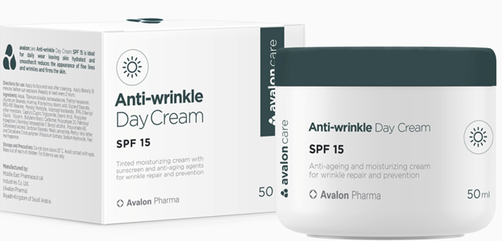
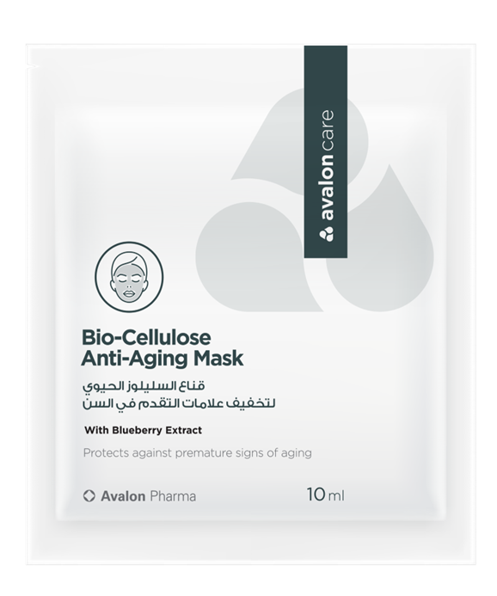
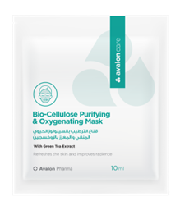
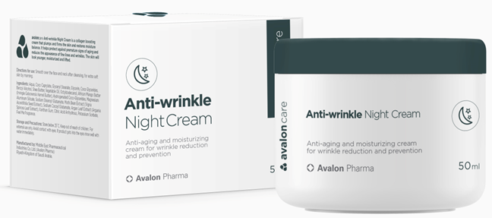

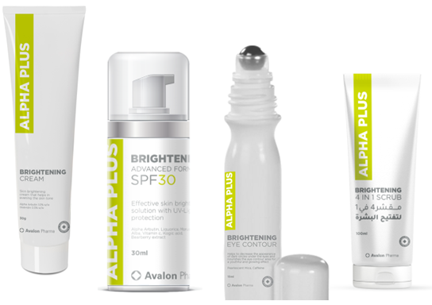

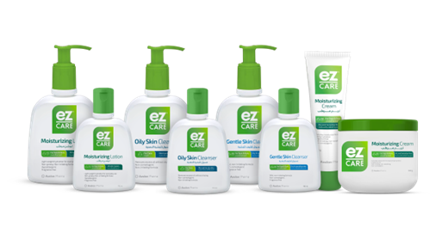

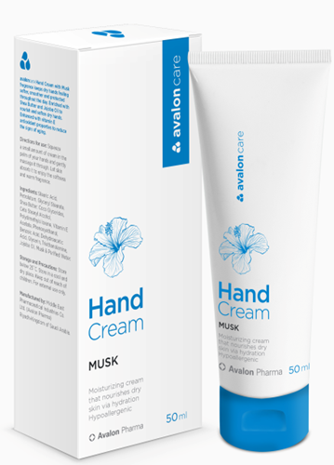
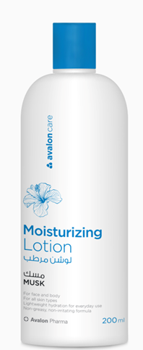


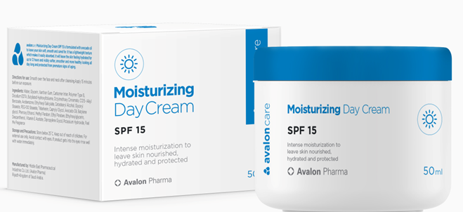
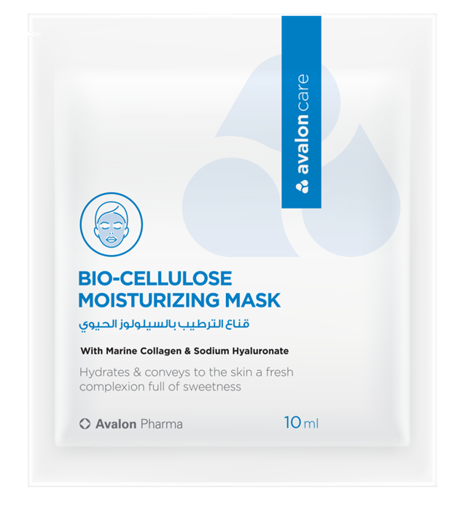
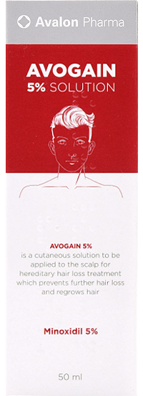
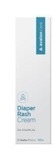
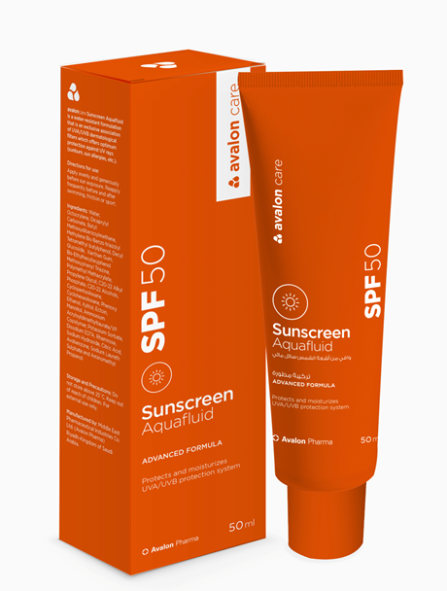
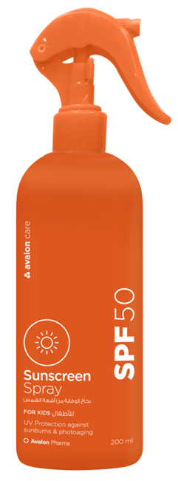
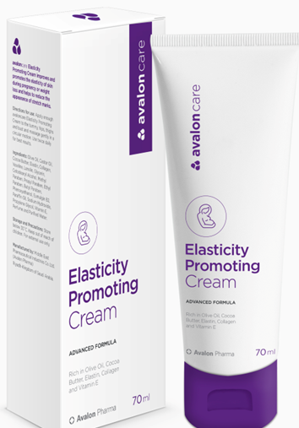
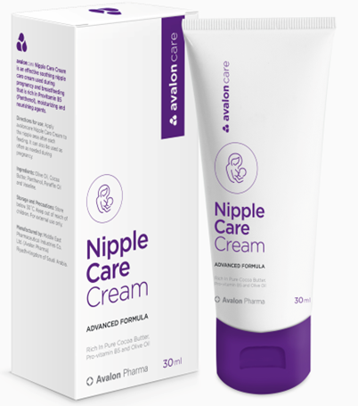
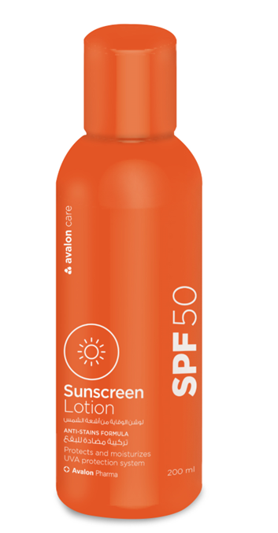
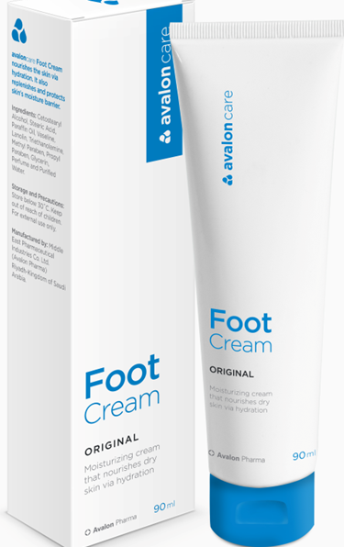
Dermatology – A Leading Portfolio

Slide 14
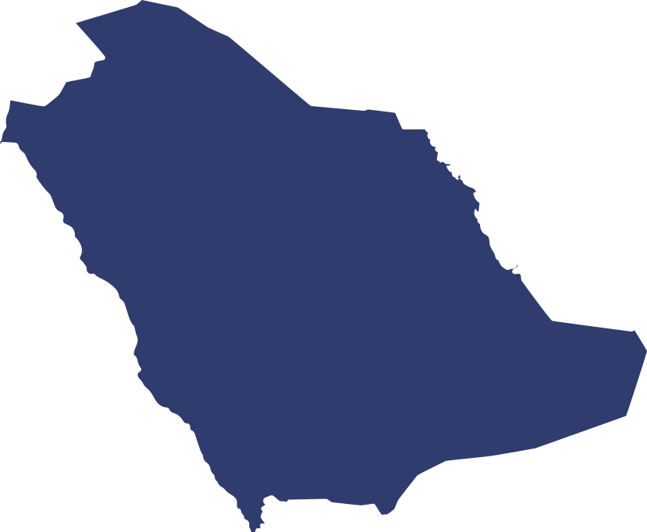




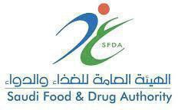
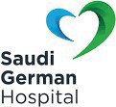



WIDESPREAD DISTRIBUTION NETWORK ACROSS SAUDI ARABIA
Avalon has a comprehensive network across all distribution channels.
A Glimpse of
AVALON’ REACH ACROSS MAJOR KSA CLIENTS
Pharmacies Chains Hospitals Polyclinics Subagents
Modern trade
and more…
www.avalonpharmaceutical.com

Slide 15












AVALON’S KEY THERAPEUTIC CATEGORIES
With over 75 brands, Avalon covers a wide range of categories.
KEY THERAPEUTIC CATEGORIES
DERMATOLOGICALS
RESPIRATORY
CARDIOVASCULAR
TOPICAL ANTIFUNGALS WOUND-HEALING AGENTS HAIR LOSS PRODUCTS ANTI-ACNE PREPARATIONS
TOPICALCORTICOSTEROIDS
BRIGHTENING
EMOLLIENTS & PROTECTIVES ANTI-HYPERPIGMENTATION TOPICAL ANTIBACTERIALS ANTISEPTICS + DISINFECTANTS
NASAL DECONGESTANTS/ANTIINFECTIVES ANTI-ASTHMA PRODUCTS
COUGH & COLDPREPARATIONS ANTIHISTAMINES SYSTEMIC
ANTI-HYPERTENSIVE DRUGS
ANIT-VARICOSE/ANTI-HAEMORRHOIDS
ALIMENTARY & ANITI-INFECTIVES
MUSCULOSKELETAL
GENITOURINARY SYSTEMS
STOMATOLOGICALS DRUGS USED IN DIABETES
SYSTEMIC ANTIBACTERIALS DIETARY SUPPLEMENTS
ANTIRHEUMATICS TOPICAL SYSTEMIC ANALGESICS
GYNAE
ANTI-INFECTIVES
LUBRICANTS
ERECT DYS PRD PDE5 INHIB
CNS
LOCAL ANAESTHETICS ANTI-EPILEPTICS
KEY BRANDS
www.avalonpharmaceutical.com

Slide 16



OUR KEY COMPETENCIES
Geographical Expansion
Expand geographically in the right Markets with the right Business Model and Portfolio
Strategic Partnership
Being the preferred strategic partner has always been endorsed by our agility in providingvarious collaboration models that meet the needs of our partners and our community
Exceptional Quality
Devote high end research and development skills to deliver quality products that cater for market needs and aspirations
KEY COMPETENCIES
Sustainable Operation
Successfully develop a robust operations strategy with focus on longer-term, transformative solutions
Capable Talents
Build the right business model which is driven by finest talents – with continuous development of capabilities and skills
Commercial Excellence
Focus on demand generation and customer satisfaction
www.avalonpharmaceutical.com

Slide 17
THANK YOU

