Slide 1

Get access to one of the largest portfolios of high-quality APIs
Cellera Farma
28/08/2020
Notes:
First of all, thank you very much for saving some time from you day to learn more about Dr Reddys. Here i am gonna show you about the history and accomplishments from Dr. Reddys so far, and also keep you updated from the tools and products that we are developing for our costumers.
.

Slide 2
Agenda
01 - DRL Corp. Present.
02 – General Discussions
Latam Organogram
Notes:
Here’s the agenda from our meeting, firstl, we will see our latest corporative presentation and current Latam Organogram
Than we can discuss about the on-going projects and some new opportunities in molecules that we believe, will fit perfectly for your portfolio.
After that, we may give a update about the situation of the commercial products and save some time for any other particular subject that you may have.

Slide 3
GLOBAL Business
Dr. Reddy’s has a legacy of being first
1984
1986-
87
1992
1997
2001
2006
2007
2010
2015
2019
Founded
by
Dr. Anji Reddy
Begin formulation operations
First Indian company to export APIs to Europe
1st inter-national move to Russia
First Indian company to out license
NCE to an
MNC innovator company
First Indian pharma-ceutical company to obtain FTF 180 days exclusive marketing rights (Fluoxetine 40mg)
1st authorized generic launched
1st Indian company to
be Sarbanes – Oxley certified
Launched world’s first biosimilar monoclonal antibody (Rituximab)
First biosimilar
darbepoetin alfa in the world
From medicines to health.
New brand identity, that guides our actions: Good Health Can’t Wait
1st Indian Pharma firm accepted under China’s new drug-buying plan
Notes:
So, Dr Reddys really has a legacy of being first.
Less than 2 years from being established by Dr Anji Reddy, at 1986-87 began our formulation operations, being the first indian company to export to Europe.
Less than 15 years after, at 2001 we were also the first indian pharmaceutical company to obtain the FTF for Fluoxetine. up till last year, 2019being again the first indian pharmaceutical company accepted under China’s new drug-buying plan.
So This shows, how high is our commitment on our main goal, being the number one API company in the world.
The Oxley Certified, is a compliance certification that companies need to have to be able to be listed at the stockmarket, such as NASDAQ.
Rituximab is a drug used to treat auto-immune diseases and some types of cancer.
Darbepoetin is a drug used to treat Aneamia on patients with kidney failure

Slide 4
Split of GG business by Geography
GLOBAL Business
Revenue contribution
$0.14 Bn
Geographical split of our Generic business
$0.34 Bn
Revenues for FY20 - $2.3 Bn
PSAI is one of the key revenue contributor of the company and gives you the confidence that the performance and success of our API business is regularly reviewed by the companies management.
$1.83 Bn
Notes:
Now we can take a look in the total Revenue contribution by the three Dr. Reddys business units. PSAI, GG and PP.
We are a company of 2.3 billion dolars on total revenue, Where fifteen%(15%) comes from the PSAI business unit
22% from this turnover remained in captive. So This shows how much our API business is important to the company as we keep heavily investing on it
In the right you may find the geographic split from our Global Generics business.
Right now the latam business is around 38 million. With 35.7 millionUS 60 million, Semea and Europe 100 million and China 70 million.
Brasil should be here!

Slide 5
Delivery
Global presence and network.
Cambridge
Cambridge
Leiden
Chiral technology, activated mPEGS
Princeton
Louisiana
Mexico
Oral solids
and topical
Steroids
India
API (8)
Active ingredients,
oral solids, injectables
Finished Dosages (9)
Biologics
Technology Development Centres
R&D Centres
(Integrated Product Development Organization [IPDO] and NCE R&D centre in Hyderabad, India. Aurigene R&D centre in Bangalore, India and Princeton, USA)
State-of-the-art R&D centers in India, U.K., U.S. & Netherlands
Over 1300+ research scientists working on various projects
more
Notes:
Global presence and Network
the GG and PSAI combine together for 17 manufacturing plants spread in and out of India.
We have Biologics, Technology Development Centres and R&D located in India, US and Europe, with more than thirteen hundred research scientists working on our pipeline products.
And that is a illustration of how much our business is built worldwide and how big is our whole structure

Slide 6
API Business
One out of 3 business units at Dr. Reddy’s.
PSAI
Pharmaceutical Services
& Active Ingredients
Global
Generics
Proprietary
Products
Access to
affordable medicines
Key markets:
US, India, China, Russia, Europe,
Fulfilling unmet
medical needs in dermatology & neurology
Strong pipeline of
differentiated formulations
Partner of choice for global customers
As leading API
supplier
Custom Pharma Services providing solutions from discovery to launch.
Notes:
So here, are the 3 business units from Dr Reddys.
The first one is Global Generics, which is a division from Dr Reddys that focus on giving access to affordable medicines and accelerate the market entry from high value molecules. It’s a division specialized in the therapeutical areas of oncology, cardiovascular and CNS, with over 200 generic products in 80 different countries. Our main markets are US, India, China Russia and Europe.
Proprietary products, is a business Unit from Dr Reddys which the main goal is, discovering new dosages of a current drug or developing new combinations of medications, with focus to improve the overall efficacy from our products and fulfil medical unmet needs.
And last is our PSAI division, Who is your Partner of choice, which you will get to know a little bit more further on this presentation.
The whole structure from Dr Reddys WW and specially in Brazil, with a team of Costumer Service, Business Development, Sales and Regulatory, gives costumers in Brazil warranty to work alongside with their API manufacturer as a partner, helping them to find best solutions from the difficulties to work on a highly regulated MKT such as Brazil.

Slide 7
API Business
Pharmaceutical Services & Active Ingredients (PSAI)
Active Pharmaceutical Ingredients
With an industry leading portfolio of generic APIs we are a partner of choice for pharma companies
in more than 80 countries.
Custom Pharma
Services
Dr. Reddy’s full service CDMO supports our global pharma customers with integrated services from innovation to commercialization of APIs and drug products.
Notes:
PSAI stands for Pharmaceutical services & Active ingredients, so Dr Reddys is not just an API company, we offer way more than that.
Besides the 150+ APIs from our portfolio in more than 80 countries, we have Customized pharmaceutical services, that gives to the costumers the decision upon what’s the best business model for each one of them. From APIs to formulations.
In Brazil, with a team of Costumer Service, Business Development, Sales and Regulatory, gives costumers warranty to work alongside with their API manufacturer as a partner, helping them to find best solutions from the difficulties to work on a MKT such as Brazil. No other API company has this kind of structure here in Brazil.

Slide 8
API is where we come from.
Today
8
API manufacturing sites
~ 2,100
MT of APIs per year
150+
APIs
~$0.5 BN
API Revenue (Int & Ext)
16%
overall Dr. Reddy’s revenue with APIs in FY 2019. Key revenue driver.
1984
1991
1995
2001
2018
2019
Founded by
Dr. Anji Reddy
The company’s first molecule was methyl-dopa, a hyper-tension drug that was unavail-able in India until 1984. The API has been supplied to leading pharma companies worldwide.
From APIs to Formulations –
Launch of Omez (Omeprazole).
Dr. Reddy’s adds formulation capabilities
Expansion
into US, Europe,
Russia and EM
First Asia Pacific pharmaceutical company outside Japan to list on the New York Stock Exchange
Launch of XCEED,
Dr. Reddy’s Digital Customer Service Portal
Awarded with a Generic and Biosimilar Bulletin Award in the category: API Supplier of the Year
Notes:
API is where we come from when Dr. Anji Reddy founded the company at 1984.
I will walk you through some of the milestones from the PSAI unit.
IN 1991, we launched our product Omez (omeprazole), adding formulation capabilities.
1995 we began our expansion plan, to markets such as US, Europe, Russia and emerging markets.
2001 we were the the first Asian pacific pharmaceutical company , outside japan, to list on the New York stock exchange.
2018 we launched our own digital costumer service portal, the Xceed, which further I would like to make a 15 min presentation to all areas of interest inside your company.
And last year, we were awarded with a Generic and Biosimilar bulleting award, on the category API supplier of the year.
Today, our PSAI unit has 8 API manufacturing sites, with close to two thousand and hundred mt of API produced per year , A one hundred and fifty plus APIS on our portfolio with a close to half a billion revenue.
The emphasis that PSAI 3rd party business contributes 16% of Dr. Reddys overall revenue and 22% of the total revenue of we include captive.
To put this number in context: from all vertically integrated players worldwide who sell APIs and formulations, the average industry standard of API 3rd part business is 5-7%. Dr. Reddy’s is the only company of this size in excess of US$1.5BN and above for whom the percentage of sales is so significant and therefore shows the importance of this business to the organisation. Hence PSAI is extremely strategic in the overall Dr. Reddy’s scheme of things…

Slide 9


API Business
Our strategy: Creating value for
our partners.
Backward integration
For commercial and future Products
Capacity expansion
Continuous manufacturing.
Portfolio expansion
Development of 5 to 15 new products
per year. Expanding RA team.
Cost leadership
New and current APIs
Customer service excellence
Global Footprint
Only API companies with presence in 8 countries globally
Notes:
In this slide, you can see why we claim ourselves, as a Partner of choice, with backward integration products and a continuous capacity expansion for our API`s, we are able to fullfil the needs of our costumers and go side by side with their growth.
In this way, ensuring a fast and reliable API supply chain.
We are also, the only API company with presence in 8 countries globally.
So, A true excellence in Costumer Service.

Slide 10
API Business
Global
Regulatory
Expertise
Russia >25
Our global regulatory affairs team support your local and global market access strategies.
Europe >120
Japan >25
Unmatched local regulatory expertise.
Our colleagues onsite are in close contact with local regulatory agencies and are supported by our global team.
US >200 filings
China >25
Israel >15
Saudi Arabia >45
More than
50 experts in regulatory affairs
Brazil >15
More than 900 drug master files across global markets
Notes:
So, besides the Worldwide regulatory presence that this slide shows, with more than 900 drugs master files submitted globally. for Brazil we have a local regulatory team and also 5 experts based on india just to support our Latam costumers.
With the new regulatory milestone coming (DIFA/CADIFA), we have a ambitious project to register 70 molecules under this new legislation. That will give our costumers safety when choosing us as a partner.

Slide 11
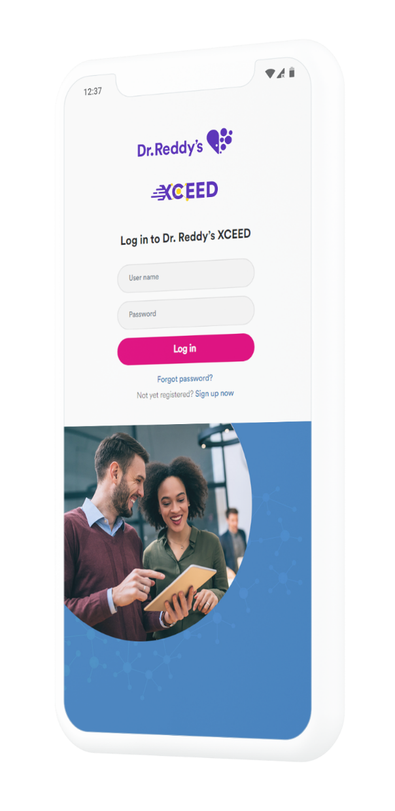
XCEED – Our Customer Service Platform
Exceptional customer experience with access to whitepapers and articles from our industry experts.
Everything, anytime. Instant access to
our API portfolio and all related documents.
Manage and track your orders
and service requests in real time.
Closely interact with Dr. Reddy’s
proactive technical experts.
Knowledge enhancement
Reimagine business with Dr. Reddy’s API.
Everything, anytime
“The information on XCEED are well structured
and easy to find. This makes my life much easier”
Associate Director, Global Procurement, French generics company.
Most convenient way
“It’s not just another fancy platform. It gives quick
access to the data I need and it also connects
me to the right person for my requirements”
Formulation Development Scientist, CDMO
Faster turnaround
Notes:
Xceed is a Costumer Service plataform we launched at 2018 to help our costumers in agility to make contact with DRL. It has been so far a success, as we are receiving good feedbacks from our costumers, is not just faster to get information and documents, but it makes easier to find the right person for each of the different requirements.
I strongly suggest all of you to schedule with our Brazilian team, a demonstration from Xceed.

Slide 12
Organograms
Notes:
SO now I will show you our Organogram for the Latam PSAI Business.

Slide 13

API Business
Latin America (Venezuela, Brazil & Columbia)
and Mexico
Amit Kaptain
Head API S&M
Regional Presence
Hitesh Mangal
Region Head LATAM & Mexico
Vinicius Leite Pedra
Team member CSC and Sales
Yuri Pereira
Country Sales and BD Manager
Manikanda P
Business Devt. Manager – Rest of Latam
Pratik Singh Bais
Regional Sales Manager (Mexico)
Simão Calvete Correa da Silva
Head Regulatory Affairs and BD - Latam
Rajeswari B
CSC Commercial
Dileep K
CSC Technical
Smitha Ramdas
IP Management Lead
Ana Clara
Regulatory Affairs Analyst
Notes:
First we have

Slide 14
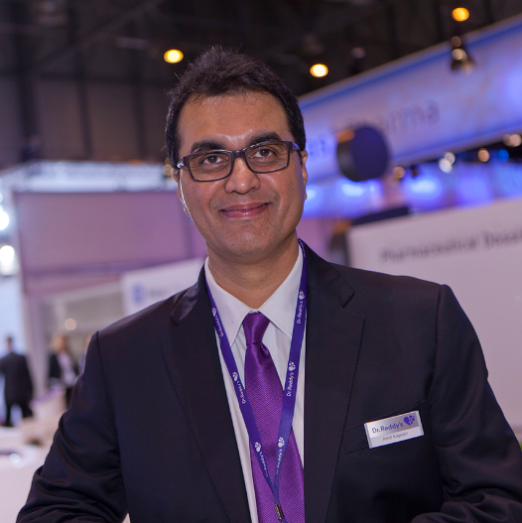

Thank You
Thank
You
Amit Kaptain
Head of Sales and Marketing
amitkaptain@drreddys.com
CEO
Christian Muraschow
c.muraschow@explain.de
015902120699

Slide 15
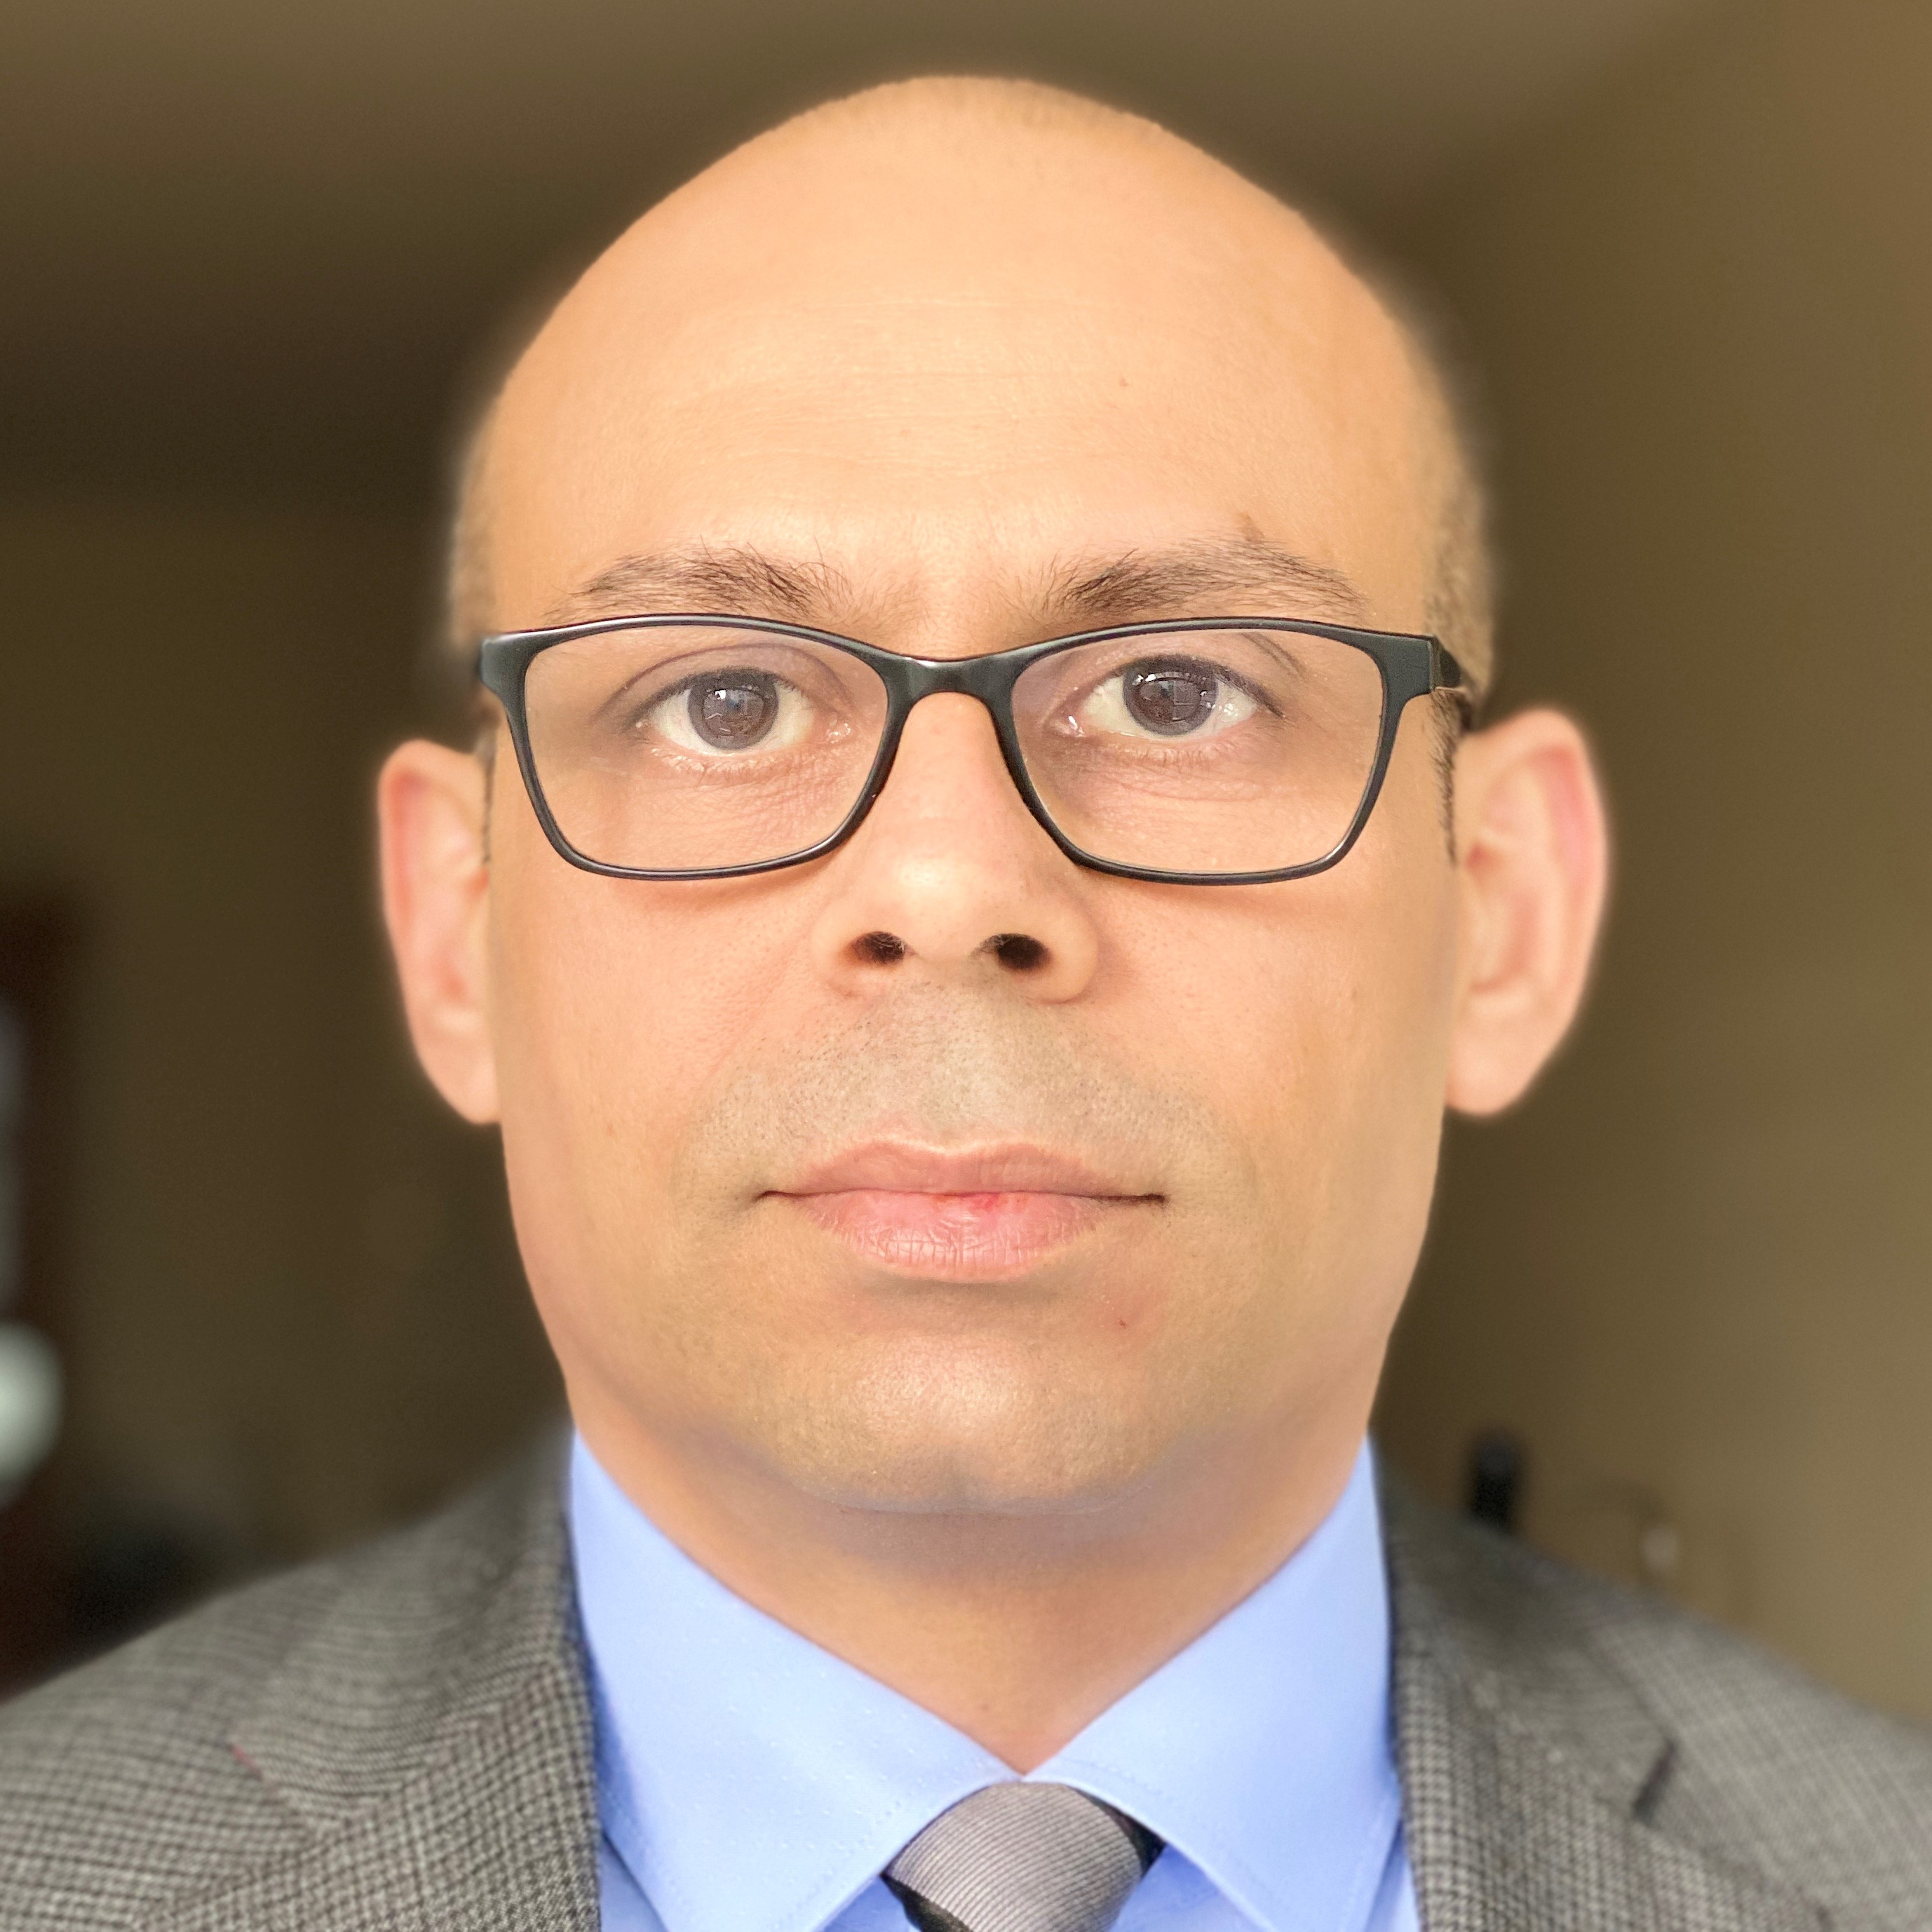
Thank You
Thank
You
Hitesh Mangal
Region Head LATAM & Mexico
mhitesh@drreddys.com
CEO
Christian Muraschow
c.muraschow@explain.de
015902120699

Slide 16
Thank You
Thank
You
Vinicius Leite Pedra
Team member CSC and Sales
vinicius.pedra@drreddys.com
CEO
Christian Muraschow
c.muraschow@explain.de
015902120699

Slide 17
Thank You
Thank
You
Manikanda P
Business Devt. Manager – Rest of Latam
manikandaps@drreddys.com
CEO
Christian Muraschow
c.muraschow@explain.de
015902120699

Slide 18
Thank You
Thank
You
Simao Calvete Correa da Silva
Head Regulatory Affairs and BD - Latam
simao.calvete@drreddys.com
CEO
Christian Muraschow
c.muraschow@explain.de
015902120699

Slide 19
Thank You
Thank
You
Ana Clara da Silva Nunes
Regulatory Affairs Analyst - Latam
ana.silvanunes@drreddys.com
CEO
Christian Muraschow
c.muraschow@explain.de
015902120699

Slide 20
Thank You
Thank
You
Yuri Alberto Pereira
Country Sales and BD Manager, Latam
yuri.pereira@drreddys.com
CEO
Christian Muraschow
c.muraschow@explain.de
015902120699

Slide 21
More than just API: PSAI
Discovery
Pharmaceutical Services & Active Ingredients
Pre-Clinical
01 - Intermediate
Phase I
Fully integrated CDMO -
from innovation to launch.
02 - API
Phase II
Phase III
Market
03 - Drug Product
Notes:
Dedicated R&D facilities and pilot plants – strict IP protection. Technology platforms: Complex and multi-step organic chemistry, chiral technology, highly potent and oncology compounds, activated mPEGs, peptides, carbohydrate chemistry, formulation development
Integrated API and formulation development and manufacturing. Vertically integrated cGMP manufacturing facilities
Strong technology platforms to develop complex APIs (HPAPIs, Peptides, etc..)
Flexible capacities and to meet changing customer demands.
Accelerate first-to-market access for our partners through innovative IP positions

Slide 22
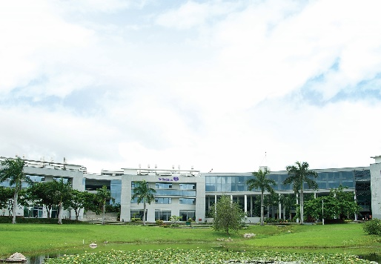
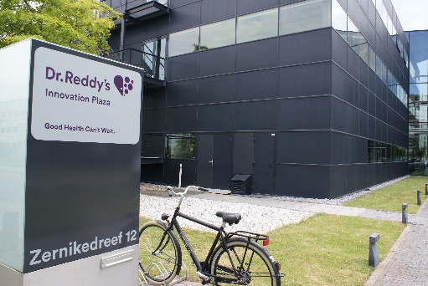
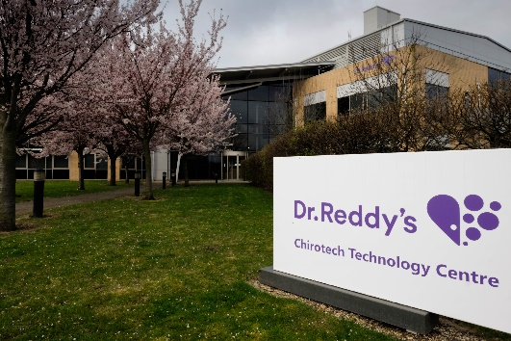
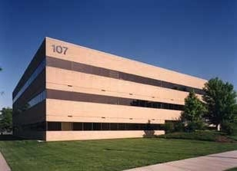
R & D
More than 1300 scientist at four global R+D centers
  Product Development
  Centers
  Hyderabad & Bangalore
  Complex
  Injectable
  Leiden, Netherlands
Over 1000+ research scientists
working on various projects
      Complex Chemistry
      Cambridge,
      UK
      Complex Generics & Proprietary Products
      Princeton,
      NJ, USA
Back
22

Slide 23
API Business
Regulatory
Expertise
Our Regulatory Affairs (RA) team is one of the strongest in the Industry
– more than 50 RA experts
are dedicated to our APIs.
Focused on global markets.
Staying on top of the latest regulatory and quality requirements ensured through active monitoring and proactive assessment of potential risks.
Understanding and connecting the expectations of the regulatory agency(ies) for the approval of each complex API.
More than
50 experts in regulatory affairs
More than 900 drug master files across global markets

Slide 24
Global Regulatory Expertise –
API DMFs across multiple geographies
Geography | Filings | Geography | Filings
Australia and New Zealand | 94 | Korea | 46
Brazil | 14 | Malaysia | 19
Canada | 72 | Russia | 22
China | 24 | Saudi Arabia | 45
Europe (ASMF) | 97 | Singapore | 26
Europe (CEP Granted) | 71 | Taiwan | 32
Indonesia | 8 | Turkey | 17
Israel | 16 | Ukraine | 6
Japan | 26 | USA | 206
Jordan | 4 | New Zealand and Australia | 94
Back

Slide 25
API Business
Unfolding our technical expertise - Peptides.
Class of Peptides
Technical Capabilities
Manufacturing
  Linear and branched chain peptides up to 40 AA
  Derivatives of peptides viz., Steroids/ Small molecules/ lipids/ Carbohydrate/ PEG
  Depsipeptides, peptides with multiple disulfides bridges, Stapled peptides
  Unnatural amino acids building blocks via asymmetric hydrogenation
  Peptides synthesis by Solid, solution and hybrid phase
  Our expertise includes:
  Process optimization and robust process development
  Expertise in down stream purification and isolation
  Impurity profiling and characterization
  Best in class manufacturing equipment, including:
  Automated peptide synthesizers (80-160 L)
  Closed loop filtration operations
  Preparative RP-HPLC with PAT (process analytical technology) blending technology
  Fully automated ion exchange resin systems
  Class 100,000 clean room class area with
  100 L Lyophilizers
Back

Slide 26
API Business
Highly Potent APIs – best practice safety and containment control.
Process
Blow legs and collection in isolators for sampling
Segregation and separate treatment of effluents
Material Handling
cGMP compliant isolator systems (OEL 0.1µg/m³) for high potent raw materials, intermediates charging, filtration and drying, dispensing and packaging
Reaction mass transfer through closed loop lines
Rapid transfer ports for solid material transfer
HVAC
HVAC system with zone classification to avoid cross-contamination
Differential pressure system with temperature and humidity control
EPA filtered air
Utilities
Multiple utilities (cooling tower water, hot water, chilled brine, nitrogen, compressed air & steam
Dr. Reddy’s can handle molecules of OEL up to 0.1 µg/m³ Protecting environment, people & product
Back
Notes:
For Highly Potent APIs, with more than 36 oncology products, it show how capable we are, not to just support on existing products, but also to develop molecules to formulations.
From Safety process and material handling to also R&D and equipments infra-structure.

Slide 27
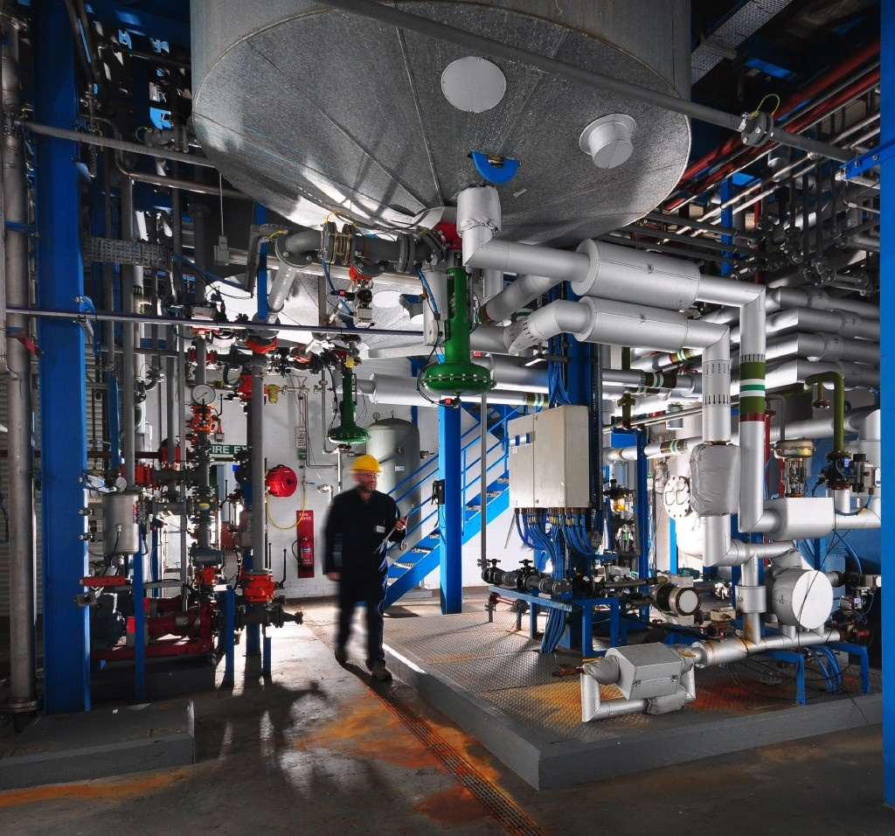
PSAI Business
API Manufacturing
API HYDERABAD PLANT 1
Plot No. 137, 138 & 146,
IDA Bollaram, Jinnram Mandal,
Sangareddy District, Telangana,
Pin: 502 325
API HYDERABAD PLANT 2
Plot No. 75B,105, 110, 111, 112 & 121/3,
IDA Bollaram, Jinnram Mandal,
Sangareddy District, Telangana
Pin: 502 325
API HYDERABAD PLANT 3
Plot No. 116,
IDA Bollaram, Jinnram Mandal,
Sangareddy District, Telangana,
Pin: 502 325
API NALGONDA PLANT
Peddadevulapally,Tripuraram Mandal,
Nalgonda District, Telangana,
Pin: 508 207
API SKIKAKULAM PLANT
Sy No. 5 to 9
Plot Nos.5/1, 5/2, 5/3 & 5/4, APIIC,
IDA Pydibheemavaram, Ransthalam Mandal,
Srikakulam District, Andhra Pradesh,
Pin: 532 409
API SKIKAKULAM PLANT (SEZ)
PU1 & Developer
Sector No. 28 & 34, Devunipalavalasa
Village, Ranastalam Mandal,
Srikakulam District, Andhra Pradesh,
Pin: 532 409
Outside India
API CUERNAVACA PLANT
Industrias Quemicas Falcon De Mexico
S.A. de C.V.
Carretera Federal Cuernavaca-Cuautla KM
4.5 CIVAC, Jiutepec Morelos, Mexico 62578
API MIRFIELD PLANT
Dr. Reddy’s Laboratories (EU) Ltd.
Mirfield, West Yorkshire, WF 14, 8HZ,
United Kingdom
All our plants are operated in accordance with
cGMP (ICH Q7a)
and regularly inspected/audited by international authorities and customers.
Back

Slide 28
Case Study
Fast execution has helped expedite access to market for our partner with a basket of products
Scope & Objective
Approach
Impact
Build partnership with a leading formulation company in the Middle East aspiring to capitalize the opportunity in Oncology segment in the region
Execute a partnership agreement and explore basket of products relevant for the selected GCC markets
Phase-wise identification and deal signing on products with unmet need for the GCC markets
Focus on:
Fast execution of dossier filing with the local regulatory authorities
Quick turnaround on deficiency responses to expedite approvals
Targeting of tenders for quick launch into the markets backed by robust supply chain and expedited supplies
A total of 19 products in the Oncology and other therapy areas were signed with the partner over a period of last couple of years
Out of 19 products, 12 product dossier were filled and approvals have been received within 9 ~ 12 months – a record timeframe in execution
Out of 19 products, 11 products have already been launched in the market by the partner and other products are in various stages of approvals.

Slide 29
Organograms

Slide 30


API Commercial
Erez Israeli
CEO, Dr. Reddy’s
Deepak Sapra
(Senior VP and Head – PSAI Business Unit)
Amit Kaptain
Head API S&M
RV Ramesh
Head Global Manufacturing
Dr. Rajeev Rehani
Head API R&D
E Sreedhar
Head of API RA, IPDO & PSAI
B. Dinesh Kumar
Head of Intellectual Property Management

Slide 31
API Business
Latin America (Venezuela, Brazil & Columbia)
and Mexico
Amit Kaptain
Head API S&M
Regional Presence
Hitesh Mangal
Region Head LATAM & Mexico
Vinicius Leite Pedra
Team Member – S&M and Customer Service
Yuri Pereira
Country Sales and BD Manager, API
Manikanda P
Business Devt. Manager
Pratik Singh Bais
Regional Sales Manager (Mexico)
Simão Calvete Correa da Silva
Head Regulatory Affairs - Latam
Rajeswari B
CSC Commercial
Dileep K
CSC Technical
Smitha Ramdas
IP Management Lead
Ana Clara
Regulatory Specialist

