Slide 1



EMPOWERING GLOBAL HEALTH WITH EXCELLENCE

Slide 2
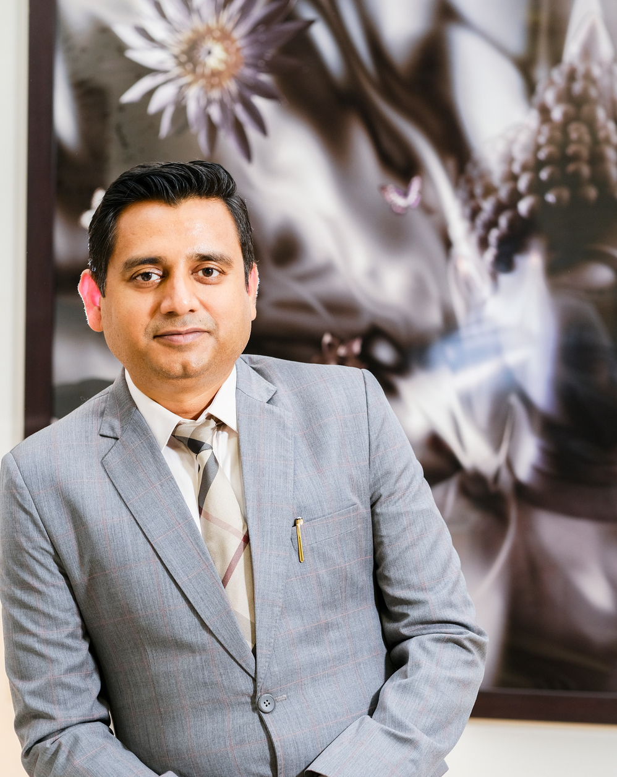
INTRODUCTION
WELCOME TO
OUR COMPANY
  AMN Life Science Pvt. Ltd. is one of India's fastest-growing pharmaceutical companies, with over two decades of commitment to delivering high-quality, affordable medicines global
  Our strength lies in a robust infrastructure for formulations, complemented by trusted expertise in API manufacturing and advanced R&D development, offering end-to-end pharmaceutical solutions under one unified vision
Ashish Khemka
Managing Director

Slide 3

Vision
& Mission
OUR VISION:
  To ensure access to a healthy life by providing seamless supplies of high-quality medicines globally, improving the well-being of communities at large.
OUR MISSION:
To become an integrated pharmaceutical company that delivers high-quality medicines at affordable prices, ensuring global access to essential healthcare solutions.

Slide 4





Core
Values
The 4 Ps
PEOPLE
PRODUCTIVITY:
Our people are the essence of AMN Life Science. We foster an inclusive culture where every employee is valued, empowered, and encouraged to contribute their best.
  Efficiency and productivity are at the core of our operations. Our fast-paced production capacity allows us to consistently deliver high-quality products while achieving significant growth.
PORTFOLIO
PARTNERS
  Our diverse portfolio of over 1,000 products reflects our commitment to quality and technical excellence, offering a wide range of dosage forms that cater to the needs of patients globally.
  Strong and lasting relationships with clients, suppliers, and stakeholders across the healthcare spectrum form the foundation of our success and growth.

Slide 5



AMN Group Overview
AMN Life Science
IQGEN-X Pharma
Proventus Life Sciences
Advantage
Finished dosage forms for global markets
  Formulation development & scale-up
  End-to-end solutions from R&D to finished products
  cGMP API & intermediate production
  .

Slide 6
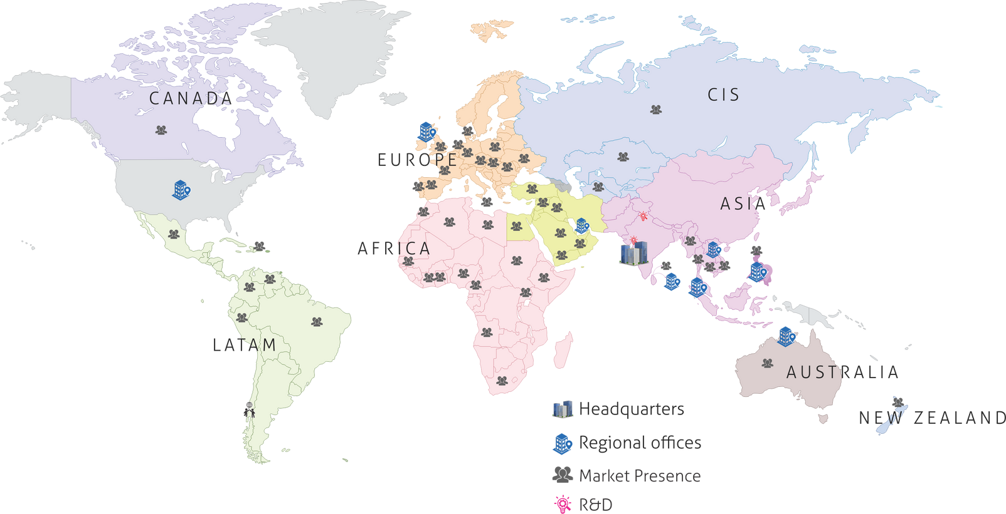
  AMN Life Science proudly serves 50+ countries across multiple regions including Africa, Southeast Asia, ANZ, North America, MENA, and CIS.
Global
Presence
Overseas Offices:
  Singapore
  Philippines
  Australia
  UAE
  UK

Slide 7

Delivering Global-Standard Healthcare Solutions
One of India’s Fastest-Growing Pharmaceutical Companies
Serving both regulated and emerging markets across the globe
Diverse Portfolio with 1000+ Globally Registered Products
Including 50+ Marketing Authorizations in the UK, Europe & Australia
Innovation-Driven R&D
R&D Centre in Kalamb, Himachal Pradesh with a skilled team of scientists
▪ Novel Formulation Development
▪ Lab-Scale Studies & Process Optimization
▪ Technology Transfer Capabilities
Robust Manufacturing Infrastructure
▪ Bhilad, Gujarat – Beta-Lactam OSD Facility
  Tablets, Capsules, Dry Suspensions, Sachets
  ▪ Kalamb, Himachal Pradesh – General OSD Facility
  Tablets, Capsules, Dry Syrups, Pellets, Oral Liquids, Ointments, Patches, Films
Widespread Global Footprint
▪ Strategic presence in 50+ countries including Canada, UK, Europe, LatAm, Australia, CIS, Africa & Asia
▪ Regional offices in: UK, Malta, Australia, Dubai, Oman, Myanmar, Singapore, Vietnam, Philippines & Sri Lanka

Slide 8
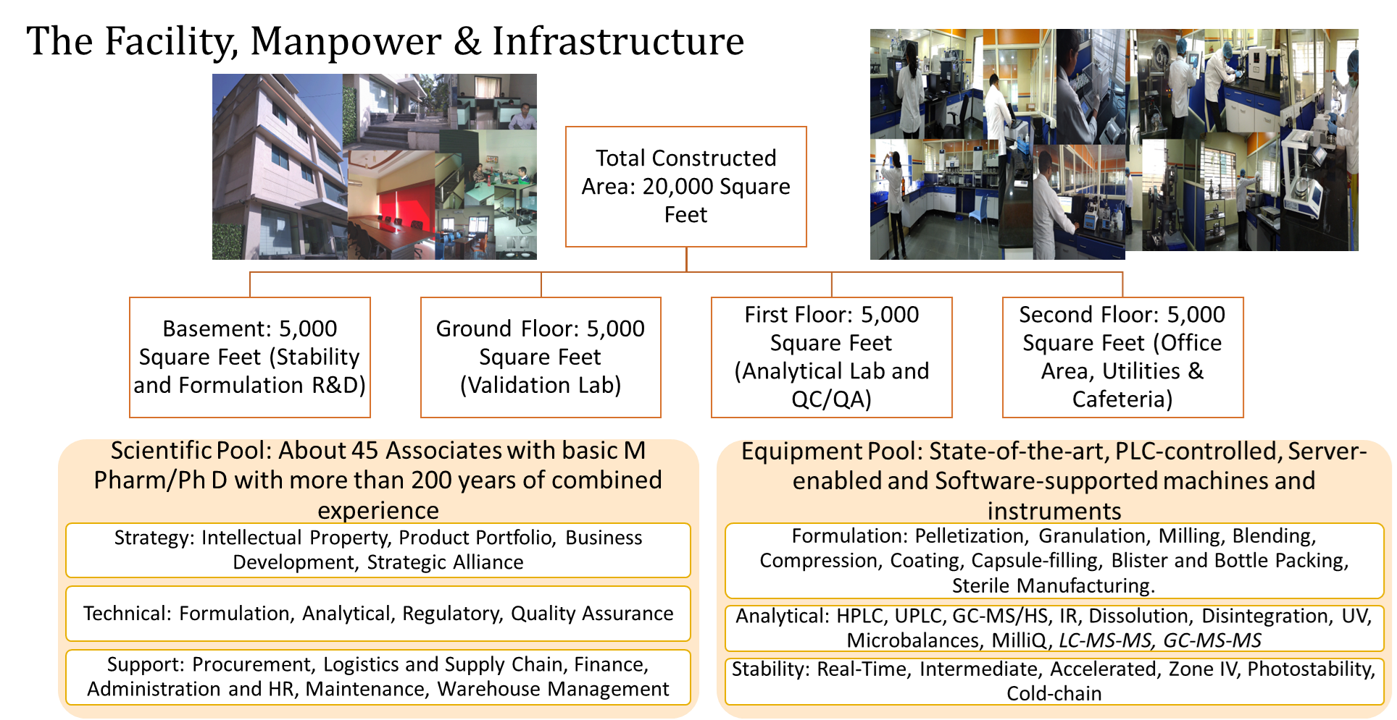

Slide 9

Global
Reach
50+
COUNTRIES
INCLUDING
UK | EUROPE | CIS | CANADA | LATAM | AUSTRALIA | NEW ZEALAND | ASIA | MIDDLE EAST | AFRICA

Slide 10


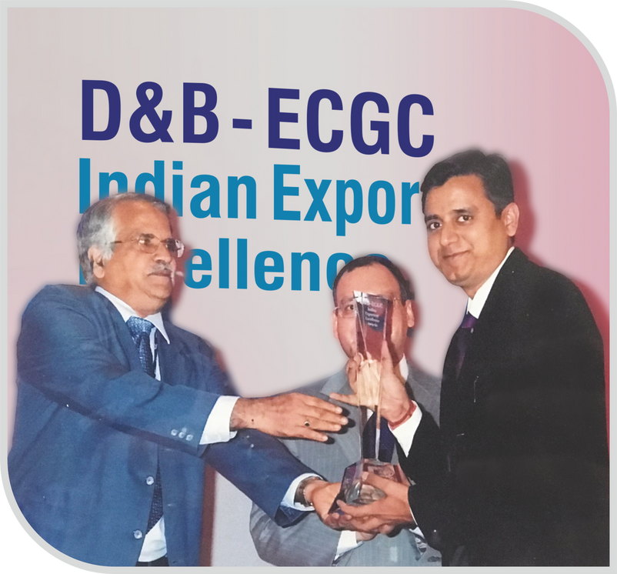

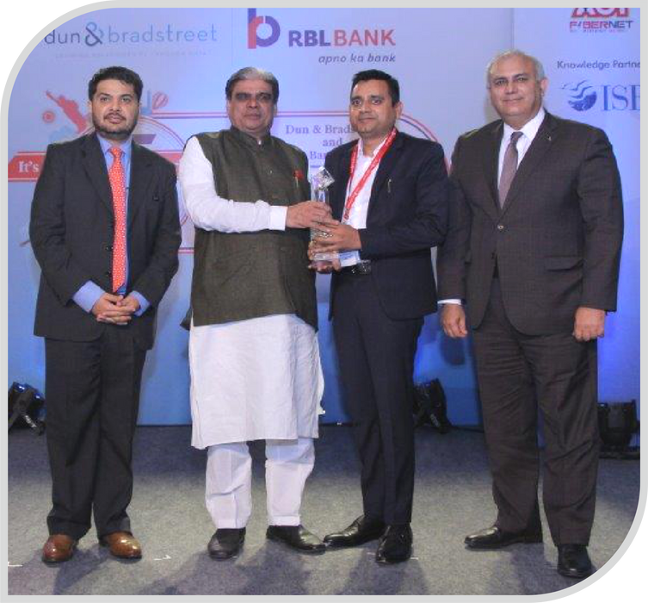
Achievements
  Ranked as the #1 pharmaceutical provider in both Myanmar and the Philippines
  Among the top 5 exporters to Myanmar from India
  Business growth: More than doubled in the past year

Slide 11
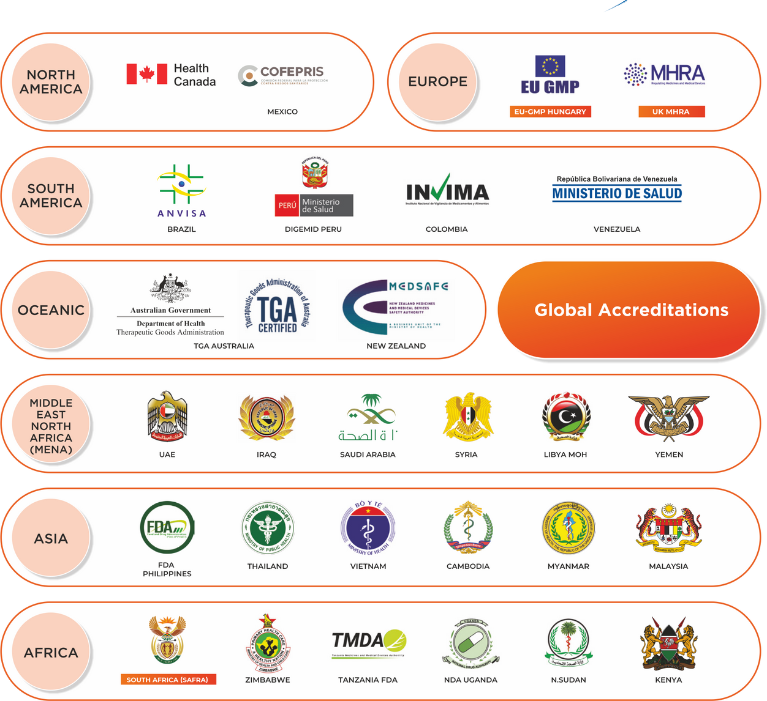
Certification
  Modern GMP-certified manufacturing facilities
  HACCP certification for dietary supplements (ISO 22000:2018), 2023.
  ISO 45001 and ISO 14001 international certificates confirming occupational safety in the company and its effective environmental management, 2024.

Slide 12

Business moving
forward
  Double digit growth over 2years
  Further investment in the R&D
  Expand the manufacturing capacities

Slide 13

Formulation
Development
  100+ dossiers under filing
  Planned >30 new development projects annually

Slide 14
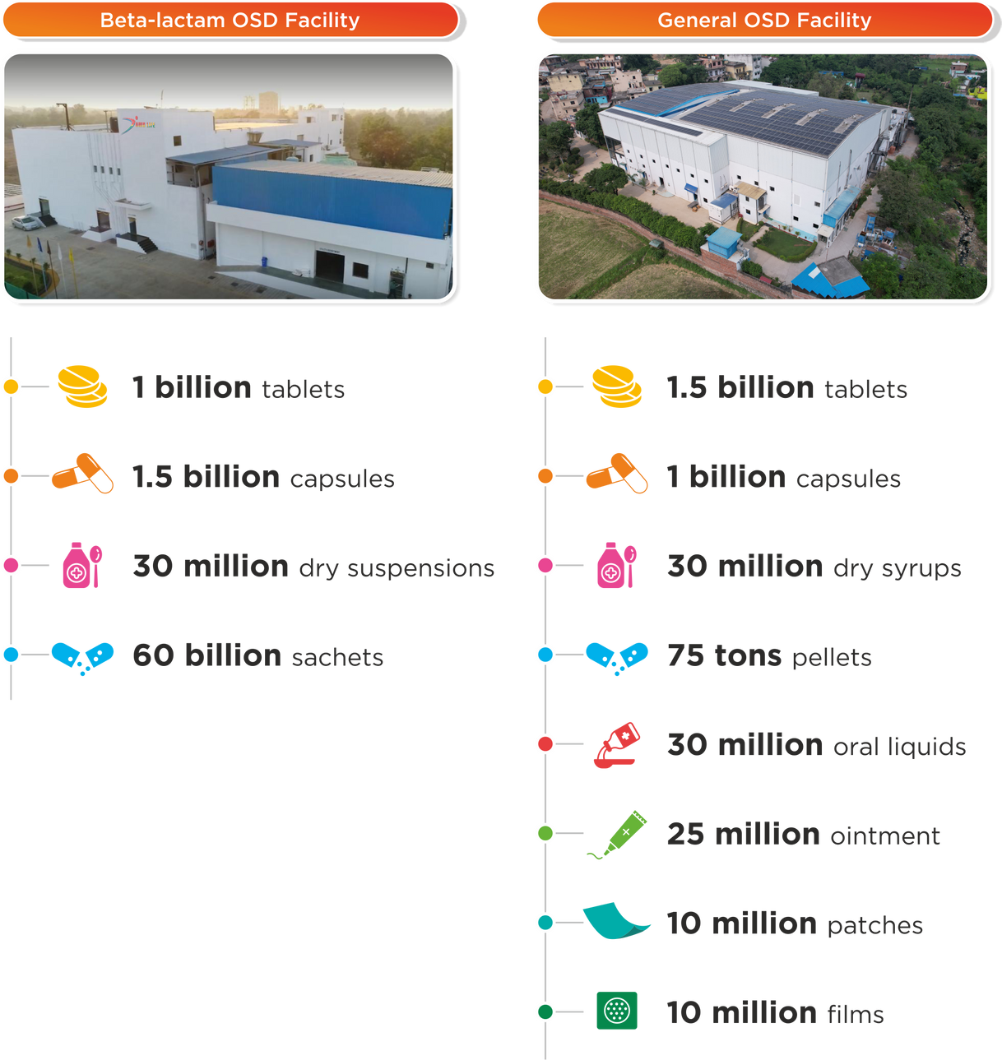

Product
Line
Focus on Cardiology, Neurology and
Pain Management
199 BRANDS, 330 SKUs
Top 5 products
  Ampicillin + Cloxacillin Capsule 500mg
  Amoxicillin Capsules 250mg/500mg
  Linagliptin + Metformin Tablet 2.5mg + 850mg
  Omeprazole Capsule 20mg
  Amoxicillin + Clavulanic Tablet 625mg

Slide 15




EXPORT
Export Destinations 2024
Planned export destinations
  Asia(Myanmar, Philippines, Sri Lanka, Cambodia, Thailand)
  MENA (Oman, Bahrain, Kuwait, Jordan, Egypt, Iraq, Syria, Yemen, Iran, Algeria, Morocco, Turkey, Libya, Qatar, Lebanon)
  Africa (South Sudan, Namibia, Nigeria, Uganda, FWA, Afghanistan, Angola, Mauritius)
  LATAM (Venezuela, Malta, Canada)
  Europe
  UK
  Australia
  South Africa

Slide 16

Digitalized
Company
PATIENTS AND PRODUCTS
BUSINESS AND PARTNERS
  Precise market targeting through detailed market analysis
  Microsoft Synapse and Power BI solutions for big data collection, market analysis, and business decision support.
  Electronic document exchange with partners
DIGITALIZED COMPANY
MANUFACTURING
  The best processes from Microsoft Software’s
  Established Microsoft ERP for plant operations
  Led rapid Digital Transformation implementations.
  Targeted Industry 4.0 transformation for the plant
  Transitioned from paper-based to paperless operations across all departments
  Built a highly efficient IT team for digital transformations.
  Integrated equipment and instrument software for real-time analytics and monitoring
EMPLOYEES
  Goal Setting: Employees set and track measurable goals for accountability.
  Data Analysis: Analyzing data to identify trends and improve decisions.
  Number Games: Math puzzles to boost problem-solving and teamwork.
  Performance Review: Regular KPI reviews to drive continuous improvement.

Slide 17


ESG
ENVIRONMENT
SOCIAL ASPECTS
  Installation of Solar panels
  The Green Office system
  Collection and disposal of expired medicines
  Our zero-waste initiative diverts 200 tons of waste from landfills annually through recycling and repurposing.
  Socialcontribution in 2019-2023
UAH 350 million
  Gender equality: women constitute 60% of the team
  Friendly working environment for 1200+employees

Slide 18

Highlights
of the Last 4 Years
  Expansion of Business beyond Asia – Canada, LATAM, MENA & Africa
  Successful execution of green field project in Bhilad
  Successful acquisition of Kala Amb facility
  Consolidation of capacity utilization in both the facilities
  European MA acquisition to create synergies with Kala Amb operations
  Consolidation of domestic contract manufacturing
  Successful EU re-inspection of Kala Amb

Slide 19
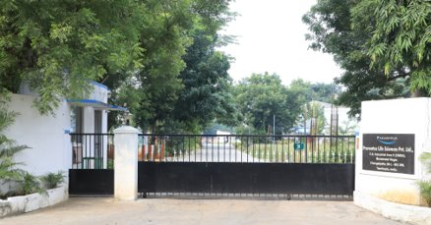
Proventus Life Sciences
A Part of AMN Group
  Founded: 1979
  Location: Maraimalai Nagar, Chengalpattu, Tamil Nadu
  Role: cGMP API & intermediate manufacturing
  Area: 5.3 Acres, near Chennai Airport (30 km)

Slide 20
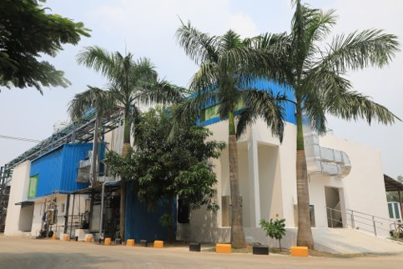
Proventus Infrastructure
  Facilities:
3 Multipurpose Intermediate Plants
100,000-Class Clean Room
QC Lab, R&D, Kilo Lab
ETP, RO & Purified Water Plant
Storage: Underground flammable liquid storage

Slide 21
Proventus Compliance & Operations
Proventus R&D
Compliance: WHO GMP, CDSCO Written Confirmation,EDQM, Schedule M
Operations: cGMP API production, QA line clearance
Systems: HVAC, Purified Water, Scrubber
Capabilities: Grignard, Diels-Alder, Hydrogenation, Chlorination
Focus: New API development, impurity synthesis
Support: Regulatory filings for global markets
Strength: High-quality API supply for AMN

Slide 22
Core Focus: ​
▪ Oral & Sterile Injectables ​▪ Ophthalmic Formulations
▪ Target Markets: US, EU, Latin America, Middle East & other regulated/semi-regulated regions​
Facility: ​
▪ 22,000 sq. ft. state-of-the-art R&D centre, Navi Mumbai ​
▪ PLC-controlled equipment & advanced analytical instruments​
Team Strength:
▪ ~40 M.Pharm / PhD professionals
▪ Expertise across formulation, tech transfer, QA, regulatory, BD, and operations
Global Reach:
▪ Trusted by 25+ clients worldwide
▪ End-to-end ANDA/dossier development to commercialization
Strategic Synergies:
▪ Strong network with API, excipient & packaging suppliers
▪ Ties with CMOs, CROs, GMP consultants & KOLs
IQGEN-X Pharma Pvt Ltd
A Part of AMN Group
📍 Founded: October 2016

Slide 23






Why Choose
AMN Life Science?
Global Reach with Local Expertise
Our strong presence across over 50 countries ensures that we deliver quality healthcare solutions with local expertise
Commitment to Quality & Affordability
With an unwavering commitment to delivering high-quality medicines at competitive prices, we ensure that healthcare is accessible to all
Innovative R&D and Manufacturing
Our state-of-the-art R&D Centre and advanced manufacturing facilities enable us to stay ahead in the industry, creating groundbreaking solutions and ensuring the highest quality standards
Robust Product Portfolio
We offer over 1,000+ registered products, catering to a wide range of therapeutic categories and dosage forms, ensuring we meet diverse healthcare needs
Scalable and Efficient Operations
With advanced production capacities, we are able to quickly scale and meet global demands, offering unmatched supply chain reliability

Slide 24

www.amnlife.com
By Rutuja Yelve - BDE

