Slide 1

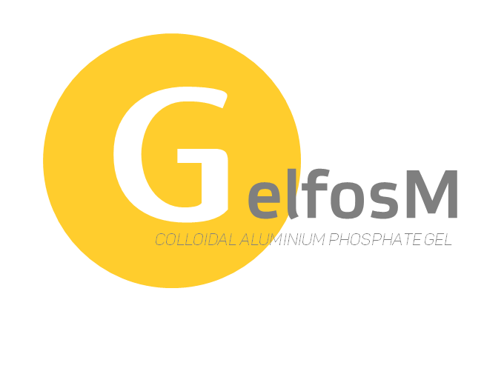
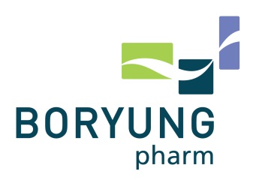
non confidential package VER 3. 0

Slide 2






=
Gel + Force
Magnesium hydroxide
Aluminum phosphate gel (EP)
(Colloidal Aluminum Phosphate)
Magnesium hydroxide (USP)
Simethicone (USP)
INDICATION
HEARTBURN I GASTRIC HYPERACIDITY I GASTRIC DISCOMFORT
GASTRIC FULLNESS I NAUSEA, VOMITING I GASTRIC PAIN I DYSPEPSIA
DOSAGE & PACKAGE
4 SACHETs A DAY [QID] , 4 SACHET(20G) / BOX
MARKETED COUNTRIES

Slide 3
MARKET PERFORMANCE OF Gelfos® & Gelfos®M
KOREA
CHINA
<GRAPH 1. ANTACID MKT IN KOREA - IMS 2014>
<GRAPH 2. ANTACID MKT IN CHINA - IMS 2014>
Rank in Korea ATACID market : No. 1
Sales revenue in 2014: 10 mil. US$¹⁾
Launched since 1975 (mono type), 2000 (Combination)
Rank in China ATACID market: No. 1
Sales revenue in 2014: 50 mil. US$²⁾
Launched since 1992 (mono type)
IMS 2014
News world: Boryung’s Gelfos M on a Roll in Korea, China : http://newsworld.co.kr/detail.htm?no=1611

Slide 4
EFFICACY
SAFETY
PORTABLE
NO ACID REBOUND

Slide 5
EFFICACY
Heartburn
Abdominal distention
100%
100%
Gelfos®M
86.7%¹⁾
(65/75ª)
80%
80%
Gelfos®M
80.8%²⁾
(59/73)
My****
400®
72.6%
(53/73)
Tablet antacid has benefit from portable, however, gel type Gelfos®M shows faster on-set time and long lasting efficacy in Phase III study.³⁾
60%
60%
My****
400®
56.3%
(36/64)
40%
40%
20%
20%
<GRAPH 3. phase-III clinical study ‘comparison gelfosM vs My****400>
a; Sum of the number of ‘Excellent’ and ‘Good’/Sum of the number of total patients
1) Significantly different from Mylanta 400 - treated group on chi-square test (P<0.05)
2) Significantly different from Mylanta 400 – treated group on chi-square test(P<0.01)
3) Phase III clinical study ‘comparison of gelfos M vs My**** 400 against various symptoms in patients with gastritis and peptic ulcer by Kyung-hee University Hospital, Asan Medical Center, Pusan National University Hospital, Cheju University, College of Medicine, Korea

Slide 6
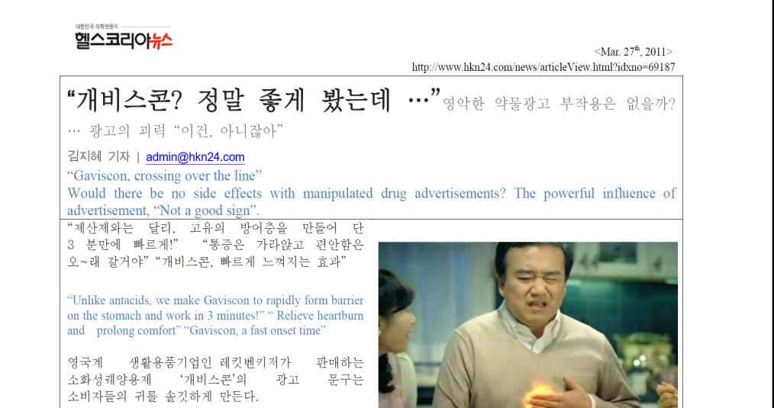
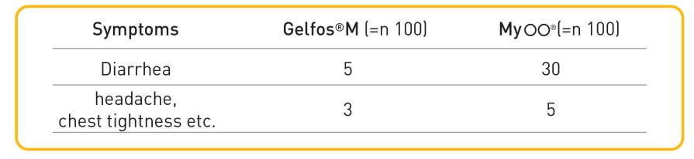
SAFETY
Because Gelfos®M doesn’t use sodium, even sodium sensitive patients can easily administrate.
Unlike other products which uses aspartame, natural orange essence was used for flavor material.
In addition, Gelfos®M is proven for reduction in side effects (Diarrhea etc.) through clinical trials against My****400®
<ARTICLE 1. Re. “Gaviscon, crossing over the line-Healthkorea>
<TABLE 1. phase-III clinical study ‘comparison gelfosM vs My**** 400²⁾>
https://drive.google.com/file/d/0ByxJ-uBJ0yx6U0RFUjR2b2Q5d1E/view?usp=sharing
2) Phase III clinical study ‘comparison of gelfos M vs Myl**** 400 against various symptoms in patients with gastritis and peptic ulcer by Kyung-hee University Hospital, Asan Medical Center, Pusan National University Hospital, Cheju University, College of Medicine, Korea

Slide 7
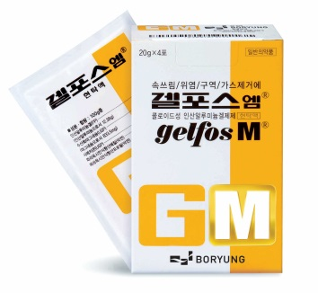
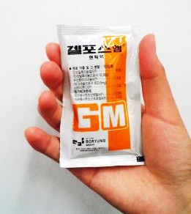

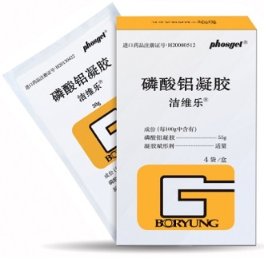
PORTABLE
Tablet type actacid products are portable but slow for on-set. The liquid type is fast but not portable.
Gelfos®M is packed with portable foil (20g/sachet) it is more convenience than Tablets in bottle or liquid type bottle.

Slide 8
NO ACID
REBOUND
Gelfos®M reduce the acidity within 20min and retain for 2 hours. Thus, Gelfos®M can show not only long lasting action but also no risk for acid rebound.
Sodium bicarbonate(NaHCO₃)
Aluminum Phosphate
<GRAPH 4. Re. Gastric acidity curve after absorption of Aluminum Phosphate >
1) Report on research at the Medical Clinic of kaiserlautern Hospital and the Clinic of the University of Heidelberg, by Ranft and Nöller

Slide 9
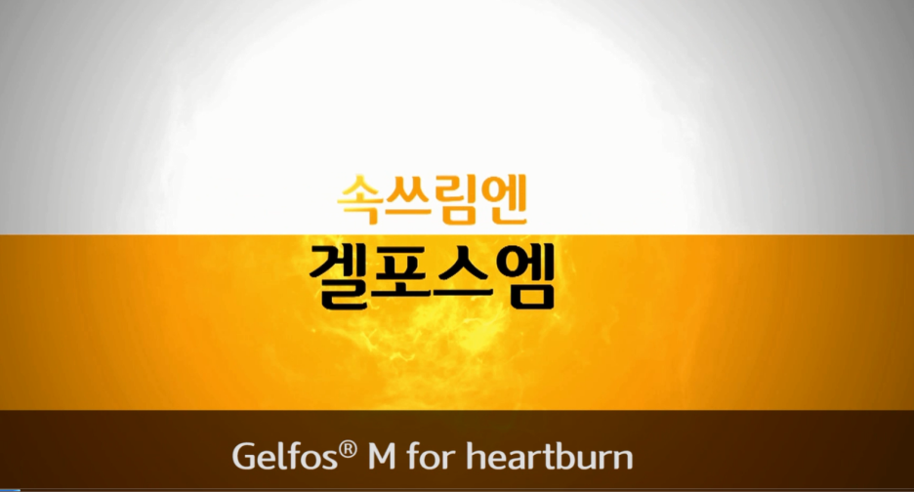
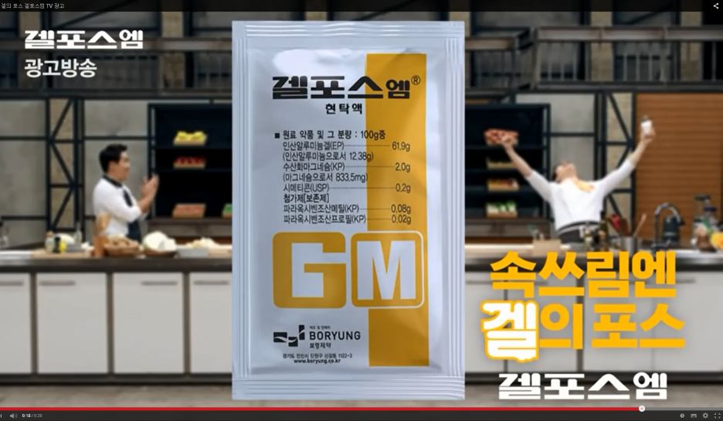
  Brand introduction video for B to B market for US, APAC, MENA, AFRICA etc.
  It can be utilized in B to C market in Drug store, Supermarket or public and SNS
<VIDEO 1. Gelfos®M introduction video>¹⁾
  Gelfos®M commercial is broadcasting every year newly
2014 https://www.youtube.com/watch?v=VVKajyojTnA
2013 https://www.youtube.com/watch?v=ZXAmM8MYGDQ
  The sales was explored after great hit through TV commercial in 1982
  https://www.youtube.com/watch?v=hhDsJ_eJmdc
  The other competitors are also rely on TV
  commercial sensitively
<VIDEO 2. TV and Theater commercials>
Gelfos introduction video: https://www.youtube.com/watch?feature=player_detailpage&v=6BNVsDgF2qo

Slide 10
THANK YOU

